Slide 1

2 What is Spring Boot?
Peter H. Chen

Slide 2
2 What is Spring Boot?
https://www.youtube.com/watch?v=9Pl4rlVAoOc&list=PLqq-6Pq4lTTbx8p2oCgcAQGQyqN8XeA1x&index=2
What is Spring Boot? Why we need to use Spring Boot? What is the benefit of Spring Boot?
We are going to build an end-to-end application.
It going to have a controller, a data layer, or service layer, everything you need for an end-to-end flow and it is going to be a restful API that is something we are going to build using Spring Boot.
The application we are going to build is a course management system.
We have topics and we have courses that belong to those topics.

Slide 3
2.1 Get, Post, Put, and Delete by ID
Peter H. Chen

Slide 4
2.1 Get, Post, Put, and Delete by ID
https://www.youtube.com/watch?v=9Pl4rlVAoOc&list=PLqq-6Pq4lTTbx8p2oCgcAQGQyqN8XeA1x&index=2
What is Spring Boot? Why we need to use Spring Boot? What is the benefit of Spring Boot?
We are going to create a bunch of REST API endpoints by the POSTMAN.

Slide 5
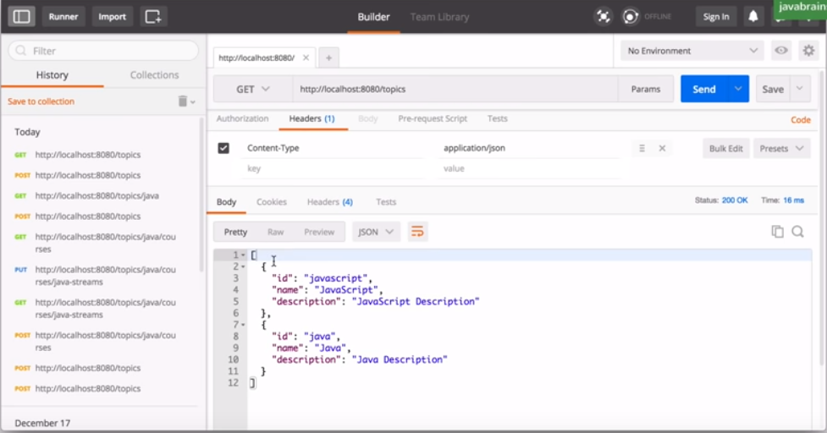
2.1 Get, Post, Put, and Delete by ID
https://www.youtube.com/watch?v=9Pl4rlVAoOc&list=PLqq-6Pq4lTTbx8p2oCgcAQGQyqN8XeA1x&index=2
For example,
We start with slash topics or when we make a get request, e.g., /java, we are going to get a list of all the topics that are in the system.

Slide 6
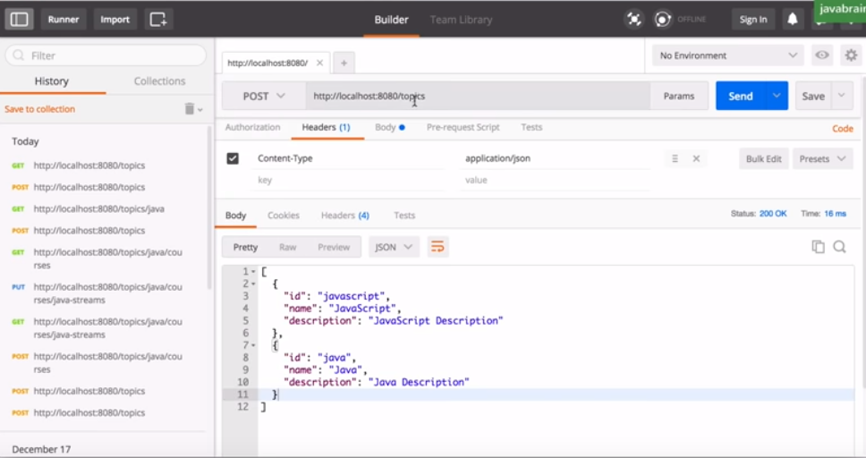
2.1 Get, Post, Put, and Delete by ID
https://www.youtube.com/watch?v=9Pl4rlVAoOc&list=PLqq-6Pq4lTTbx8p2oCgcAQGQyqN8XeA1x&index=2
I can make a Post /topics/topic-id to create a new entry of system.

Slide 7
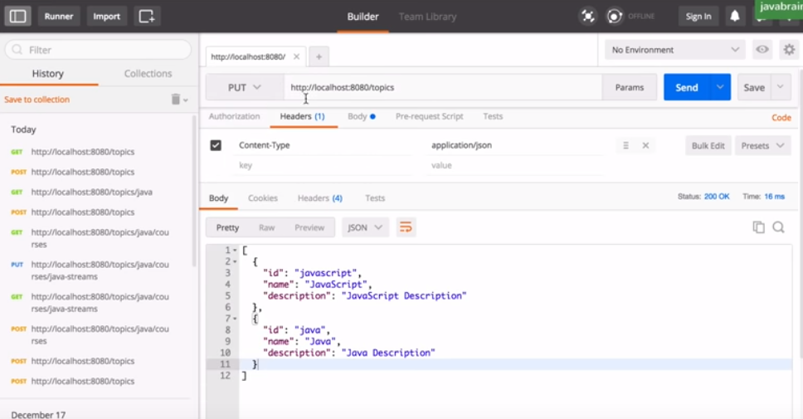
2.1 Get, Post, Put, and Delete by ID
https://www.youtube.com/watch?v=9Pl4rlVAoOc&list=PLqq-6Pq4lTTbx8p2oCgcAQGQyqN8XeA1x&index=2
I can make a PUT (Update) request, e.g., “PUST /topic-id” to create a new topic into the system.
I can make a PUT request to /topics/topic-id that in order to update the topic.

Slide 8

2.1 Get, Post, Put, and Delete by ID
https://www.youtube.com/watch?v=9Pl4rlVAoOc&list=PLqq-6Pq4lTTbx8p2oCgcAQGQyqN8XeA1x&index=2
I can make a DELETE /topics/topic-id to delete the topic in the system.

Slide 9
2.2 Get, Post, Put, and Delete by Topic
Peter H. Chen

Slide 10
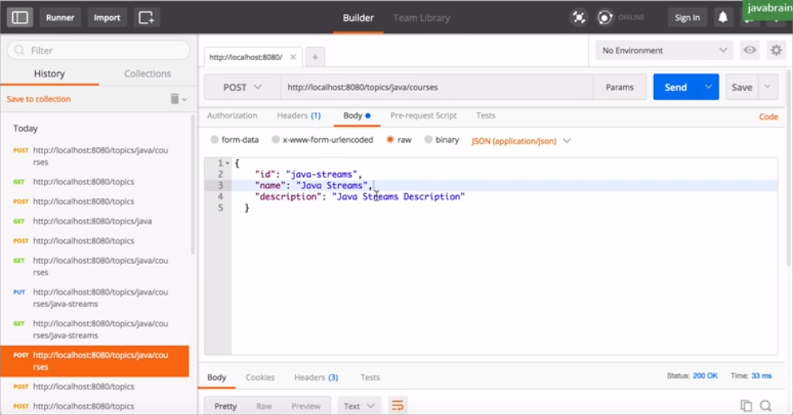
2.2 Get, Post, Put, and Delete by Topic
https://www.youtube.com/watch?v=9Pl4rlVAoOc&list=PLqq-6Pq4lTTbx8p2oCgcAQGQyqN8XeA1x&index=2
I can make the POST request for /topics/java/courses to create the course in the topic of Java instead of using Java ID.

Slide 11
2.2 Get, Post, Put,and Delete by Topic
https://www.youtube.com/watch?v=9Pl4rlVAoOc&list=PLqq-6Pq4lTTbx8p2oCgcAQGQyqN8XeA1x&index=2
I can make the POST request for /topics/java/courses to create the course in the topic of Java instead of using Java ID.

Slide 12
2.2 Get, Post, Put, and Delete by Topic
https://www.youtube.com/watch?v=9Pl4rlVAoOc&list=PLqq-6Pq4lTTbx8p2oCgcAQGQyqN8XeA1x&index=2
Same thing you can put and delete by topic for system.

Slide 13
2.3 Spring Boot Features
Peter H. Chen

Slide 14
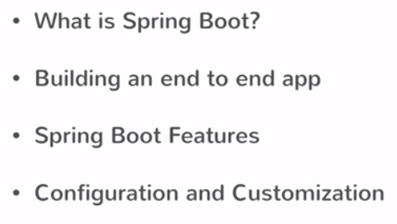
2.3 Spring Boot Features
https://www.youtube.com/watch?v=9Pl4rlVAoOc&list=PLqq-6Pq4lTTbx8p2oCgcAQGQyqN8XeA1x&index=2
We will discuss the Spring Boot Features.
Finally, we will discuss configuration and customization.
At the end, we should have enough knowledge and information to create an application using the Spring Boot.
The application will have all the controller API, all the ways to the data tier connecting to the database. We will have the knowledge and ability to create that application.

Slide 15
End of Chapter

