Slide 1

15 Spring MVC
Peter H. Chen

Slide 2
15 Spring MVC
https://www.youtube.com/watch?v=E7_a-kB46LU&list=PLqq-6Pq4lTTbx8p2oCgcAQGQyqN8XeA1x&index=9
This is the second part of Spring Boot, we will have proper response for all those requests.
There are going to build the controllers and have files that Java files that map progress to response but you are not going to be connecting to the database.
We just going to have these controllers ready. So that latter, we are going to be able to connect to the database and show live data.
For this sake, we can establish mapping and use hard-coded values and hard-coded data.
The spring boot framework handle called spring MVC which is a another project in the spring framework umbrella.
Spring MVC lets your build these controllers which map request to response.

Slide 3
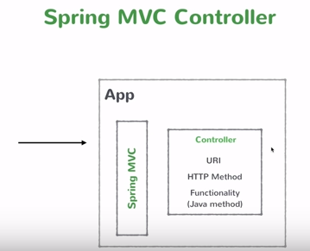
15 Spring MVC
https://www.youtube.com/watch?v=E7_a-kB46LU&list=PLqq-6Pq4lTTbx8p2oCgcAQGQyqN8XeA1x&index=9
We will implement the following diagram.

Slide 4
End of Chapter

