Slide 1

16 REST Api
Peter H. Chen

Slide 2
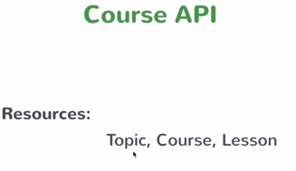
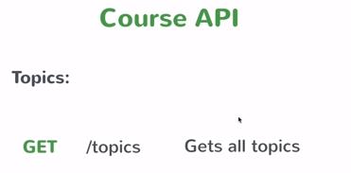
16 REST Api
https://www.youtube.com/watch?v=E7_a-kB46LU&list=PLqq-6Pq4lTTbx8p2oCgcAQGQyqN8XeA1x&index=9
We have resource database which contains Topic, Course, and Lesson.
We will use HTTP to get the resources.
We have some standard. Topics is to get all the resources.
You need to design an API to get all the resources.

Slide 3
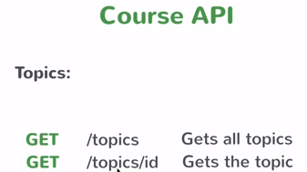
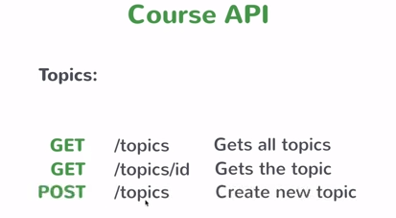
16 REST Api
https://www.youtube.com/watch?v=E7_a-kB46LU&list=PLqq-6Pq4lTTbx8p2oCgcAQGQyqN8XeA1x&index=9
We have /topics/id for each individual element in the topic.
For example, we have topic of spring, you can have particular element by that ID.
These are all the GET.
We also can have POST to create “/topics” which actually create a new topic.

Slide 4
16 REST Api
https://www.youtube.com/watch?v=E7_a-kB46LU&list=PLqq-6Pq4lTTbx8p2oCgcAQGQyqN8XeA1x&index=9
These REST Api with hard coded data.

Slide 5
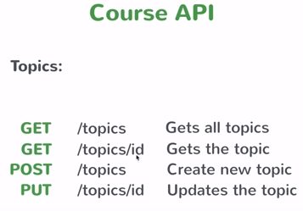
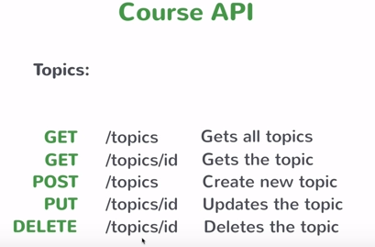
16 REST Api
https://www.youtube.com/watch?v=E7_a-kB46LU&list=PLqq-6Pq4lTTbx8p2oCgcAQGQyqN8XeA1x&index=9
Finally, we have PUT “/topics” to update the topics.
Actually, we have one more for delete topic.
These are API we will build in this course. Again, we will hard coded list.
This will give you idea how to build spring MVC controller.

Slide 6
End of Chapter

