Slide 1

22 Spring Initializr
Peter H. Chen

Slide 2
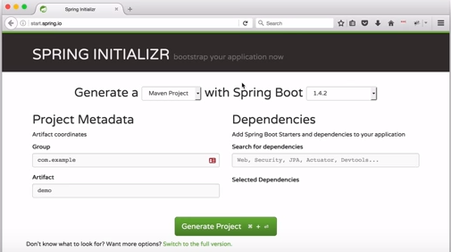
22 Spring Initializr
https://www.youtube.com/watch?v=E7_a-kB46LU&list=PLqq-6Pq4lTTbx8p2oCgcAQGQyqN8XeA1x&index=9
The first way we use is the web UI on the spring web site.
You start with choosing the option and download.
The following is the Spring Intializr to bootstrap your application.
You have the option to what your project wants to be.
You can select maven project and you can select Gradle project. We want maven in this case. The spring version, we will choose 1.4.2. because that is the latest stable version in this list.

Slide 3
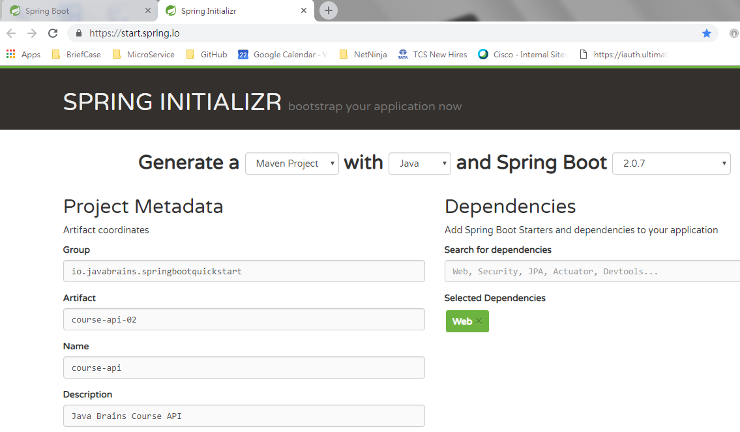
22 Spring Initializr
https://www.youtube.com/watch?v=E7_a-kB46LU&list=PLqq-6Pq4lTTbx8p2oCgcAQGQyqN8XeA1x&index=9
Project meta data.
group: io.javabrains.springboootquickstart
Artifact: course-api-02

Slide 4
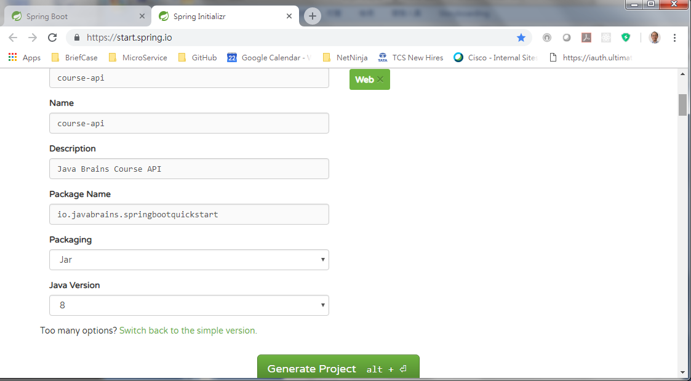
22 Spring Initializr
https://www.youtube.com/watch?v=E7_a-kB46LU&list=PLqq-6Pq4lTTbx8p2oCgcAQGQyqN8XeA1x&index=9
Description ,Package Name, Packaging, Java version 8.
Click Create Project, we will get course-api.zip.
Unzip cousre-api.zip into a directory course-api.

Slide 5
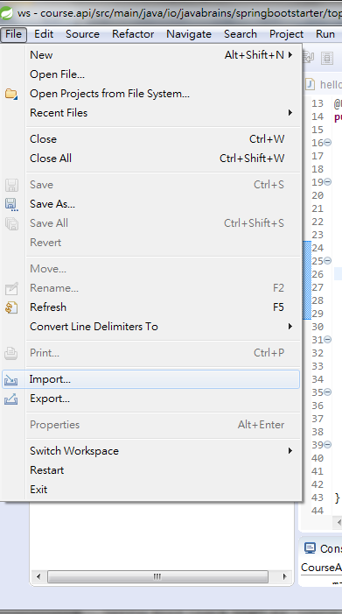
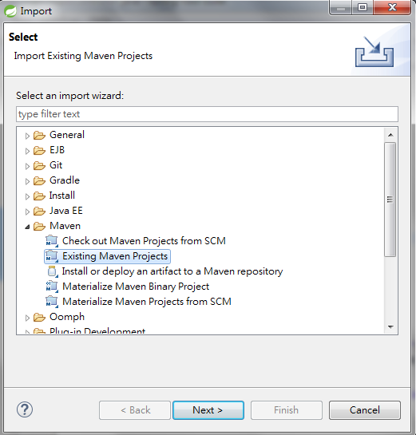
22 Spring Initializr
https://www.youtube.com/watch?v=E7_a-kB46LU&list=PLqq-6Pq4lTTbx8p2oCgcAQGQyqN8XeA1x&index=9
Start STS: File > Import
Maven > Existing Maven Project

Slide 6
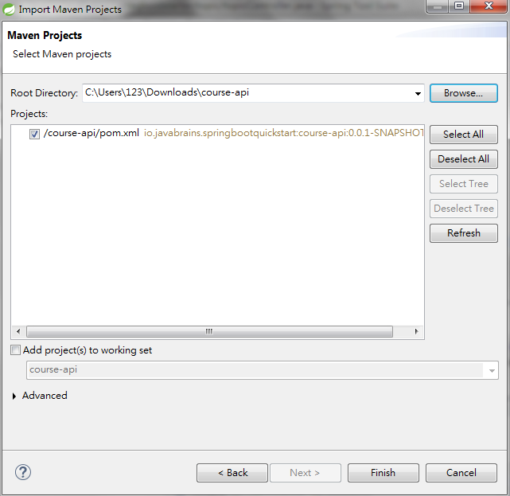
22 Spring Initializr
https://www.youtube.com/watch?v=E7_a-kB46LU&list=PLqq-6Pq4lTTbx8p2oCgcAQGQyqN8XeA1x&index=9
Start STS: File > Import
Maven > Existing Maven Project
Download from the unzipped direcoty cousre-api

Slide 7
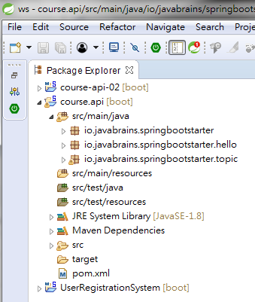
22 Spring Initializr
https://www.youtube.com/watch?v=E7_a-kB46LU&list=PLqq-6Pq4lTTbx8p2oCgcAQGQyqN8XeA1x&index=9
We have course-api-02 project.

Slide 8
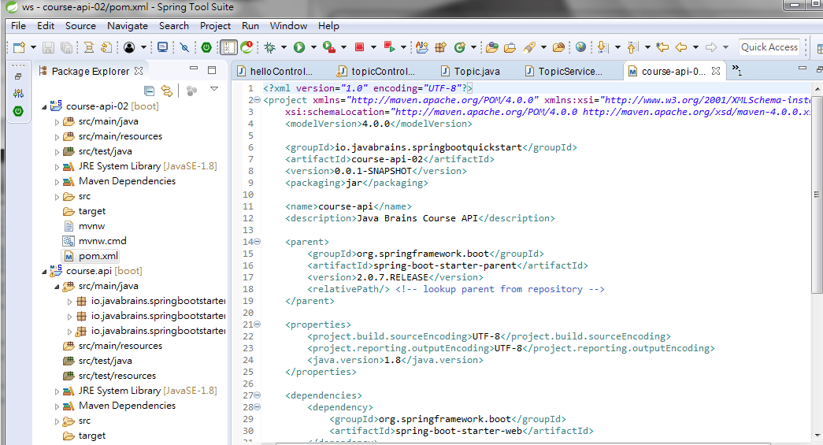
22 Spring Initializr
https://www.youtube.com/watch?v=E7_a-kB46LU&list=PLqq-6Pq4lTTbx8p2oCgcAQGQyqN8XeA1x&index=9
Examine pom.xml. You can see there is a lot we did in the first unit.
In parent section, we already done. Java version is 1.8. It has source and output encode UTF-8.

Slide 9
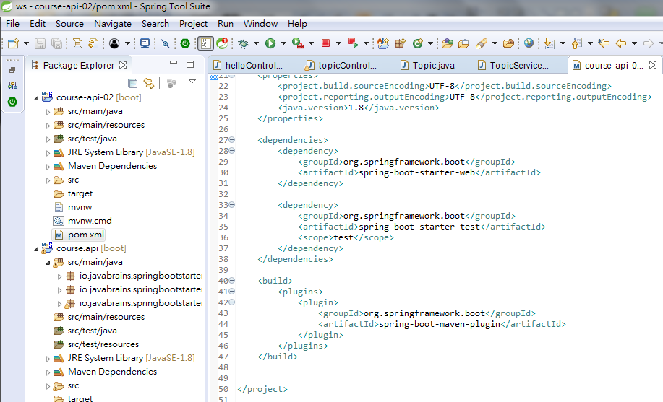
22 Spring Initializr
https://www.youtube.com/watch?v=E7_a-kB46LU&list=PLqq-6Pq4lTTbx8p2oCgcAQGQyqN8XeA1x&index=9
It has spring boot starter web which is added as dependency.
It also has a spring boot starter test for testing.
It also have maven plugin for better maven integration.

Slide 10
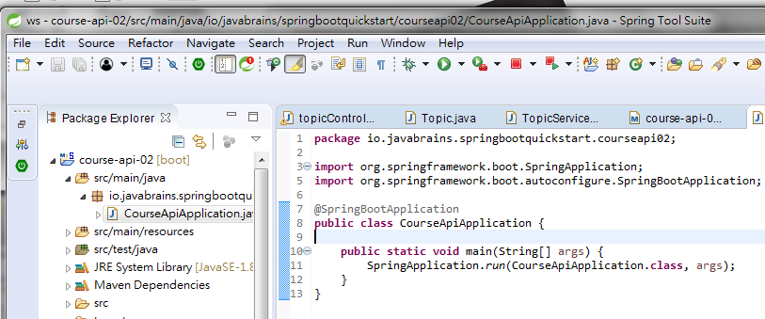
22 Spring Initializr
https://www.youtube.com/watch?v=E7_a-kB46LU&list=PLqq-6Pq4lTTbx8p2oCgcAQGQyqN8XeA1x&index=9
When we look at the Java code, unit 1 is empty, we have to add this code.

Slide 11
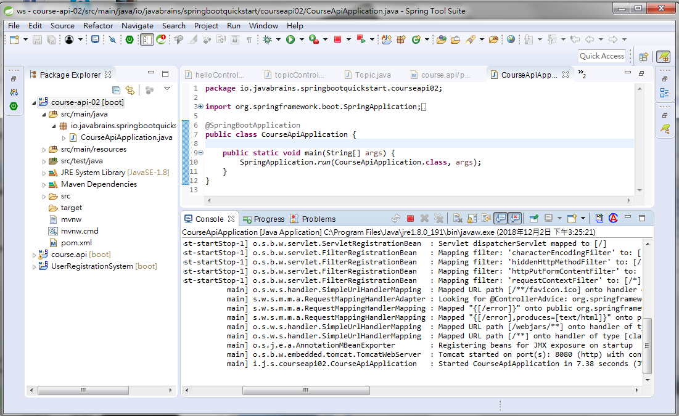
22 Spring Initializr
https://www.youtube.com/watch?v=E7_a-kB46LU&list=PLqq-6Pq4lTTbx8p2oCgcAQGQyqN8XeA1x&index=9
Select the project and click Run.
Check for port 8080

Slide 12
22 Spring Initializr
https://www.youtube.com/watch?v=E7_a-kB46LU&list=PLqq-6Pq4lTTbx8p2oCgcAQGQyqN8XeA1x&index=9
The name of online application is called “Spring Initializr”
The address is “http://start.spring.io”

Slide 13
End of Chapter

