Slide 1

12 Run Object from Controller
Peter H. Chen

Slide 2

12 Run Object from Controller
https://www.youtube.com/watch?v=E7_a-kB46LU&list=PLqq-6Pq4lTTbx8p2oCgcAQGQyqN8XeA1x&index=9
We are going to add one more mapping to a URL.
Let’s have it map to a method and see that in execution.

Slide 3
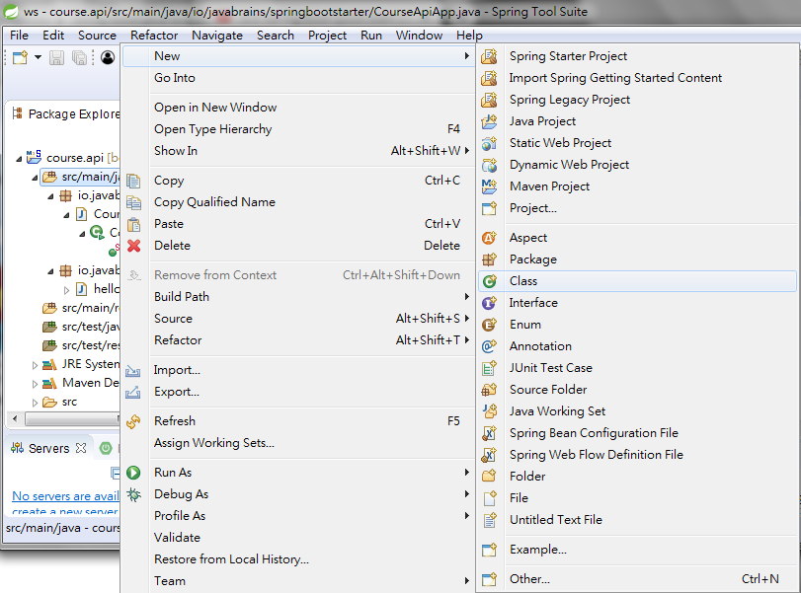
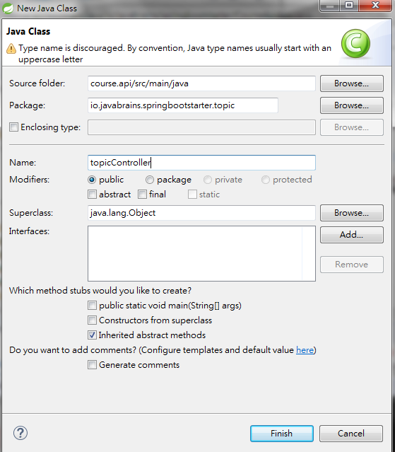
12 Run Object from Controller
https://www.youtube.com/watch?v=E7_a-kB46LU&list=PLqq-6Pq4lTTbx8p2oCgcAQGQyqN8XeA1x&index=9
File > New > class
Package Name: io.javabrains.sptingbootstarter.topic
Class Name: topicController

Slide 4
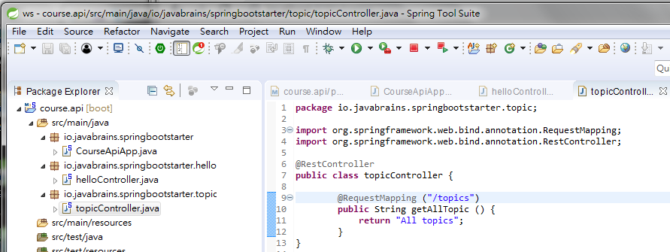
12 Run Object from Controller
https://www.youtube.com/watch?v=E7_a-kB46LU&list=PLqq-6Pq4lTTbx8p2oCgcAQGQyqN8XeA1x&index=9
In the topCotroller.java,
Add @RestController and click to add “import …”
Add @RequestMapping (“/topics”) and click to add “import …”

Slide 5
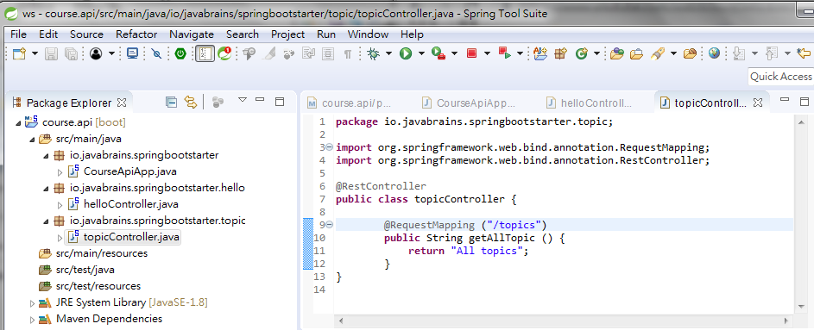
12 Run Object from Controller
https://www.youtube.com/watch?v=E7_a-kB46LU&list=PLqq-6Pq4lTTbx8p2oCgcAQGQyqN8XeA1x&index=9
Click “Stop” and “Run As”

Slide 6
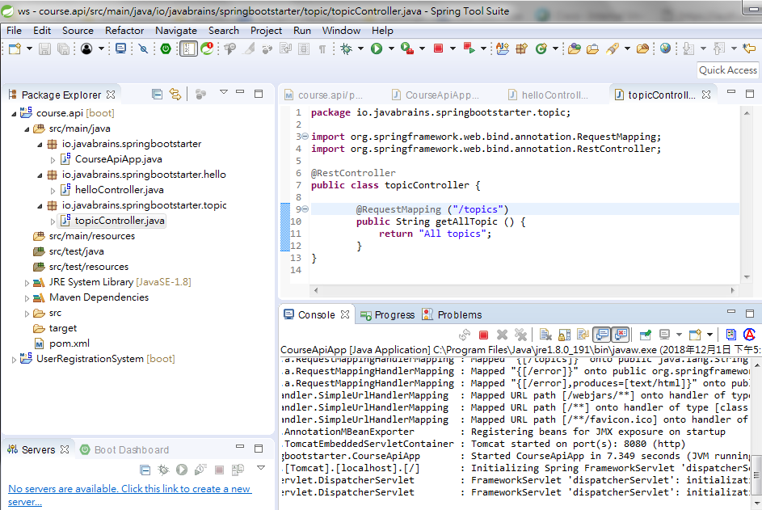
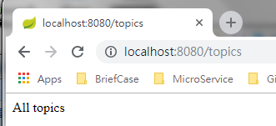
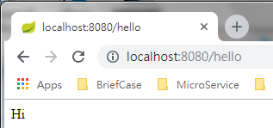
12 Run Object from Controller
https://www.youtube.com/watch?v=E7_a-kB46LU&list=PLqq-6Pq4lTTbx8p2oCgcAQGQyqN8XeA1x&index=9
Make sure port “localhost:8080” is running.
Open chrome and enter “localhost:8080/topics”
enter “localhost:8080/hello”

Slide 7
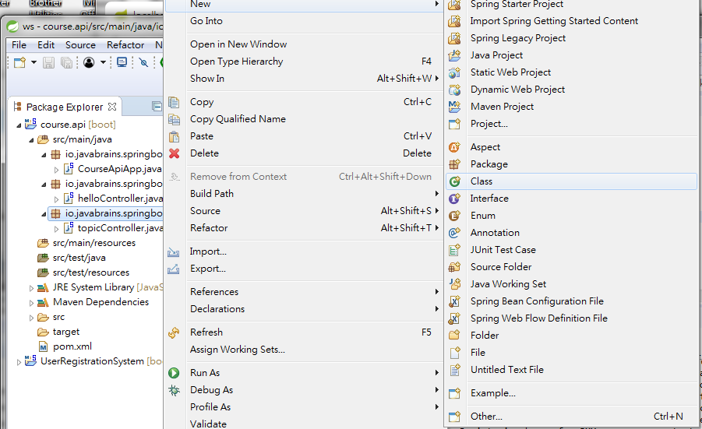
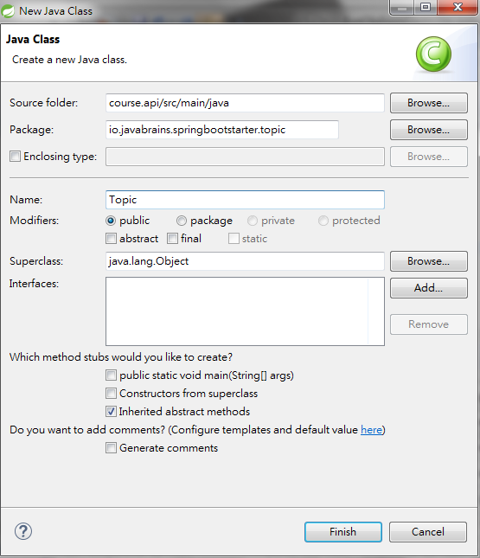
12 Run Object from Controller
https://www.youtube.com/watch?v=E7_a-kB46LU&list=PLqq-6Pq4lTTbx8p2oCgcAQGQyqN8XeA1x&index=9
We will add a list of objects. These objects will be get from database.
We will hard coded data at this moment. To add hard coded data, we add a new class to generate the hard code data.
Click the package name: io,javabrains.springbootstarter.tppic and RMB: New > class
Enter class “Topic” and click “Finish” button.

Slide 8
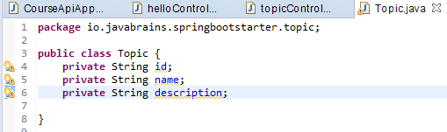
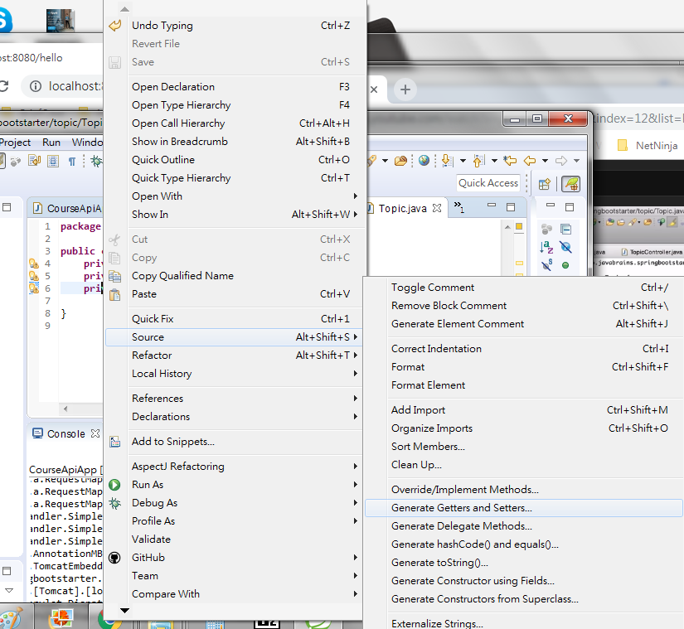
12 Run Object from Controller
https://www.youtube.com/watch?v=E7_a-kB46LU&list=PLqq-6Pq4lTTbx8p2oCgcAQGQyqN8XeA1x&index=9
Add private String for id, name, and description.
Click the code content and RMB> source > generate Getter and Setter.

Slide 9
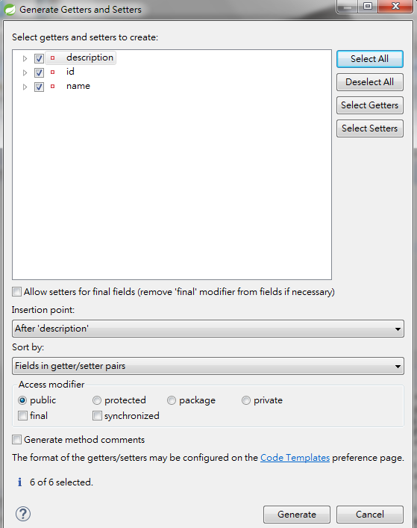
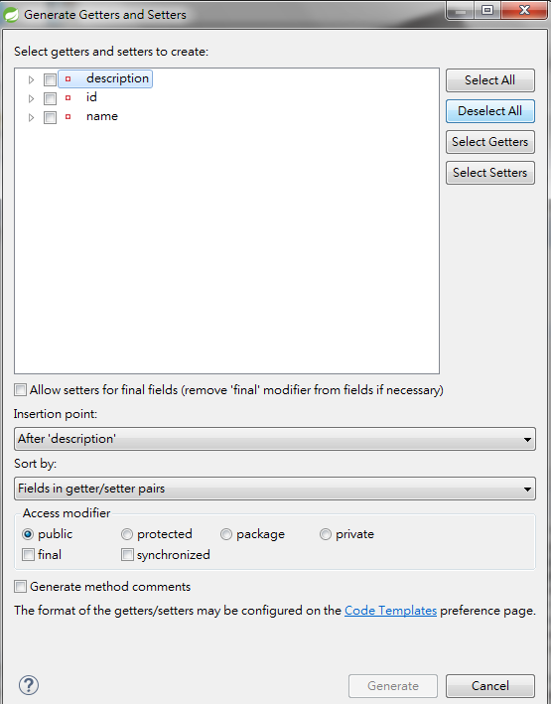
12 Run Object from Controller
https://www.youtube.com/watch?v=E7_a-kB46LU&list=PLqq-6Pq4lTTbx8p2oCgcAQGQyqN8XeA1x&index=9
Select all variables by “Select All” button.
Click “Generate” button.

Slide 10
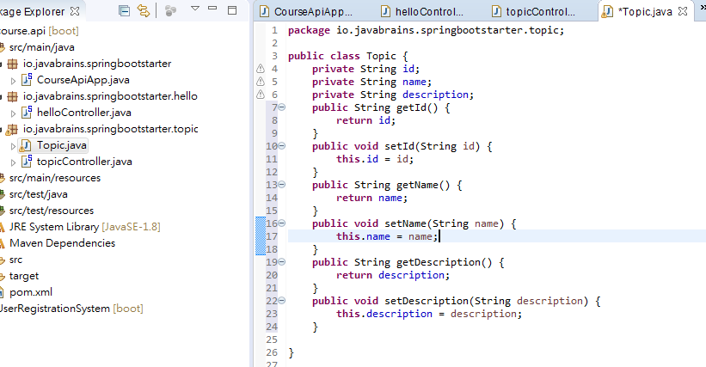
12 Run Object from Controller
https://www.youtube.com/watch?v=E7_a-kB46LU&list=PLqq-6Pq4lTTbx8p2oCgcAQGQyqN8XeA1x&index=9
We have all the getter and setter methods.

Slide 11
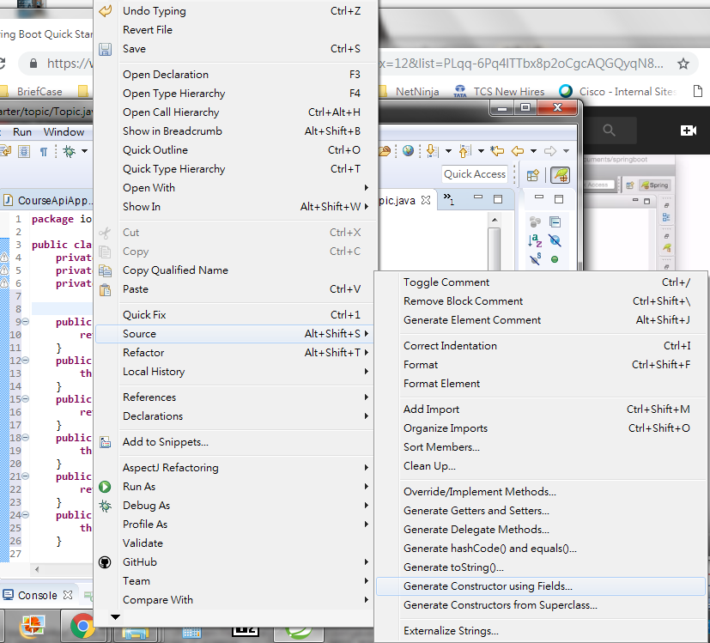
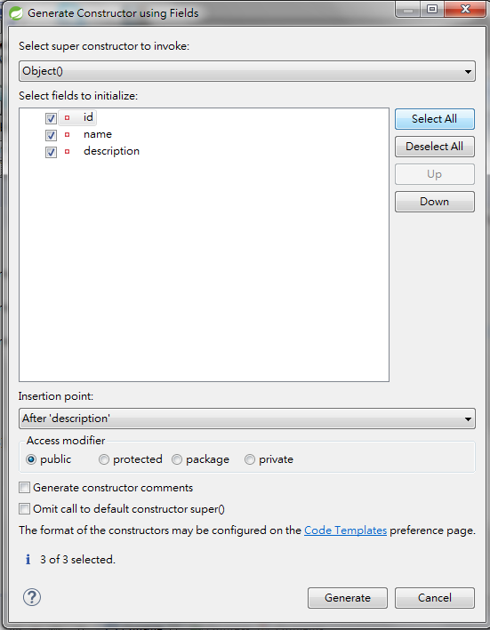
12 Run Object from Controller
https://www.youtube.com/watch?v=E7_a-kB46LU&list=PLqq-6Pq4lTTbx8p2oCgcAQGQyqN8XeA1x&index=9
Generate constructor using fields.
Click “Select All” button and click “Generate” button.

Slide 12
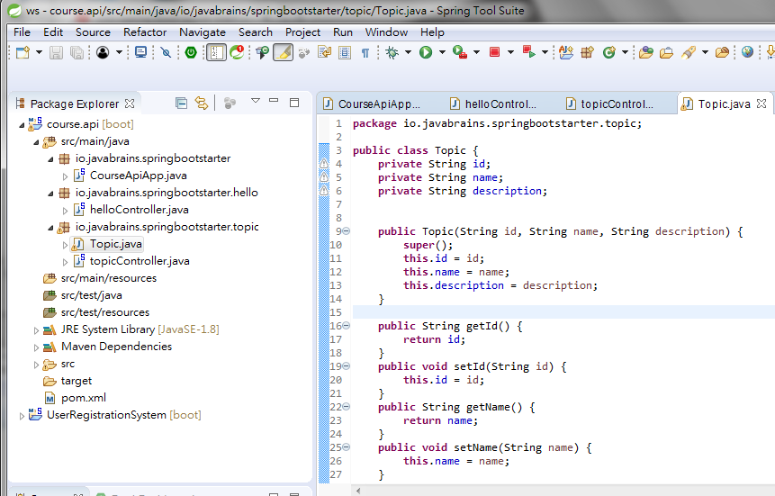
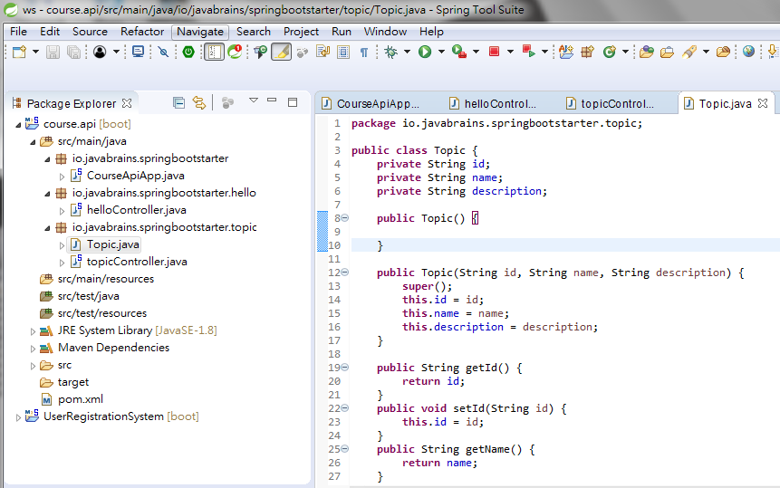
12 Run Object from Controller
https://www.youtube.com/watch?v=E7_a-kB46LU&list=PLqq-6Pq4lTTbx8p2oCgcAQGQyqN8XeA1x&index=9
We have all generate constructor, setter, and getter.
Manually add the default constructor.

Slide 13
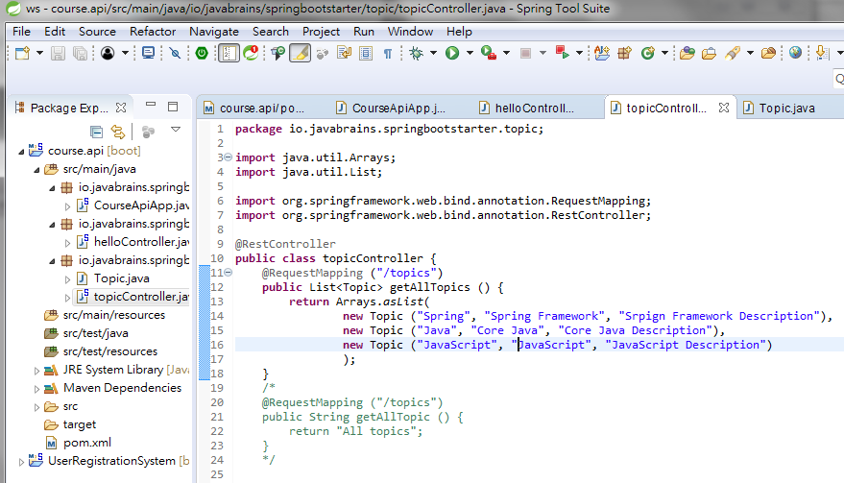
12 Run Object from Controller
https://www.youtube.com/watch?v=E7_a-kB46LU&list=PLqq-6Pq4lTTbx8p2oCgcAQGQyqN8XeA1x&index=9
We changed the list of object from class Topic.
The List will automatically converted into JSON format.
Return an Arrays of List. Return type is List.

Slide 14
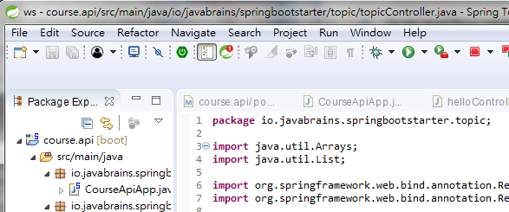
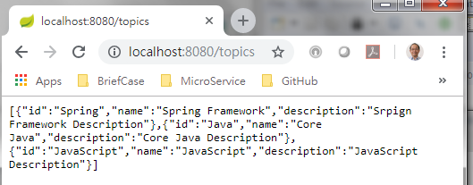
12 Run Object from Controller
https://www.youtube.com/watch?v=E7_a-kB46LU&list=PLqq-6Pq4lTTbx8p2oCgcAQGQyqN8XeA1x&index=9
Stop and Run again.
Check console with Port “8080”
Open chrome and enter “localhost:8080/topics”
Display the array of object with JSON format.

Slide 15
12 Run Object from Controller
https://www.youtube.com/watch?v=E7_a-kB46LU&list=PLqq-6Pq4lTTbx8p2oCgcAQGQyqN8XeA1x&index=9
This is how easy of REST api with spring MVC.
All you have to do is to create a controller for it
Map a particular request to our method and your business logic in that method.
In the further, we will get data from database, for right now, we hard code the data and see how to controller work.

Slide 16
End of Chapter

