Slide 1

3 What is Spring Boot?
Peter H. Chen

Slide 2
3 What is Spring Boot?
https://www.youtube.com/watch?v=99Nw2smMTLg&list=PLqq-6Pq4lTTbx8p2oCgcAQGQyqN8XeA1x&index=3
What is the meaning of name “Spring Boot?”
The first part is Spring and the second part is Boot.
The Spring means Spring Framework. The Spring Framework let you write the Enterprise Java Application. The Spring Framework is a huge framework, a zillions of framework. We will not going to talk huge framework.
Boot means Bootstrap.
Spring Book means that bootstrap the spring application from the scratch. That is the meaning of the name “Spring Boot”.

Slide 3
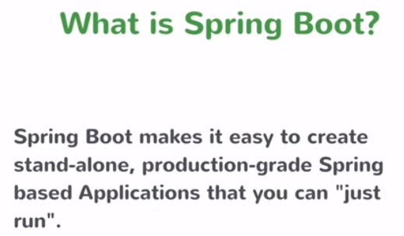
3 What is Spring Boot?
https://www.youtube.com/watch?v=99Nw2smMTLg&list=PLqq-6Pq4lTTbx8p2oCgcAQGQyqN8XeA1x&index=3
Here is the official definition of the Spring Boot from the web-site.
“Spring boot makes it easy to create stand-alone, production-grade Spring based Applications that you can “Just run”.

Slide 4
3 What is Spring Boot?
https://www.youtube.com/watch?v=99Nw2smMTLg&list=PLqq-6Pq4lTTbx8p2oCgcAQGQyqN8XeA1x&index=3
There is a lot of key elements here.
First, Spring Boot make it easy to create standalone, production grade based application.
The key is “create Spring based Application.”
Spring boot is the tool to create the Spring based Application. What is the spring based application looks like that Spring Boot create for us?
It is a standalone. It is run on its own. It is production grade. It is not just “Hello World” application.
You have something that you can actually deploy production and it is something that “Just Run.”
This is very important that you have spent time creating a Spring application without using Spring Boot. You will understand the pain of having to do a lot of stuff to get to the point for easier on it. There are a lot of configuration steps that you have to do, a lot of charging you need to import a whole lot of stuff.
“Create Spring Application” and “Just Run”.

Slide 5
End of Chapter

