Slide 1

29 Crud Operation with Repository
Peter H. Chen

Slide 2
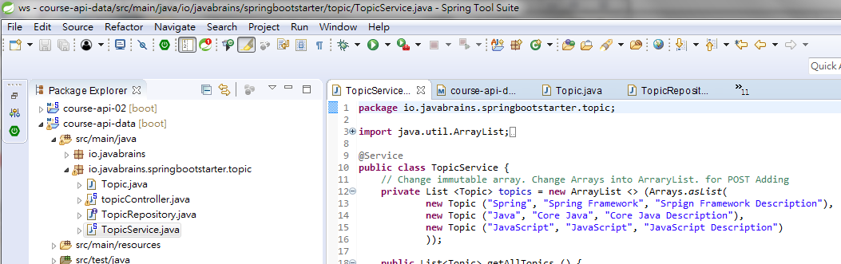
29 Crud Operation with Repository
https://www.youtube.com/watch?v=E7_a-kB46LU&list=PLqq-6Pq4lTTbx8p2oCgcAQGQyqN8XeA1x&index=9
In the last chapter, we want to remove the hard-coded data.

Slide 3
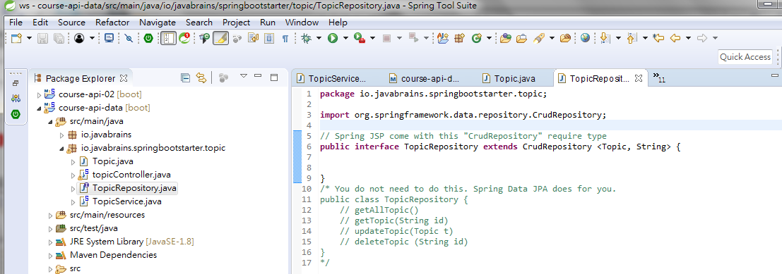
29 Crud Operation with Repository
https://www.youtube.com/watch?v=E7_a-kB46LU&list=PLqq-6Pq4lTTbx8p2oCgcAQGQyqN8XeA1x&index=9
We want to implement the data layer. The CRUD Operation:

Slide 4
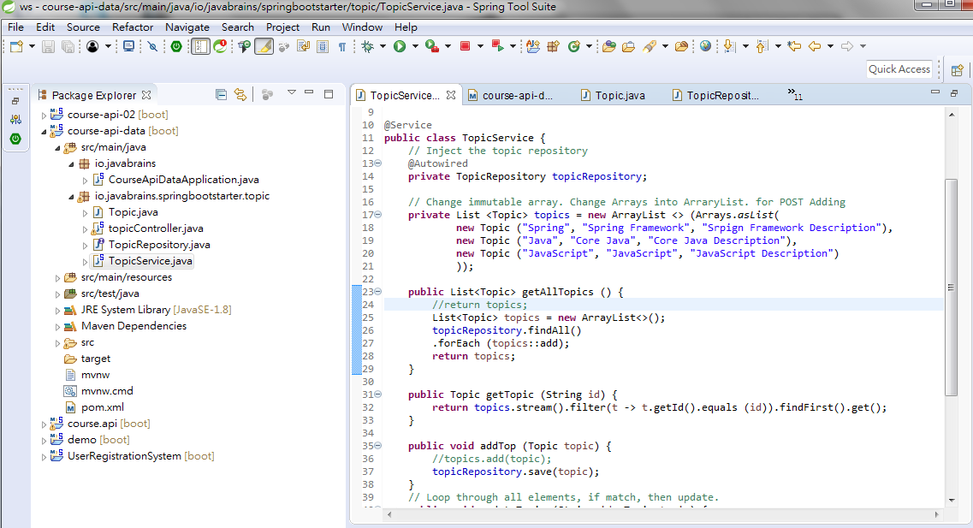
29 Crud Operation with Repository
https://www.youtube.com/watch?v=E7_a-kB46LU&list=PLqq-6Pq4lTTbx8p2oCgcAQGQyqN8XeA1x&index=9
We want to implement the data layer. The CRUD Operation:

Slide 5
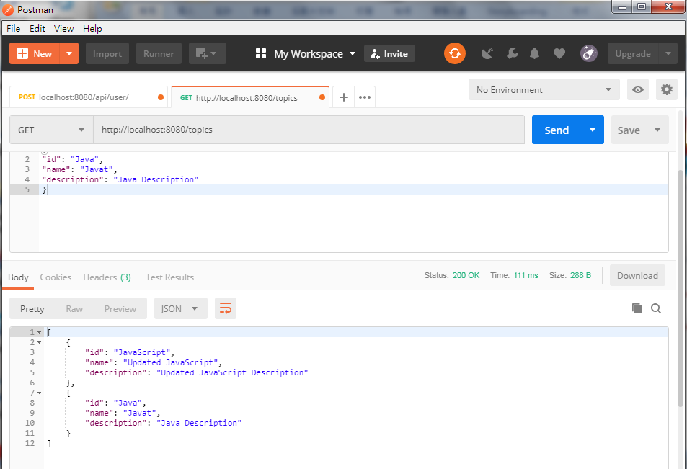
29 Crud Operation with Repository
https://www.youtube.com/watch?v=E7_a-kB46LU&list=PLqq-6Pq4lTTbx8p2oCgcAQGQyqN8XeA1x&index=9
Run as “Java Application” (Embedded database)
Run Postman.
Retrieve data is empty. GET “localhost:8080/topics”
POST “JavaScript” and “Java”
GET “localhost:8080/topics”

Slide 6
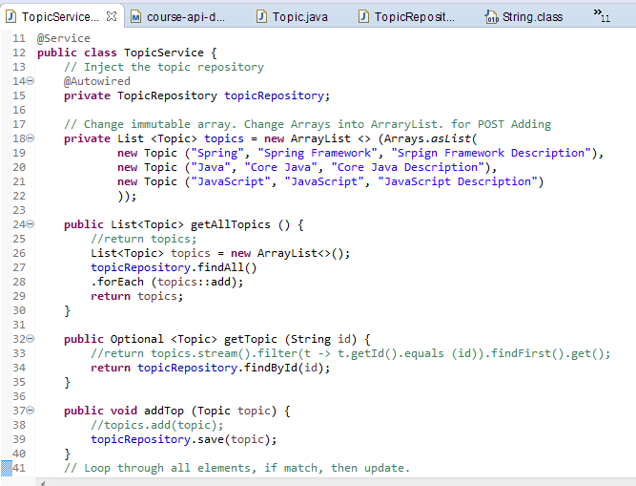
29 Crud Operation with Repository
https://www.youtube.com/watch?v=E7_a-kB46LU&list=PLqq-6Pq4lTTbx8p2oCgcAQGQyqN8XeA1x&index=9
Add Update and Post

Slide 7
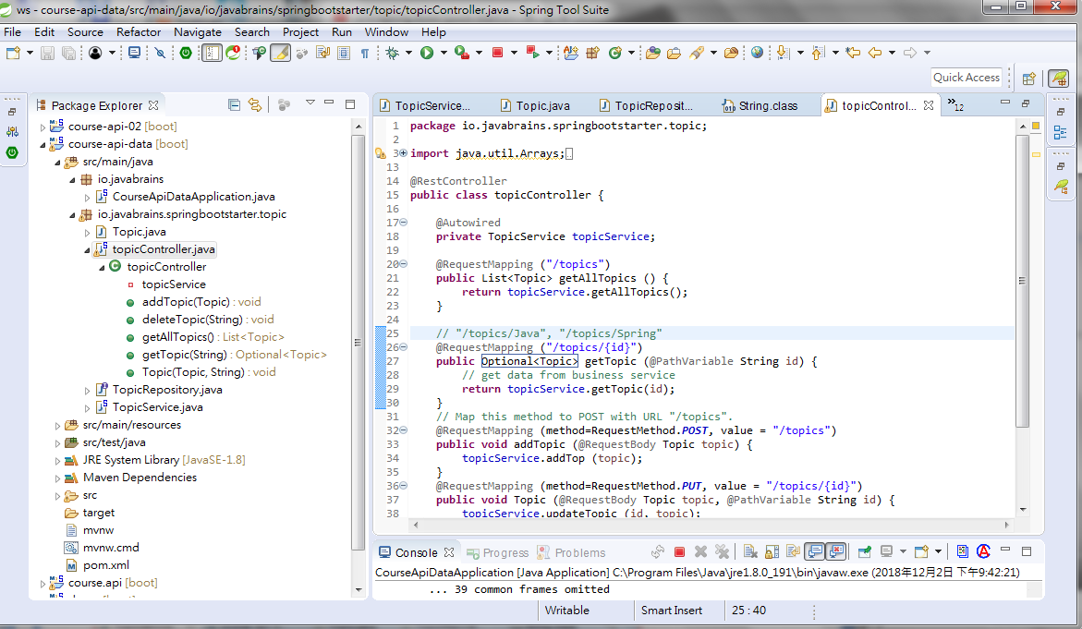
29 Crud Operation with Repository
https://www.youtube.com/watch?v=E7_a-kB46LU&list=PLqq-6Pq4lTTbx8p2oCgcAQGQyqN8XeA1x&index=9
Add Update and Post

Slide 8
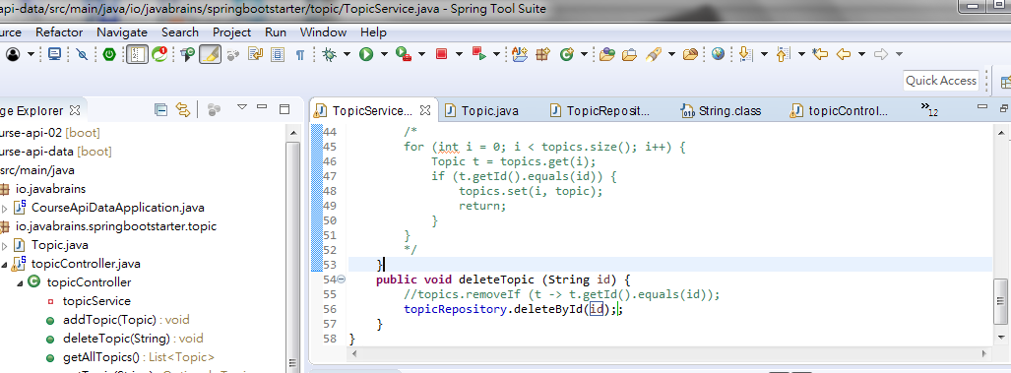
29 Crud Operation with Repository
https://www.youtube.com/watch?v=E7_a-kB46LU&list=PLqq-6Pq4lTTbx8p2oCgcAQGQyqN8XeA1x&index=9
Delete a topic.

Slide 9
End of Chapter

