Slide 1

13 Bill Of Material
Peter H. Chen

Slide 2

13 Bill Of Material
https://www.youtube.com/watch?v=E7_a-kB46LU&list=PLqq-6Pq4lTTbx8p2oCgcAQGQyqN8XeA1x&index=9
What is happening?
Spring boot keep track of version by pom.xml

Slide 3
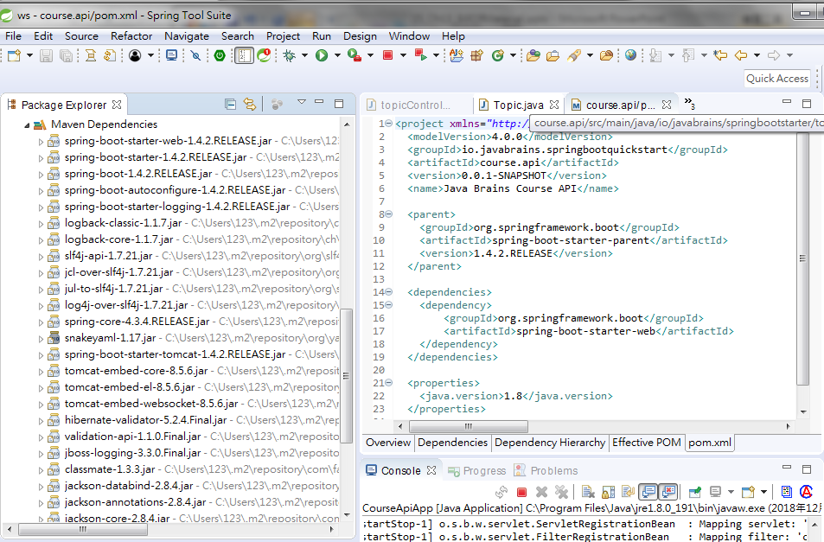
13 Bill Of Material
https://www.youtube.com/watch?v=E7_a-kB46LU&list=PLqq-6Pq4lTTbx8p2oCgcAQGQyqN8XeA1x&index=9
The parent specified the original spring-boot-1.4.2.RELEASE.jar for project.
The dependencies specify the tomcat version.
You can remove the dependencies or parent and save see what are the differences in the Maven Dependencies folder.

Slide 4
13 Bill Of Material
https://www.youtube.com/watch?v=E7_a-kB46LU&list=PLqq-6Pq4lTTbx8p2oCgcAQGQyqN8XeA1x&index=9
You do not need to worry about the individual version number.
The spring boot will pick for you.
You just need to worry about the version number of parent.
The parent will instruct spring or maven about what are the different combination of versions.

Slide 5
End of Chapter

