Slide 1

1 Spring Boot
Peter H. Chen

Slide 2
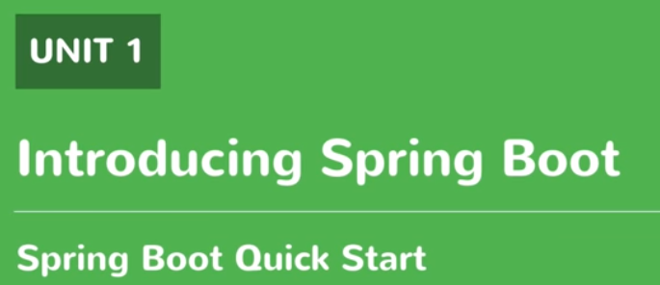
1 Spring Boot
https://www.youtube.com/watch?v=E7_a-kB46LU&list=PLqq-6Pq4lTTbx8p2oCgcAQGQyqN8XeA1x&index=9
Spring Boot is for full stack developer including the front-end and back-end.
This document is a quick introduction of Spring Boot.

Slide 3
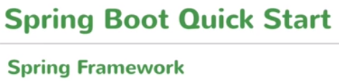
1 Spring Boot
https://www.youtube.com/watch?v=E7_a-kB46LU&list=PLqq-6Pq4lTTbx8p2oCgcAQGQyqN8XeA1x&index=9
We use Spring boot to create spring application.
We need some basic knowledge of Spring Framework.
Spring Framework is actually an enterprise Java Framework which let you write enterprise Java Application.
Spring Boot is a name of bootstrap or quickly start up a simple Spring Application. We should say Complicated Spring Application instead of simple Spring Application.
The main idea of Spring Boot is to easily start up the Spring Application.
You can actually build you application all the way to the production, an end-to-end application which is production ready.
You can create the production ready application using Spring Boot within short time.
If you ask to create the Spring Application, my go-to approach is using the Spring Boot.
We will use Spring Boot to create an end-to-end Restful API application using Spring Boot.
The application will include controller, end-to-end point communication, and database.

Slide 4
End of Chapter

