Slide 1

9 Spring Boot Application
Peter H. Chen

Slide 2
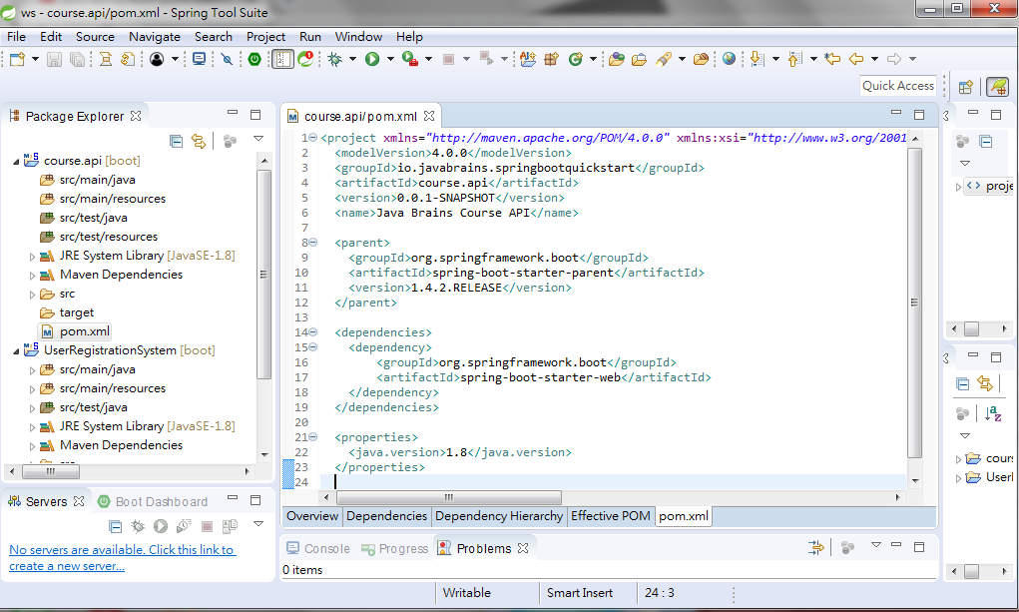
9 Spring Boot Application
https://www.youtube.com/watch?v=E7_a-kB46LU&list=PLqq-6Pq4lTTbx8p2oCgcAQGQyqN8XeA1x&index=9
Right now, we have pom.xml.

Slide 3
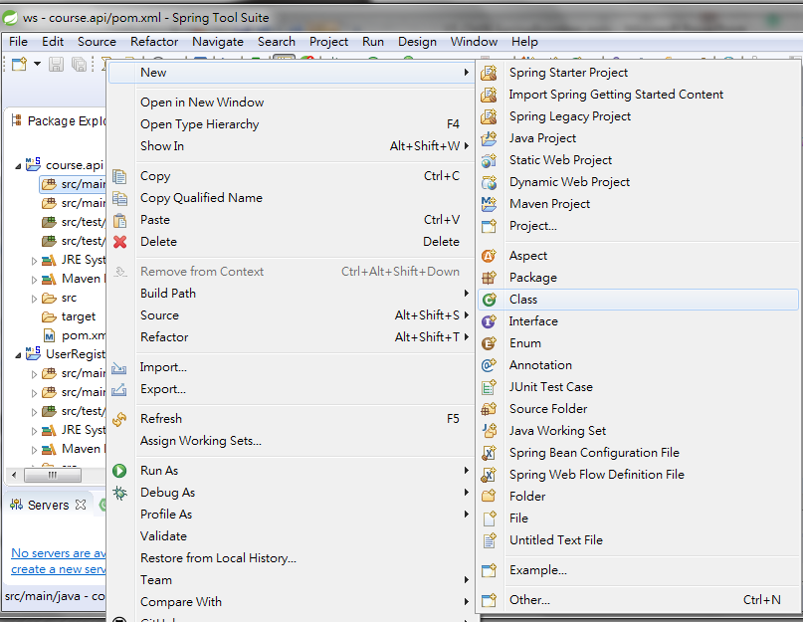
9 Spring Boot Application
https://www.youtube.com/watch?v=E7_a-kB46LU&list=PLqq-6Pq4lTTbx8p2oCgcAQGQyqN8XeA1x&index=9
We will going to create a simple Java class.
We are going to create src/main/java here.
Click src/main/java folder and create a new class: File > New > Class.

Slide 4
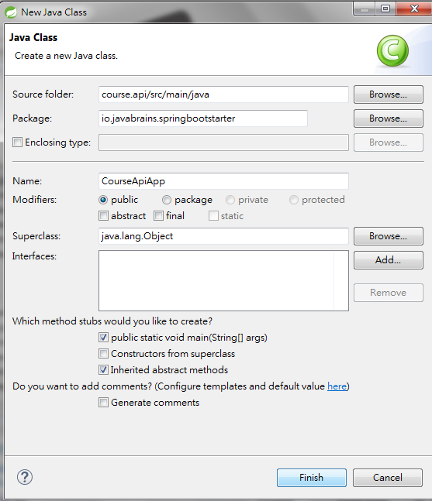
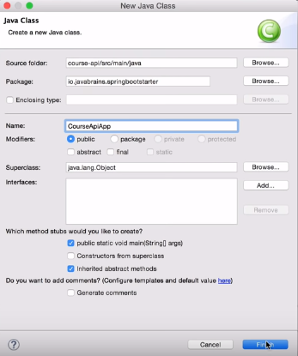
9 Spring Boot Application
https://www.youtube.com/watch?v=E7_a-kB46LU&list=PLqq-6Pq4lTTbx8p2oCgcAQGQyqN8XeA1x&index=9
We will create a simple Java class at src/main/java here.
Click src/main/java folder and create a new class: File > New > Class.
Package Name: io.javabrains.springboostarter, class Name: CourseApiApp
Click on “public static void main (String [] args)

Slide 5
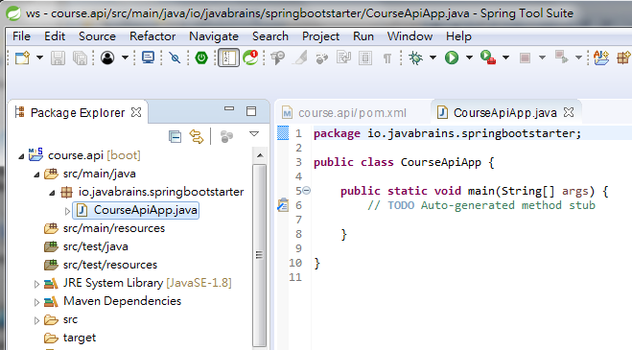
9 Spring Boot Application
https://www.youtube.com/watch?v=E7_a-kB46LU&list=PLqq-6Pq4lTTbx8p2oCgcAQGQyqN8XeA1x&index=9
This is the java class with main method where we bootstrap a spring boot application.

Slide 6
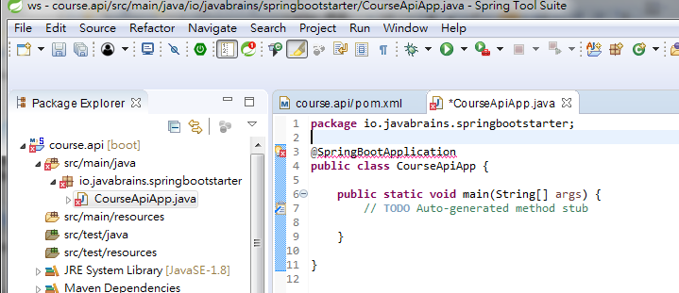
9 Spring Boot Application
https://www.youtube.com/watch?v=E7_a-kB46LU&list=PLqq-6Pq4lTTbx8p2oCgcAQGQyqN8XeA1x&index=9
Spring boot is a standalone. Spring boot does not need servlet and does not need deployed on a server. It just like any Java Program which has main.
This take care of everything including servlet container start it and hosts your application for you. That seems a lot. This is a very complicated code inside.
This is a very simple code tell spring this is the spring application.
How do we do that?
Add “@SpringBootApplicaiton”
There is a error. How to fix it?

Slide 7
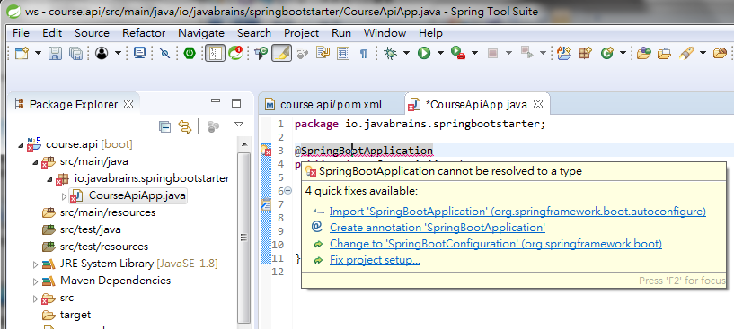
9 Spring Boot Application
https://www.youtube.com/watch?v=E7_a-kB46LU&list=PLqq-6Pq4lTTbx8p2oCgcAQGQyqN8XeA1x&index=9
Click the Error, popup a menu.
Select “import …”

Slide 8
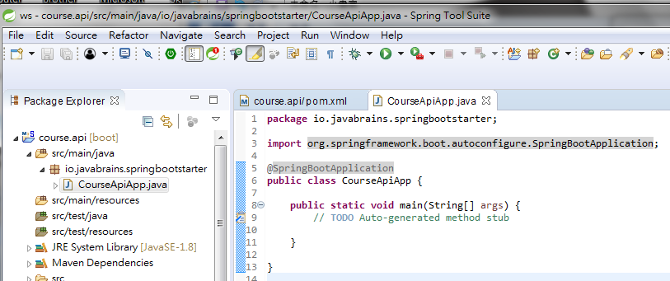
9 Spring Boot Application
https://www.youtube.com/watch?v=E7_a-kB46LU&list=PLqq-6Pq4lTTbx8p2oCgcAQGQyqN8XeA1x&index=9
We have @SpringBootApplicaiton and “import org.springframework”
This annotation tell srping boot this is the starting point of spring boot application.
This application will have servlet container and host the application.
It seems a lot of code but spring boot does it one line of code for you.

Slide 9
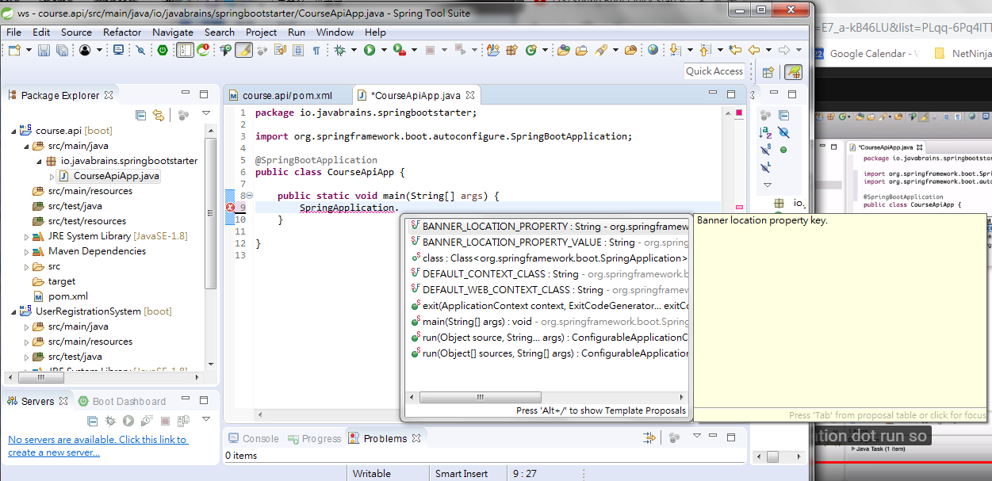
9 Spring Boot Application
https://www.youtube.com/watch?v=E7_a-kB46LU&list=PLqq-6Pq4lTTbx8p2oCgcAQGQyqN8XeA1x&index=9
We have @SpringBootApplicaiton and “import org.springframework”
This annotation tell srping boot this is the starting point of spring boot application.
This application will have servlet container and host the application.
It seems a lot of code but spring boot does it one line of code for you.
Type “SpringApplication.” and select “run” from popup menu.

Slide 10
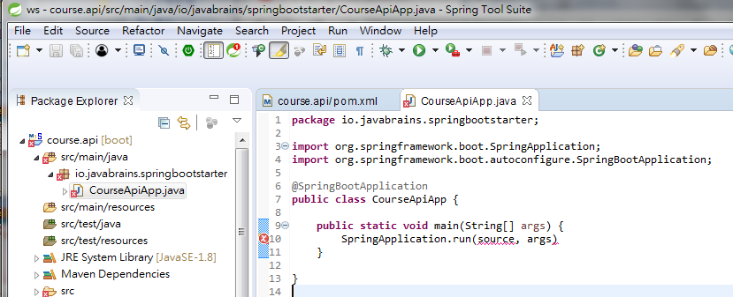
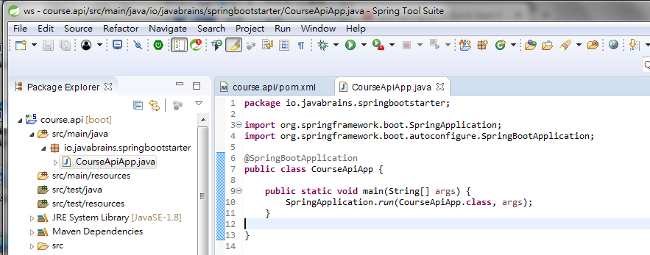
9 Spring Boot Application
https://www.youtube.com/watch?v=E7_a-kB46LU&list=PLqq-6Pq4lTTbx8p2oCgcAQGQyqN8XeA1x&index=9
This is the starting method of spring boot.
Change the first argument to “CourseApiApp” to bootstrap the spring boot for servlet and host application.

Slide 11
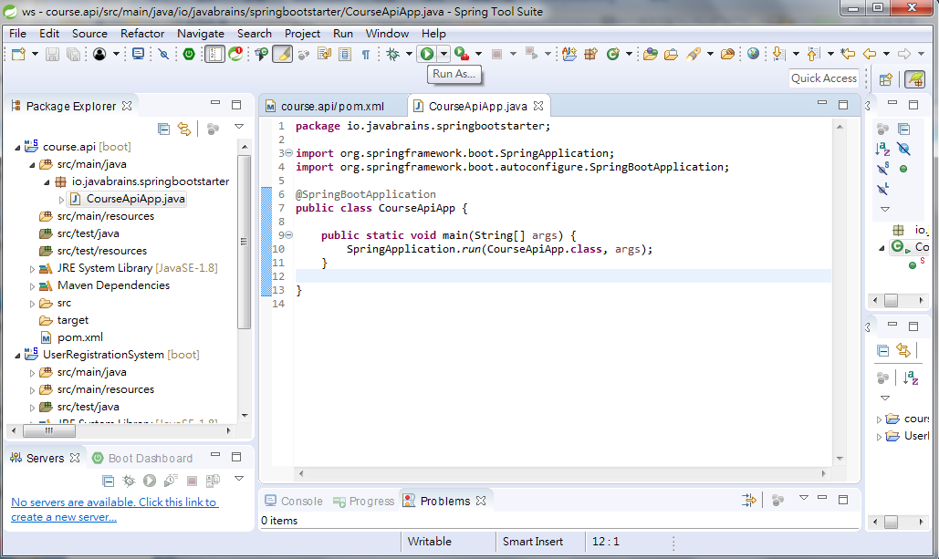
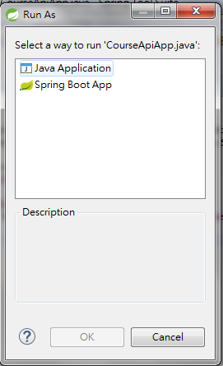
9 Spring Boot Application
https://www.youtube.com/watch?v=E7_a-kB46LU&list=PLqq-6Pq4lTTbx8p2oCgcAQGQyqN8XeA1x&index=9
This is our spring boot application.
It does not do anything but it is a spring boot application.
It has everything you need to create a servlet container and run it.
Let’s run it. Click “Run As …” and select “Java Application”.
We also can select “Spring Boot” because we already have spring boot inside.

Slide 12
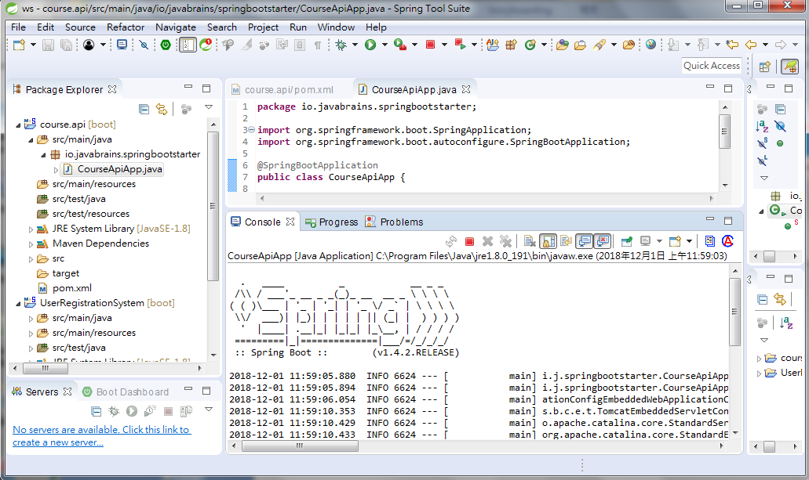
9 Spring Boot Application
https://www.youtube.com/watch?v=E7_a-kB46LU&list=PLqq-6Pq4lTTbx8p2oCgcAQGQyqN8XeA1x&index=9
A lot of staff display on console.
We have ASCII “Spring”, “Spring Boot”, version number displayed.

Slide 13
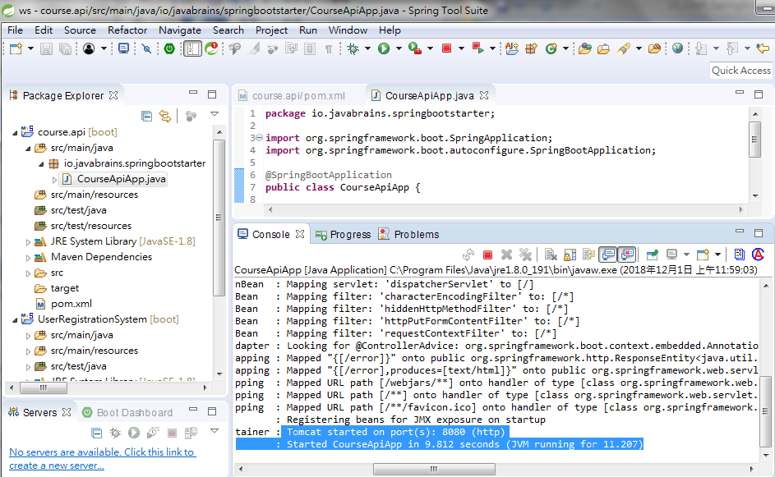
9 Spring Boot Application
https://www.youtube.com/watch?v=E7_a-kB46LU&list=PLqq-6Pq4lTTbx8p2oCgcAQGQyqN8XeA1x&index=9
Scroll down and then scroll right to the console.
You will to see “Started CourseApiApp” and “Tomcat started on port(s): 8080 (http)”

Slide 14
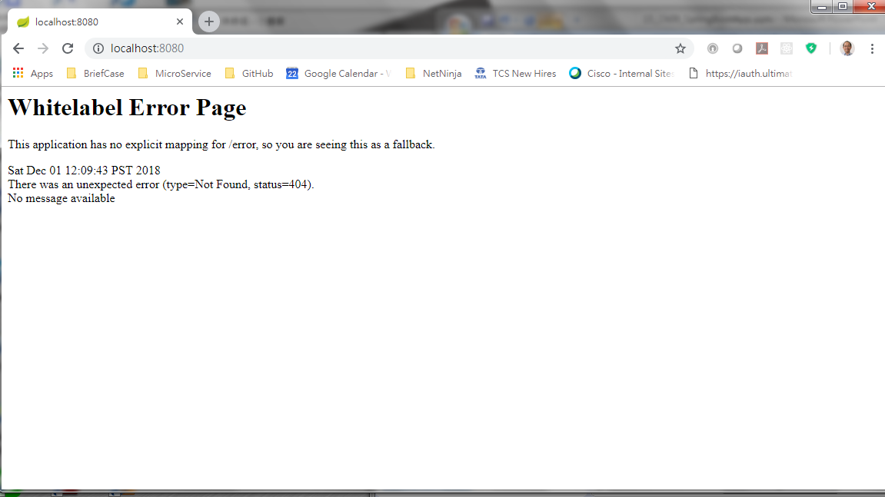
9 Spring Boot Application
https://www.youtube.com/watch?v=E7_a-kB46LU&list=PLqq-6Pq4lTTbx8p2oCgcAQGQyqN8XeA1x&index=9
Open Chrome and enter “localhost:8080”
We have error message as below. No mapping for this URL.

Slide 15
End of Chapter

