Slide 1

17 Business Service
Peter H. Chen

Slide 2
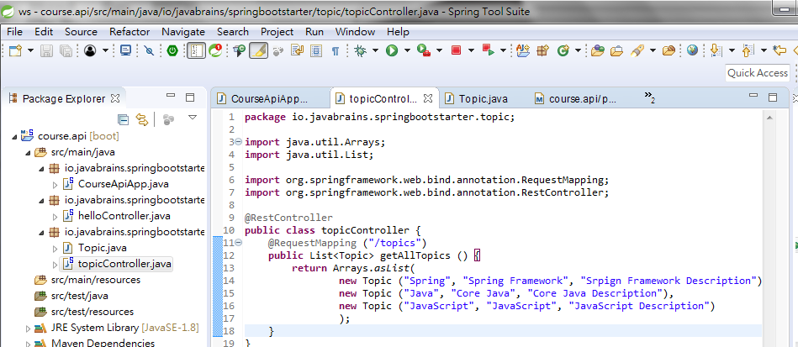
17 Business Service
https://www.youtube.com/watch?v=E7_a-kB46LU&list=PLqq-6Pq4lTTbx8p2oCgcAQGQyqN8XeA1x&index=9
We will move the hard-code data to the business service.

Slide 3
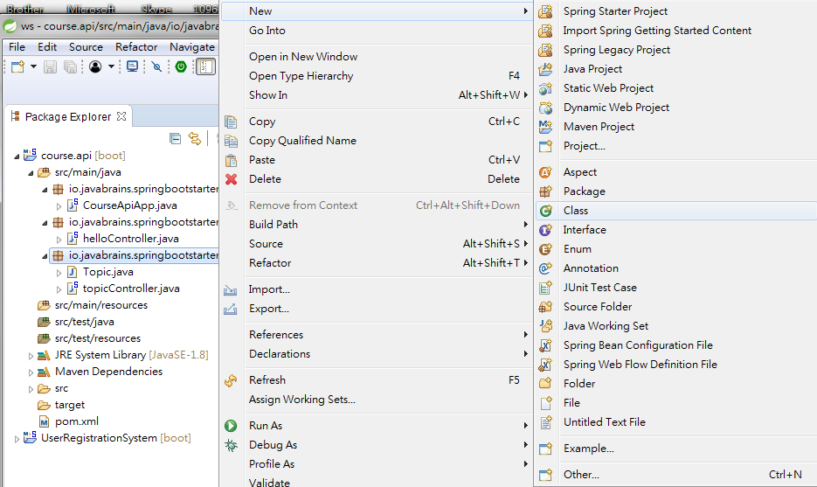
17 Business Service
https://www.youtube.com/watch?v=E7_a-kB46LU&list=PLqq-6Pq4lTTbx8p2oCgcAQGQyqN8XeA1x&index=9
Click package io.javabrains.springbootstarter.topic: RMB > New > class

Slide 4
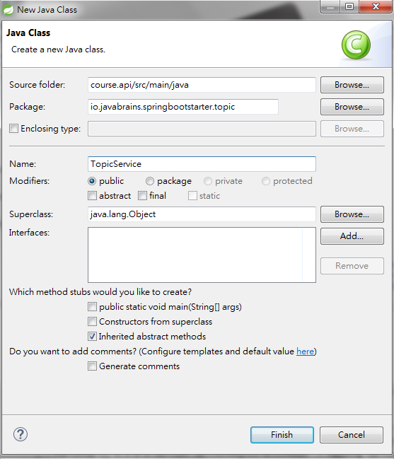
17 Business Service
https://www.youtube.com/watch?v=E7_a-kB46LU&list=PLqq-6Pq4lTTbx8p2oCgcAQGQyqN8XeA1x&index=9
Class Name: TopicService

Slide 5
17 Business Service
https://www.youtube.com/watch?v=E7_a-kB46LU&list=PLqq-6Pq4lTTbx8p2oCgcAQGQyqN8XeA1x&index=9
I want class TopicService to business service.
What is business service?
Business service is typically singleton.
When application start up, spring create s an instance of this service and then keep that in its memory.
You can have other classes, other services, and other controllers. Spring knows the service and inject to different classes.

Slide 6
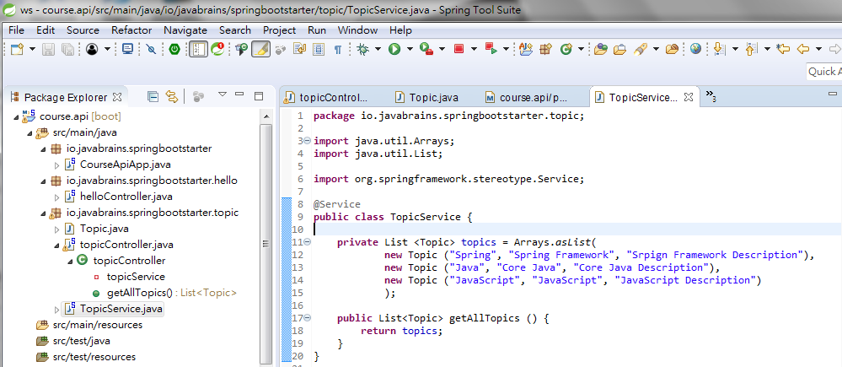
17 Business Service
https://www.youtube.com/watch?v=E7_a-kB46LU&list=PLqq-6Pq4lTTbx8p2oCgcAQGQyqN8XeA1x&index=9
How do I declare the business service?
We can use annotation @Service.
When you have Service Class. All the classes will know this Service.
We hard-coded private data in class TopService. Use public getAllTopics() to get all data.

Slide 7
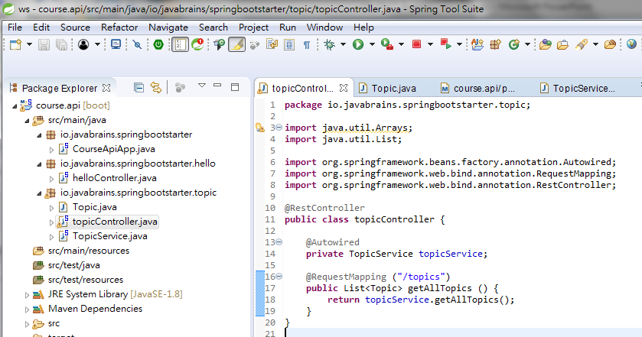
17 Business Service
https://www.youtube.com/watch?v=E7_a-kB46LU&list=PLqq-6Pq4lTTbx8p2oCgcAQGQyqN8XeA1x&index=9
topicController get data from topcService.getAllTopics().
Use @autowire to tell spring boot TopicService is a service.

Slide 8
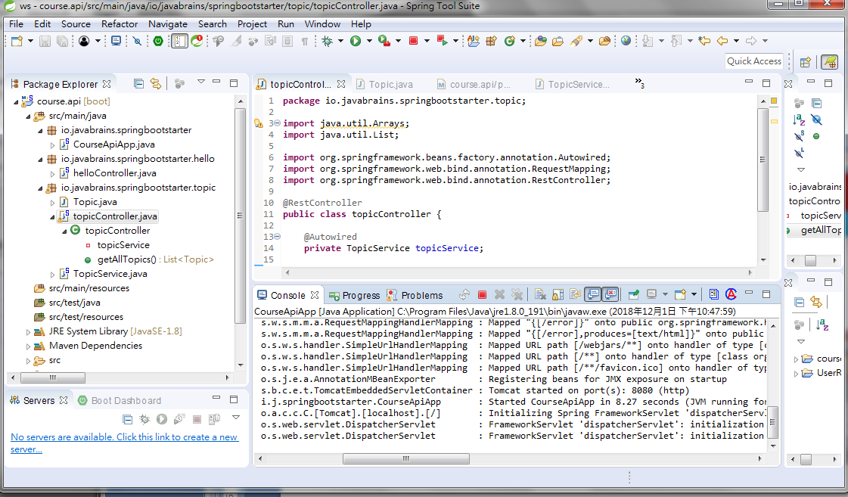
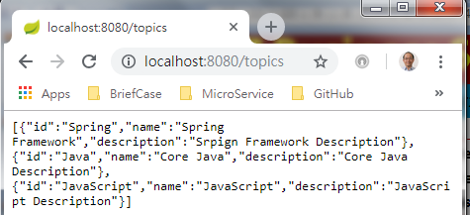
17 Business Service
https://www.youtube.com/watch?v=E7_a-kB46LU&list=PLqq-6Pq4lTTbx8p2oCgcAQGQyqN8XeA1x&index=9
Stop and Run
Check port: 8080
Open Chrome and “localhost:8080/topics”

Slide 9
End of Chapter

