Slide 1

20 Update and Delete
Peter H. Chen

Slide 2
20 Update and Delete
https://www.youtube.com/watch?v=E7_a-kB46LU&list=PLqq-6Pq4lTTbx8p2oCgcAQGQyqN8XeA1x&index=9
We implemented the get request and get API in the last previous chapter.
Let’s move on the POST to create a new document.
To do that, we need to make a POST request “/topics/POST”.

Slide 3
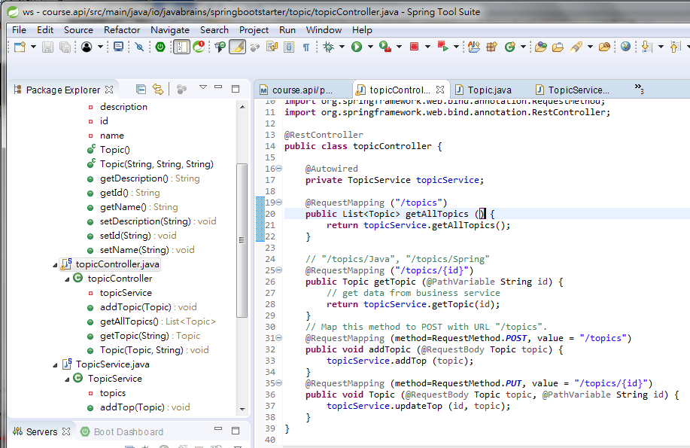
20 Update and Delete
https://www.youtube.com/watch?v=E7_a-kB46LU&list=PLqq-6Pq4lTTbx8p2oCgcAQGQyqN8XeA1x&index=9
URL mapping to Method for PUT:

Slide 4
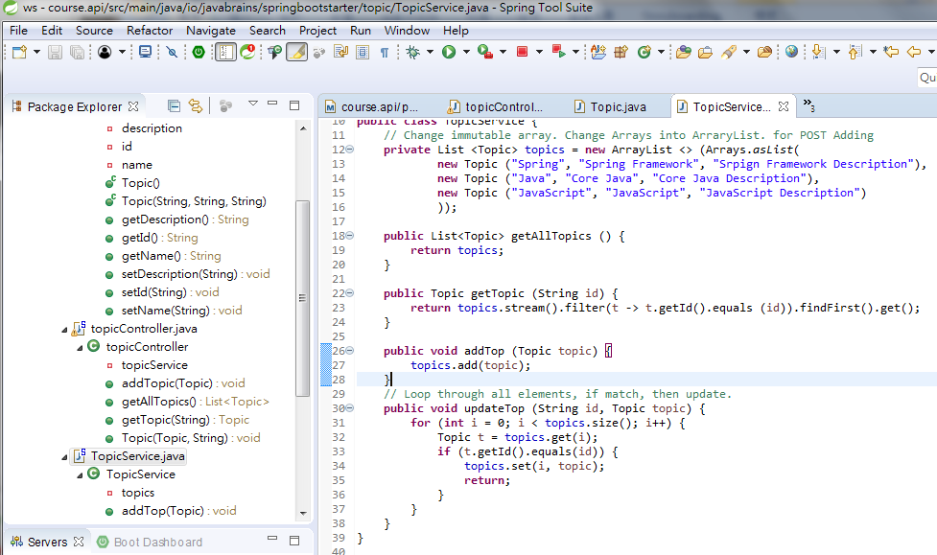
20 Update and Delete
https://www.youtube.com/watch?v=E7_a-kB46LU&list=PLqq-6Pq4lTTbx8p2oCgcAQGQyqN8XeA1x&index=9
Update ArrayList topics (i, topic) when key = “Java/JavaScript/Spring” is matched.

Slide 5
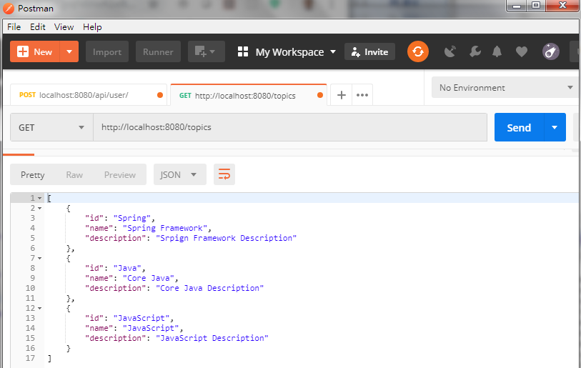
20 Update and Delete
https://www.youtube.com/watch?v=E7_a-kB46LU&list=PLqq-6Pq4lTTbx8p2oCgcAQGQyqN8XeA1x&index=9
Stop and Run Application.
Start postman enter “localhost:8080/topics”
Click “Send”

Slide 6
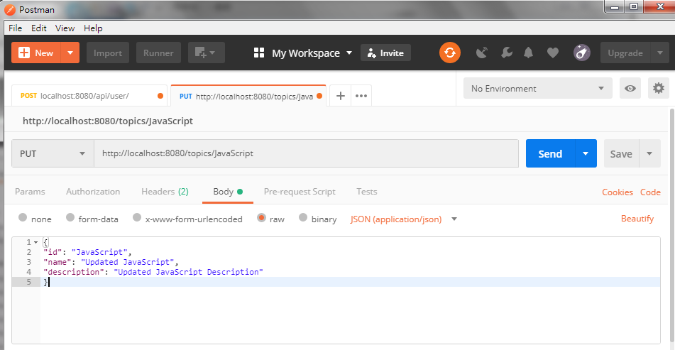
20 Update and Delete
https://www.youtube.com/watch?v=E7_a-kB46LU&list=PLqq-6Pq4lTTbx8p2oCgcAQGQyqN8XeA1x&index=9
Select “PUT” and enter the URL “localhost://8080/topics/JavaScript”
Click “Body” and enter the data for JavaScript as below.
Note: Only URL ID and Body ID totally match, then it will be update.
Our URL topics/{id} = “JavaScript” have to match upper lower case.
Body id= “JavaScript” has also Upper lower case.

Slide 7
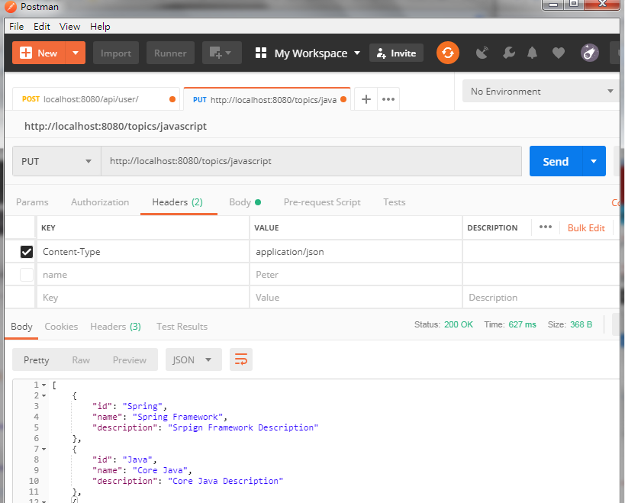
20 Update and Delete
https://www.youtube.com/watch?v=E7_a-kB46LU&list=PLqq-6Pq4lTTbx8p2oCgcAQGQyqN8XeA1x&index=9
Check the headers: KEY = “Content-Type”, VALUE = “application/json”

Slide 8
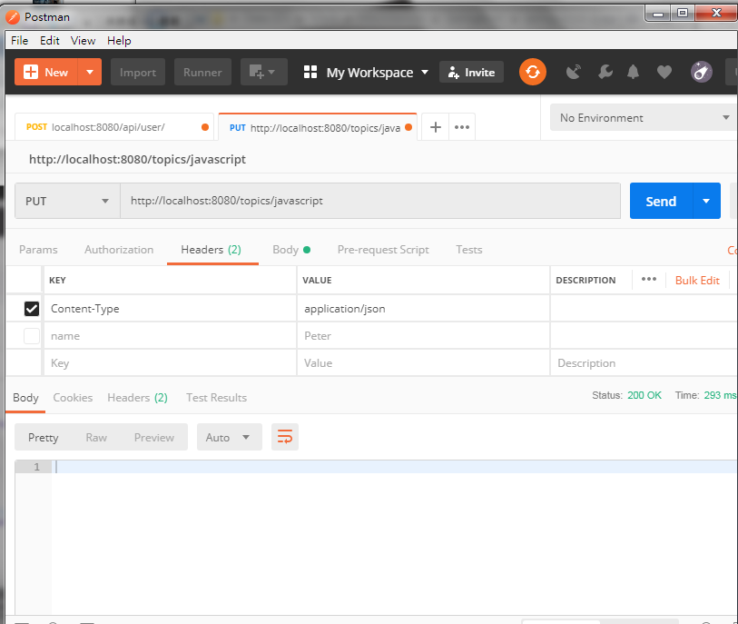
20 Update and Delete
https://www.youtube.com/watch?v=E7_a-kB46LU&list=PLqq-6Pq4lTTbx8p2oCgcAQGQyqN8XeA1x&index=9
Click “Send”. We did not get any error.

Slide 9
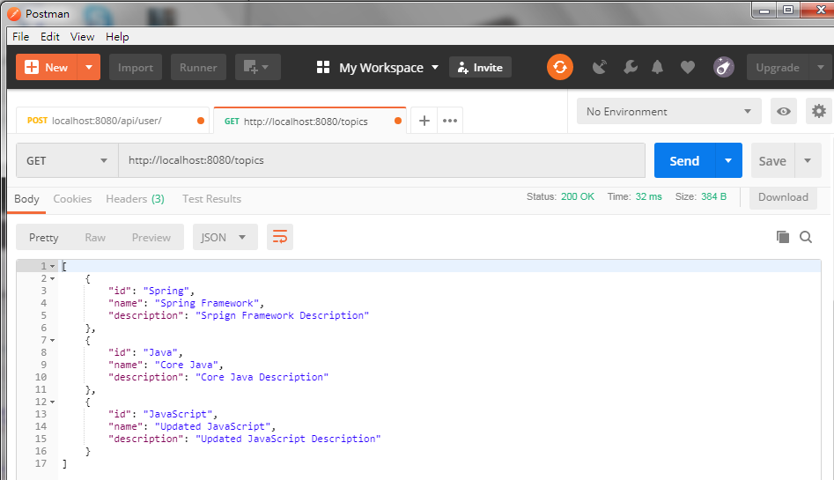
20 Update and Delete
https://www.youtube.com/watch?v=E7_a-kB46LU&list=PLqq-6Pq4lTTbx8p2oCgcAQGQyqN8XeA1x&index=9
Change to “GET” and “localhost:8080/topics”.
We will see Updated Information in name =“Updated JavaScript” and in description = “Updated JavaScript Description”.

Slide 10
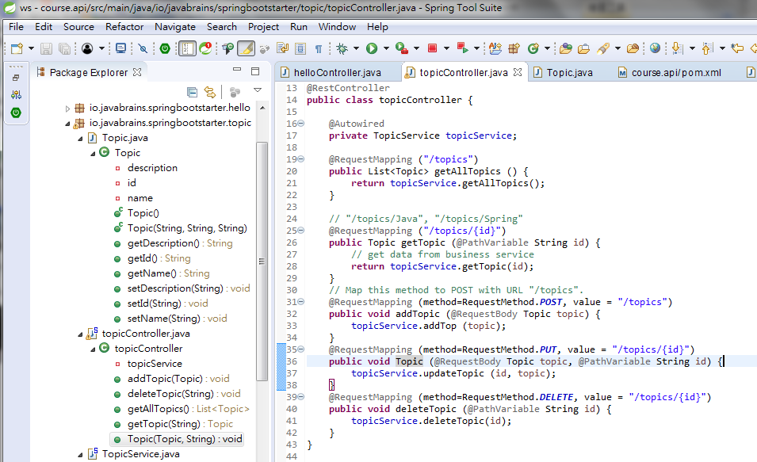
20 Update and Delete
https://www.youtube.com/watch?v=E7_a-kB46LU&list=PLqq-6Pq4lTTbx8p2oCgcAQGQyqN8XeA1x&index=9
Add DELETE in topicController

Slide 11
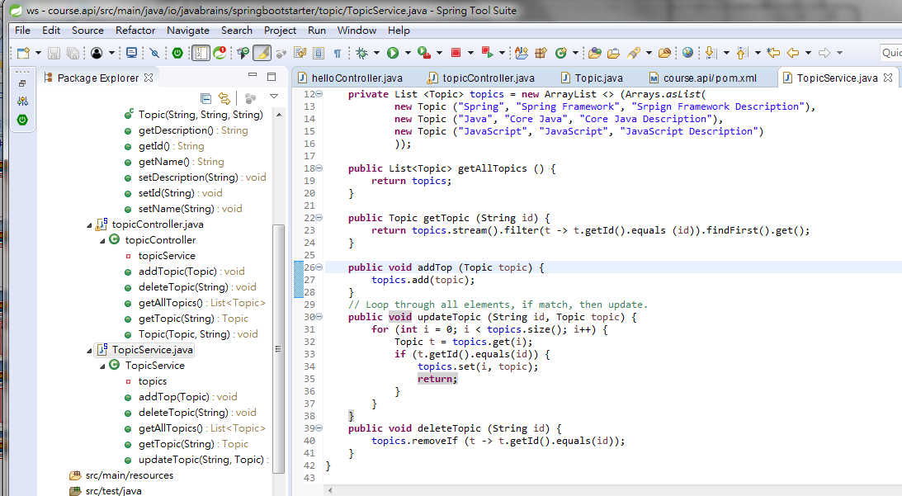
20 Update and Delete
https://www.youtube.com/watch?v=E7_a-kB46LU&list=PLqq-6Pq4lTTbx8p2oCgcAQGQyqN8XeA1x&index=9
Add DELETE in topicService

Slide 12
20 Update and Delete
https://www.youtube.com/watch?v=E7_a-kB46LU&list=PLqq-6Pq4lTTbx8p2oCgcAQGQyqN8XeA1x&index=9
Use postman to insert “javaee” and then delete “javaee”

Slide 13
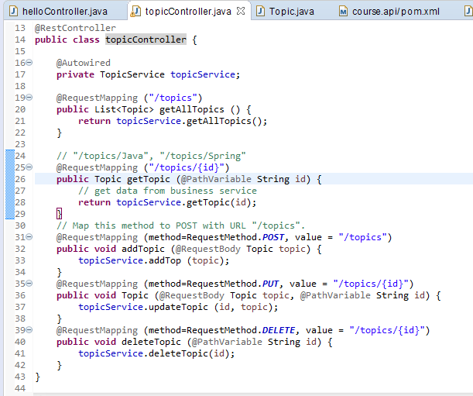
20 Update and Delete
https://www.youtube.com/watch?v=E7_a-kB46LU&list=PLqq-6Pq4lTTbx8p2oCgcAQGQyqN8XeA1x&index=9
We have GET, POST (Create), DELETE, UPDATE,

Slide 14
End of Chapter

