Slide 1

21 Unit 3 Overview
Peter H. Chen

Slide 2
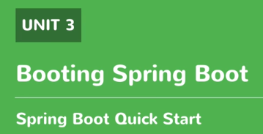
21 Unit Overview
https://www.youtube.com/watch?v=E7_a-kB46LU&list=PLqq-6Pq4lTTbx8p2oCgcAQGQyqN8XeA1x&index=9
Booting Spring boot, we will look at other way of spring boot.
We have one way in unit 1. We create a simple maven project, add the required dependencies ourselves, and run as a maven application. This is valid way to run sprint boot application.
But, there are a couple ways. You may be have preference to do that. We will run through different ways to do that.
Create a brand new application with spring boot.

Slide 3
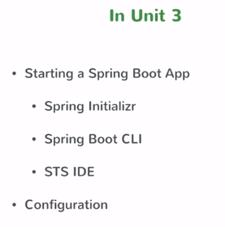
21 Unit Overview
https://www.youtube.com/watch?v=E7_a-kB46LU&list=PLqq-6Pq4lTTbx8p2oCgcAQGQyqN8XeA1x&index=9
We will use the online tool, called the spring intializr.
Then, we will look at Spring Boot CLI
STST IDE
Finally, we will move onto configuring your spring boot application.
No matter which option you choose to create it.
By the end of unit, you can create spring boot app using one of multiple options that you have and do some basic configuration.
So, get started.

Slide 4
End of Chapter

