Slide 1

14 Embedded Service
Peter H. Chen

Slide 2
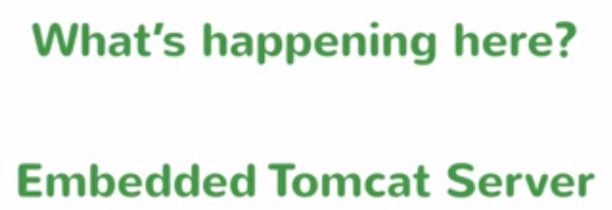
14 Embedded Service
https://www.youtube.com/watch?v=E7_a-kB46LU&list=PLqq-6Pq4lTTbx8p2oCgcAQGQyqN8XeA1x&index=9
What is happening here? Embedded Tomcat Server.
We do not have to download the tomcat server to run the spring boot application.

Slide 3
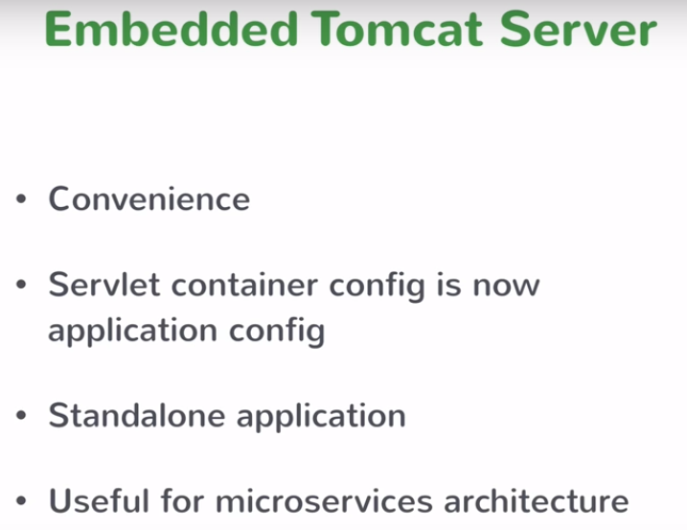
14 Embedded Service
https://www.youtube.com/watch?v=E7_a-kB46LU&list=PLqq-6Pq4lTTbx8p2oCgcAQGQyqN8XeA1x&index=9
Tomcat server came with spring boot server. I do not have to find the servlet container.

Slide 4
14 Embedded Service
https://www.youtube.com/watch?v=E7_a-kB46LU&list=PLqq-6Pq4lTTbx8p2oCgcAQGQyqN8XeA1x&index=9
Tomcat server came with spring boot server. I do not have to find the servlet container.
There are couple of reasons that the spring boot decide to have the embedded tomcat server.
For the application developer, they do not need to download the tomcat server and install it. It greatly save the development time.
There are some servlet configuration, the servlet container configuration. We need to apply something to tomcat. You have to configure something on Tomcat. Most of times are defaults. Now, spring boot configure for us. Every one can run your application without configuration servlet container.
Standalone application is very important, it is easy to deploy, it is easy to try, easy to run, and also easy to develop. It is the goals of spring boot project in order to provide a standalone application to easy to execute.
Spring boot have a bunch of micro-services. You don’t want to have additional step for micro-services. That is why embedded tomcat is convenient to have. You have one command to run application, tomcat server, and servlet container. You can choose other server by the specifying the dependency in pom.xml.

Slide 5
End of Chapter

