Slide 1

24 Spring Boot IDE
Peter H. Chen

Slide 2
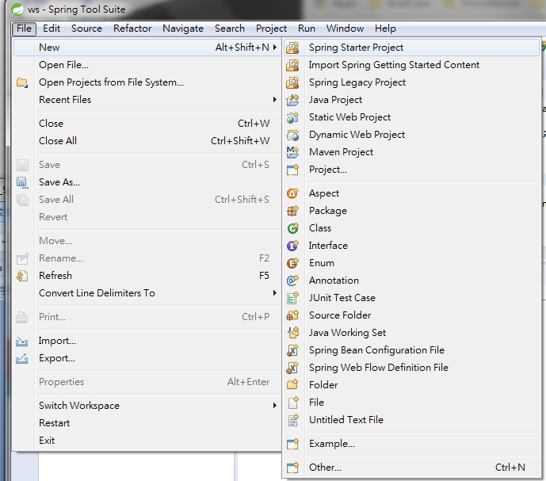
24 Spring Boot IDE
https://www.youtube.com/watch?v=E7_a-kB46LU&list=PLqq-6Pq4lTTbx8p2oCgcAQGQyqN8XeA1x&index=9
Another way to start is using Spring Boot IDE.
File > New > Spring Starter Project

Slide 3
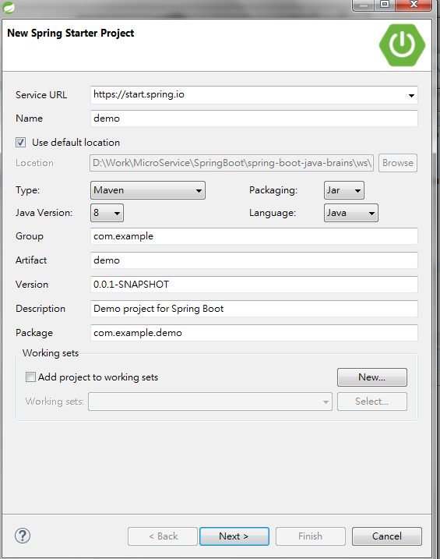
24 Spring Boot IDE
https://www.youtube.com/watch?v=E7_a-kB46LU&list=PLqq-6Pq4lTTbx8p2oCgcAQGQyqN8XeA1x&index=9
Another way to start is using Spring Boot IDE.
File > New > Spring Starter Project

Slide 4
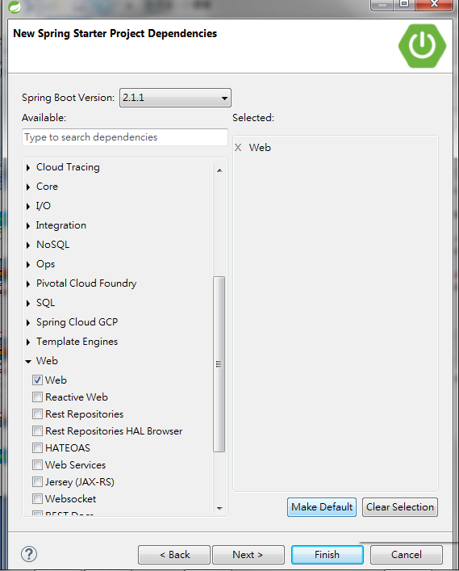
24 Spring Boot IDE
https://www.youtube.com/watch?v=E7_a-kB46LU&list=PLqq-6Pq4lTTbx8p2oCgcAQGQyqN8XeA1x&index=9
Select web

Slide 5
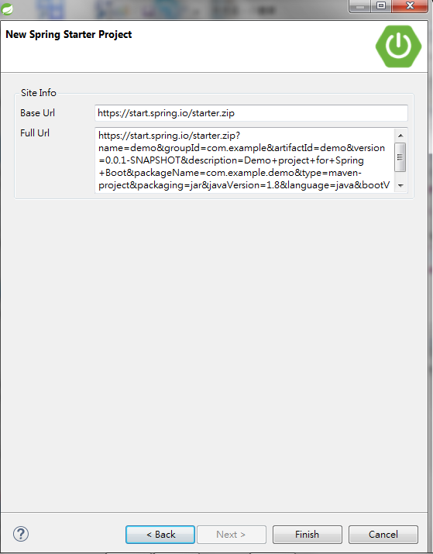
24 Spring Boot IDE
https://www.youtube.com/watch?v=E7_a-kB46LU&list=PLqq-6Pq4lTTbx8p2oCgcAQGQyqN8XeA1x&index=9
There is a zip file: https://start.spring.io/starter.zip

Slide 6
24 Spring Boot IDE
https://www.youtube.com/watch?v=E7_a-kB46LU&list=PLqq-6Pq4lTTbx8p2oCgcAQGQyqN8XeA1x&index=9
There are 4 ways to start spring boot:
Unit 1: new Maven Project and New Java Project.
Spring initializr
Sprint Boot CLI
Spring Boot IDE.

Slide 7
End of Chapter

