Slide 1

4 What is Spring?
Peter H. Chen

Slide 2
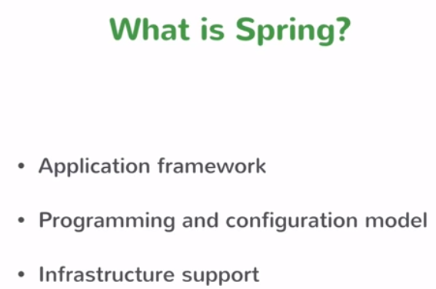
4 What is Spring?
https://www.youtube.com/watch?v=YXlSkWq04jk&list=PLqq-6Pq4lTTbx8p2oCgcAQGQyqN8XeA1x&index=4
To really understand the Spring Boot, we have to understand the Spring.
What is the Spring?

Slide 3
4 What is Spring?
https://www.youtube.com/watch?v=YXlSkWq04jk&list=PLqq-6Pq4lTTbx8p2oCgcAQGQyqN8XeA1x&index=4
To answer the question, Spring is something related to Dependency Injection.
That is the perfect answer of 2006. As for today, it is no longer the case.
Spring is much more than the Dependency Injection.
Spring is the whole application framework. Spring has the origin the concept of Dependency Injection. Spring does a lot of more. Spring is something to build Enterprise Java Application.
There are hundred of zillions of enterprise java applications out there and there are all do things but underlying foundation of all those enterprise Java applications have a lot of similarities.
When you write a business service, you do similar things for every business service no mater what business problem they try to solve. Things like transactional services you want to establish a transaction to connect to the database. Those are common problems. There are common things that every enterprise application needs to solve and Spring handles all the those things.

Slide 4
4 What is Spring?
https://www.youtube.com/watch?v=YXlSkWq04jk&list=PLqq-6Pq4lTTbx8p2oCgcAQGQyqN8XeA1x&index=4
Spring provides a template, Spring provides a framework which lets you build those enterprise applications. Spring also has a programming and configuration model.
Spring lets you focus on building your business services and Spring handles a lot of these common concerns for things like connecting to the database running query. Things like handling HTTP request having MVC layer.
What Spring does is building the classes which are simple POJO. Spring has annotation on them which did not what they are. For example, you are writing business services with the code containing only the logic that is specific to your business application.
Spring annotate that business service in a class. Spring knows the class to be a service and manages the lifecycle of the class. So the class acts as a service.
When you building your application, you focus on your business problem and let Spring handle the rest. Spring provides the model for you to build those applications.
Spring supports infrastructure for database, such as, IBM database or MongoDB. Spring has infrastructure supports for it.

Slide 5
End of Chapter

