Slide 1

32 Deployment
Peter H. Chen

Slide 2
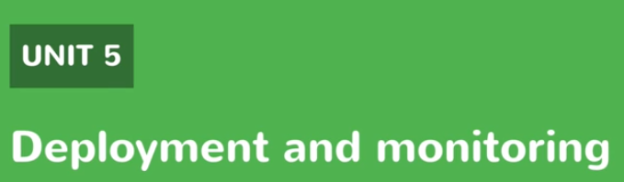
32 Deployment
https://www.youtube.com/watch?v=E7_a-kB46LU&list=PLqq-6Pq4lTTbx8p2oCgcAQGQyqN8XeA1x&index=9
Deployment

Slide 3


32 Deployment
https://www.youtube.com/watch?v=E7_a-kB46LU&list=PLqq-6Pq4lTTbx8p2oCgcAQGQyqN8XeA1x&index=9
On target linux machine.
You just need a java compiler, src folder, and target folder.
> ls
src
target

Slide 4
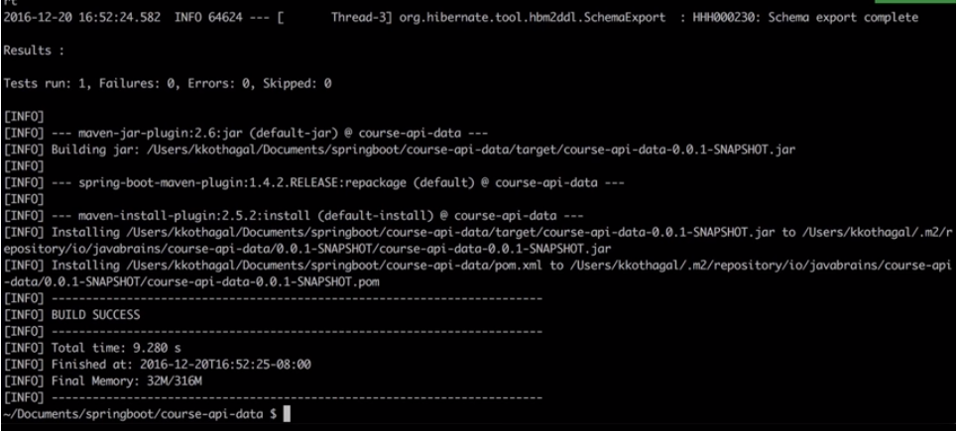
32 Deployment
https://www.youtube.com/watch?v=E7_a-kB46LU&list=PLqq-6Pq4lTTbx8p2oCgcAQGQyqN8XeA1x&index=9
Build the jar file.
> mvn clean install
It will download all the repositories.
Create a jar file

Slide 5
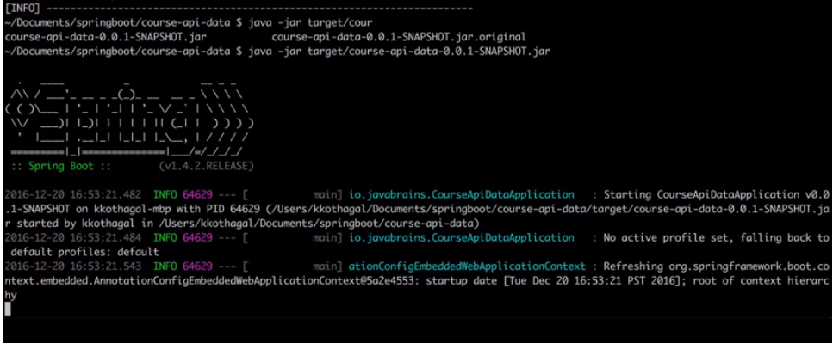
32 Deployment
https://www.youtube.com/watch?v=E7_a-kB46LU&list=PLqq-6Pq4lTTbx8p2oCgcAQGQyqN8XeA1x&index=9
Run jar file:
> jar –jar target/cpurse-api-data-0.0.1-SNAPSHOT.jar

Slide 6
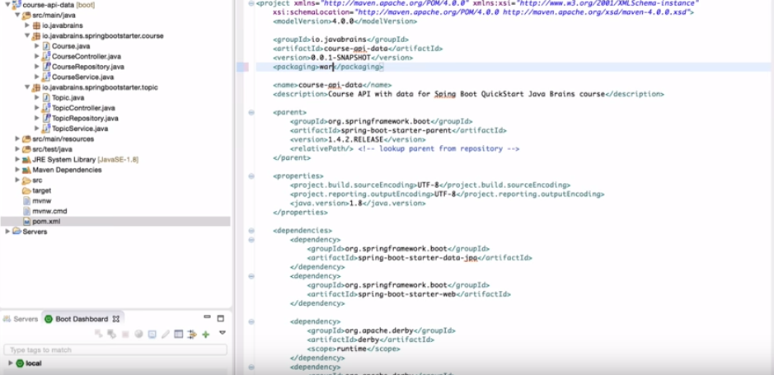
32 Deployment
https://www.youtube.com/watch?v=E7_a-kB46LU&list=PLqq-6Pq4lTTbx8p2oCgcAQGQyqN8XeA1x&index=9
You can run war as well. Just change one line: change jar into war in pom.xml.

Slide 7
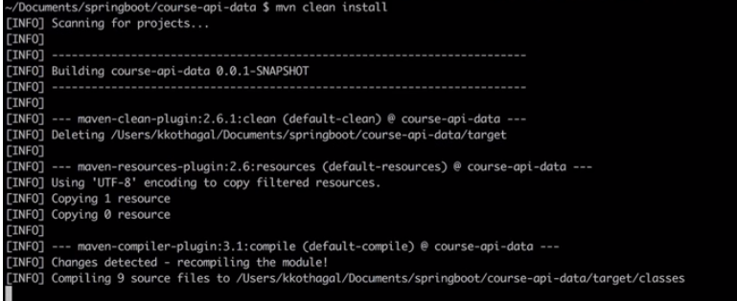
32 Deployment
https://www.youtube.com/watch?v=E7_a-kB46LU&list=PLqq-6Pq4lTTbx8p2oCgcAQGQyqN8XeA1x&index=9
> mvn clean install

Slide 8
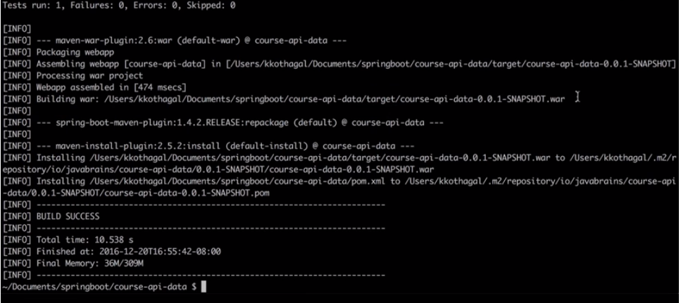
32 Deployment
https://www.youtube.com/watch?v=E7_a-kB46LU&list=PLqq-6Pq4lTTbx8p2oCgcAQGQyqN8XeA1x&index=9
Run the same process. Instead of jar file, we have war file at the same spot.

Slide 9
32 Deployment
https://www.youtube.com/watch?v=E7_a-kB46LU&list=PLqq-6Pq4lTTbx8p2oCgcAQGQyqN8XeA1x&index=9
Run the same process. Instead of jar file, we have war file at the same spot.

Slide 10
End of Chapter

