Slide 1

33 Actuator
Peter H. Chen

Slide 2
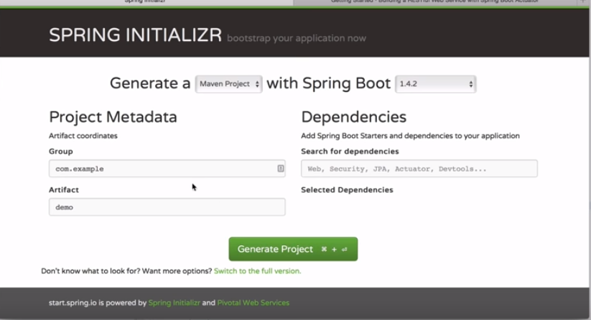
33 Actuator
https://www.youtube.com/watch?v=E7_a-kB46LU&list=PLqq-6Pq4lTTbx8p2oCgcAQGQyqN8XeA1x&index=9
Spring boot initializr: select Actuator

Slide 3
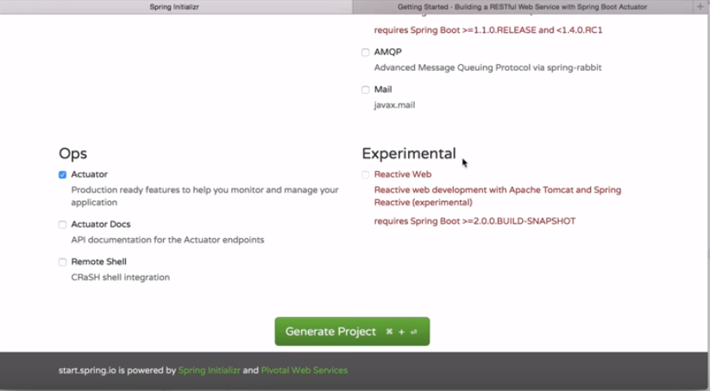
33 Actuator
https://www.youtube.com/watch?v=E7_a-kB46LU&list=PLqq-6Pq4lTTbx8p2oCgcAQGQyqN8XeA1x&index=9
Select Actuator.

Slide 4
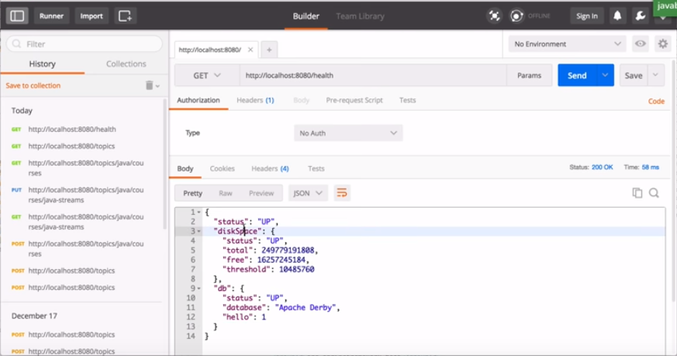
33 Actuator
https://www.youtube.com/watch?v=E7_a-kB46LU&list=PLqq-6Pq4lTTbx8p2oCgcAQGQyqN8XeA1x&index=9
Postman: You can use health through the actuator. Check the diskspace and database.

Slide 5
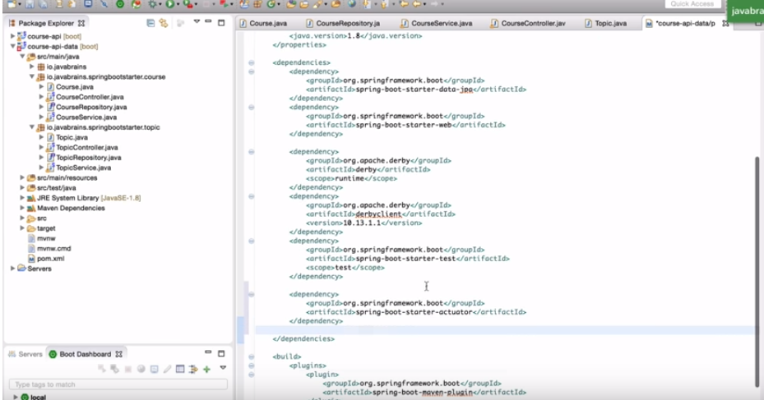
33 Actuator
https://www.youtube.com/watch?v=E7_a-kB46LU&list=PLqq-6Pq4lTTbx8p2oCgcAQGQyqN8XeA1x&index=9
Add dependencies: Actuator is a group of binaries to add the classpath to enable the a few features.

Slide 6
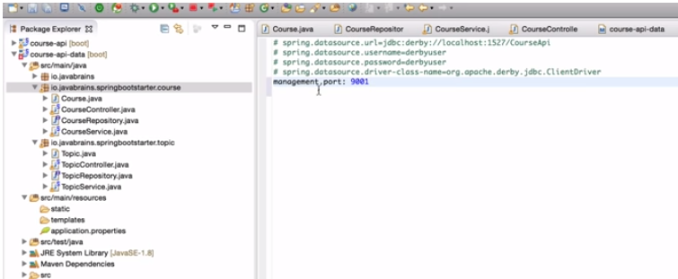
33 Actuator
https://www.youtube.com/watch?v=E7_a-kB46LU&list=PLqq-6Pq4lTTbx8p2oCgcAQGQyqN8XeA1x&index=9
Setup application.properties: management.port: 9001

Slide 7
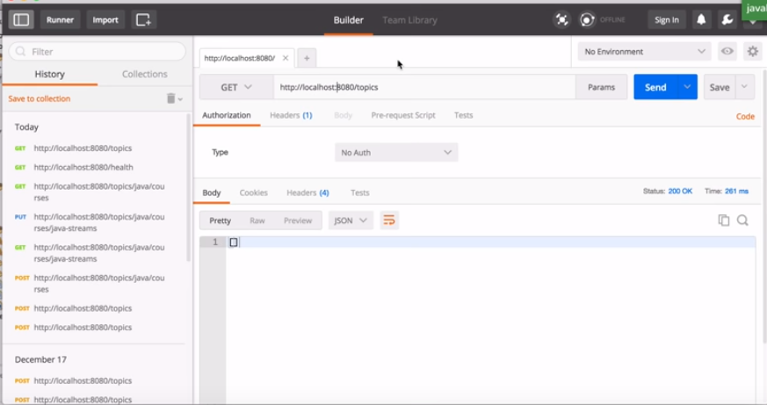
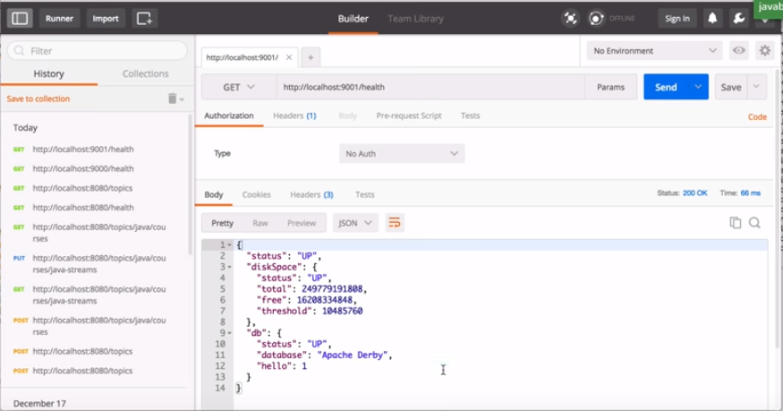
33 Actuator
https://www.youtube.com/watch?v=E7_a-kB46LU&list=PLqq-6Pq4lTTbx8p2oCgcAQGQyqN8XeA1x&index=9
It can access for application itself of port 8080 and it also access actuator endpoint 9001.
Actuator provides you the different URL.

Slide 8
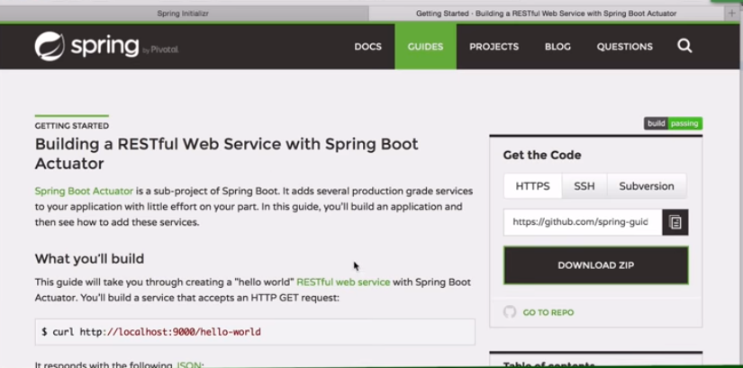
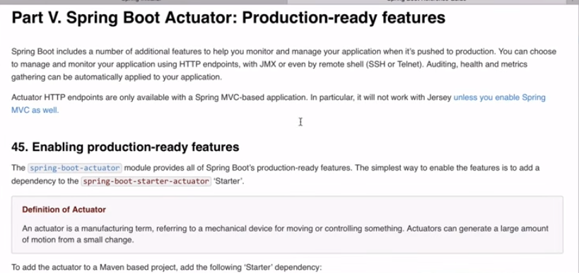
33 Actuator
https://www.youtube.com/watch?v=E7_a-kB46LU&list=PLqq-6Pq4lTTbx8p2oCgcAQGQyqN8XeA1x&index=9
Spring boot actuator web site.

Slide 9
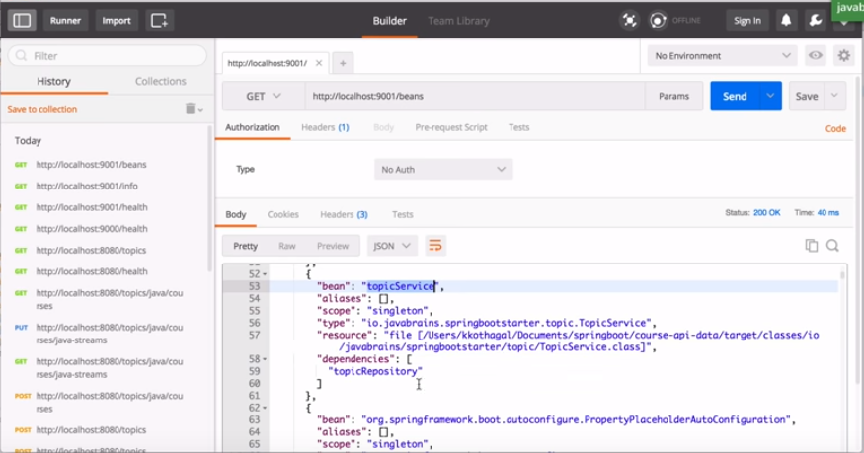
33 Actuator
https://www.youtube.com/watch?v=E7_a-kB46LU&list=PLqq-6Pq4lTTbx8p2oCgcAQGQyqN8XeA1x&index=9
Spring boot actuator I super useful to check the health of web server and associated information.

Slide 10
End of Chapter

