Slide 1

18 Get Single Resource
Peter H. Chen

Slide 2
18 Get Single Resource
https://www.youtube.com/watch?v=E7_a-kB46LU&list=PLqq-6Pq4lTTbx8p2oCgcAQGQyqN8XeA1x&index=9
In chapter, we implement “/topics/id”, such as, “localhost:8080/topics/Spring”, “localhost:8080/topics/Java”, or “localhost:8080/topics/JavaScript”.
We will have API with only one topic.
How do we do in spring MVC?
First, we need to write the method to execute when URL is accessed.
Second, we need to put the request mapping annotation on the method.
How do we do that? Let’s create a public method

Slide 3
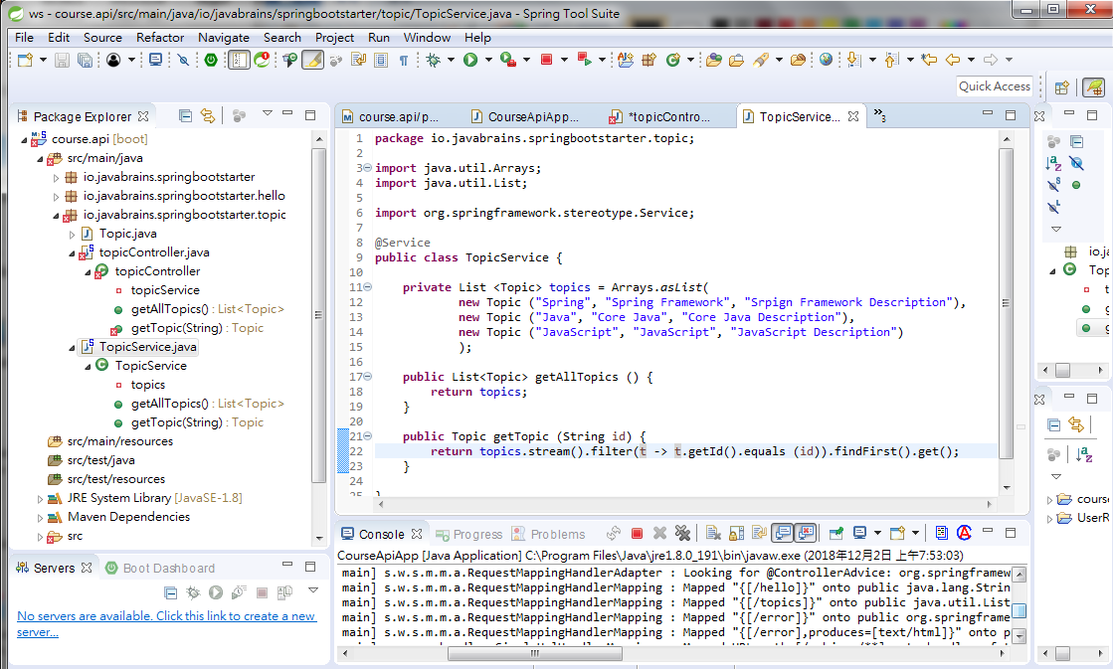
18 Get Single Resource
https://www.youtube.com/watch?v=E7_a-kB46LU&list=PLqq-6Pq4lTTbx8p2oCgcAQGQyqN8XeA1x&index=9
Business Service: topics.stream.filter (lambda expression).findFrst.get();
We topics is a Arrays of object. The streams take one of object and filter out wit getID = id.
defined function the getId() is a method defined in class Topic

Slide 4
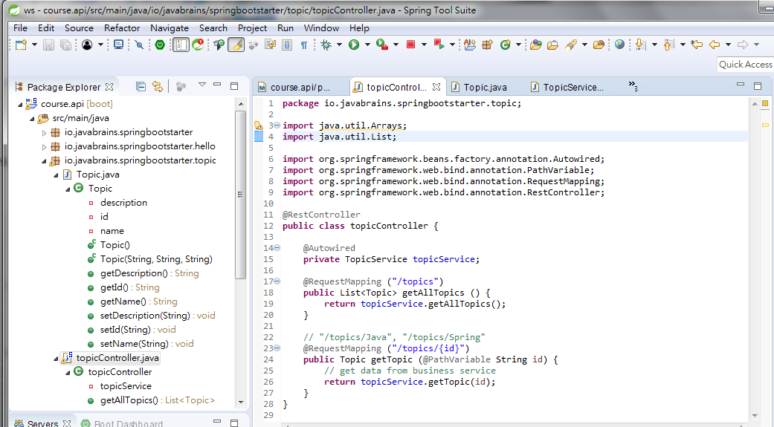
18 Get Single Resource
https://www.youtube.com/watch?v=E7_a-kB46LU&list=PLqq-6Pq4lTTbx8p2oCgcAQGQyqN8XeA1x&index=9
@RequestMapping (“/topics/{id}”) tell path is “topics/{id}” where id =“Spring”, “Java”, or “JavaScript”.
@PathVarible tell the spring, the passing variable is “id”.

Slide 5
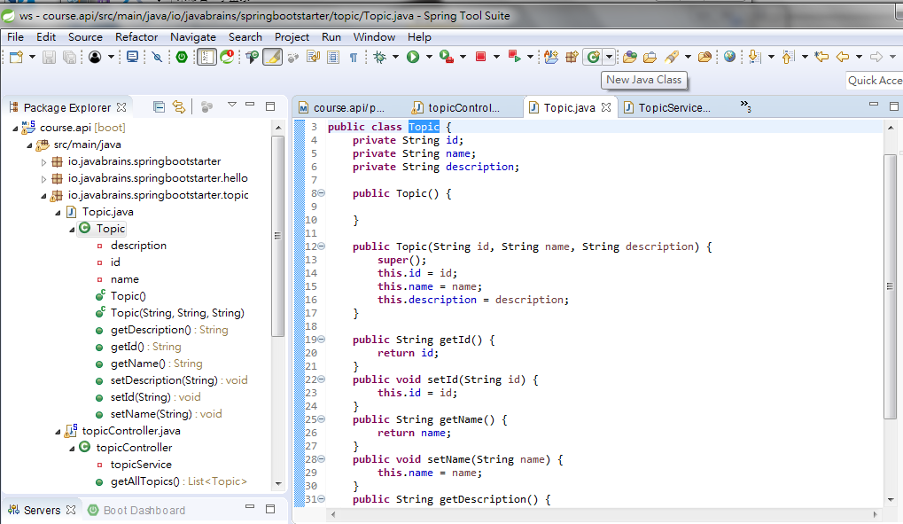
18 Get Single Resource
https://www.youtube.com/watch?v=E7_a-kB46LU&list=PLqq-6Pq4lTTbx8p2oCgcAQGQyqN8XeA1x&index=9
getId: filter (t->t.getId) are associated data structure are defined in Topic.java previously.

Slide 6
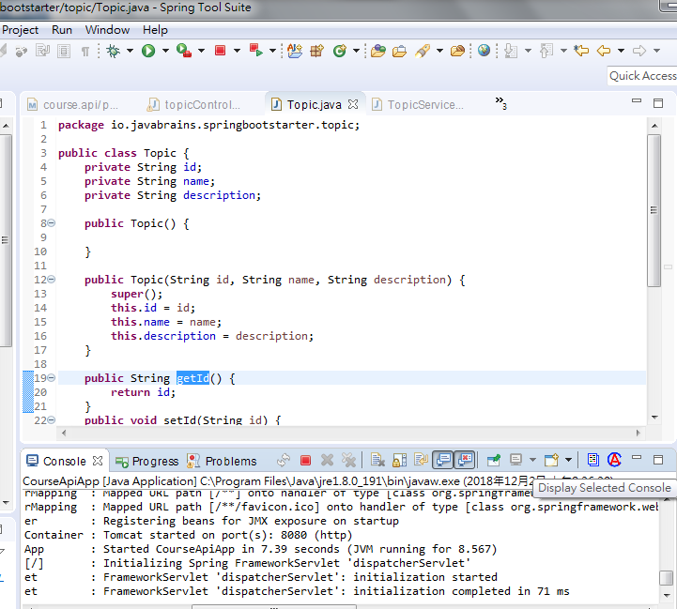
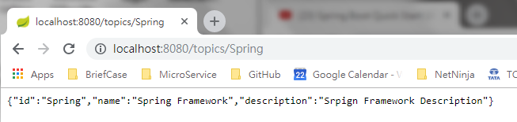
18 Get Single Resource
https://www.youtube.com/watch?v=E7_a-kB46LU&list=PLqq-6Pq4lTTbx8p2oCgcAQGQyqN8XeA1x&index=9
Stop and Run
Check Port 8080
Open Chrome and enter “localhost:8080/topics/Sping”

Slide 7
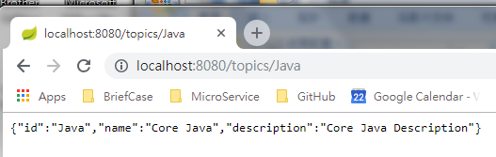
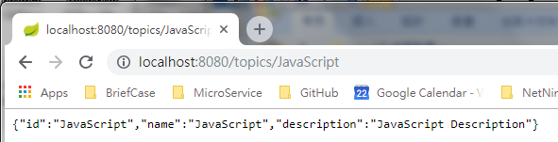
18 Get Single Resource
https://www.youtube.com/watch?v=E7_a-kB46LU&list=PLqq-6Pq4lTTbx8p2oCgcAQGQyqN8XeA1x&index=9
Stop and Run
Check Port 8080
Open Chrome and enter “localhost:8080/topics/Spring”, “localhost:8080/topics/Java”, or “localhost:8080/topics/JavaScript”.

Slide 8
End of Chapter

