Slide 1

5 Spring Boot Function
Peter H. Chen

Slide 2
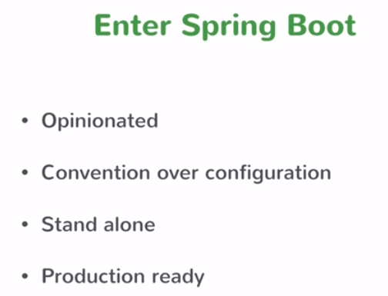
5 Spring Boot Function
https://www.youtube.com/watch?v=cONbHJ9azvw&list=PLqq-6Pq4lTTbx8p2oCgcAQGQyqN8XeA1x&index=5
Enter Spring Boot:

Slide 3
5 Spring Boot Function
https://www.youtube.com/watch?v=cONbHJ9azvw&list=PLqq-6Pq4lTTbx8p2oCgcAQGQyqN8XeA1x&index=5
Enter Spring Boot:
Opinionated: Spring Boot is opinionated. This is a good starting point. Spring Boot makes certain configuration choice. It makes certain decision for you say OK: “Start with this, then see what to do, and then see what to change things if required.”
Convention over Configuration: Spring Boot is convention over configuration concept if you had to do hundred different things in order to configurate something that says again let’s look at the 80% case and that be the default only and configure 20% if you want things later. For 80%, there is no configuration necessary.
Stand alone: The Spring Boot Application is a stand alone application. What is stand alone? Typically, when you build a Sprint application, you are building a war file, you are building a web application that you apply to a Tomcat container or some other servlet container. But the Spring boot would what you get is a stand alone application. What you get is something that you can “Just Run” and have it start a web server. You do not have to find a servlet container to deploy to. The output of String is just ready to run right there. You do not have to find a servlet container, configure it, and deploy it. None of that stuff is required. Just run a command and it transit stand alone application.
Production Ready: Spring Boot is production ready. You do not have to do anything extra to get it ready for production. You just take that and apply to production.

Slide 4
End of Chapter

