Slide 1

31 Mapping
Peter H. Chen

Slide 2
31 Mapping
https://www.youtube.com/watch?v=E7_a-kB46LU&list=PLqq-6Pq4lTTbx8p2oCgcAQGQyqN8XeA1x&index=9
First question: How to let spring JPA know the topic is the foreign key to the primary key of topic table?
Second Question: How to we get all the courses of a particular topic?

Slide 3
31 Mapping
https://www.youtube.com/watch?v=E7_a-kB46LU&list=PLqq-6Pq4lTTbx8p2oCgcAQGQyqN8XeA1x&index=9
How do we map the course into the topic?
This is a many to one relationship: JPA Annotation “@ManyToOne”
@Entity
public class Topic {
@OneToMany
private Topic topic
}
@Entity
public class course {
@ManyToOne
private Topic topic;
}

Slide 4
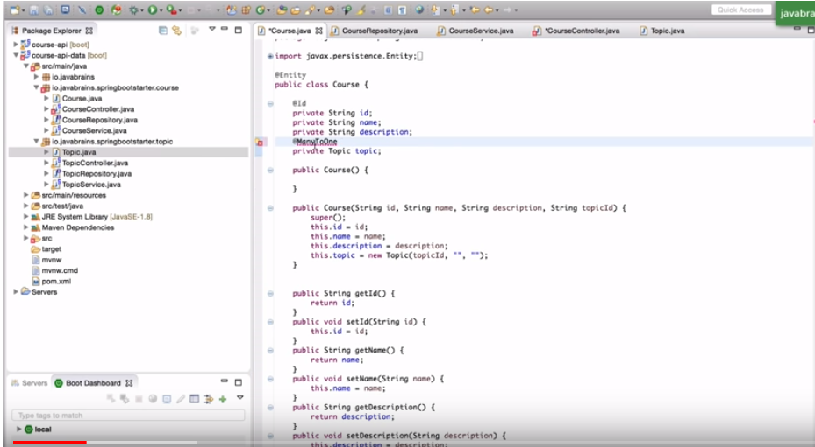
31 Mapping
https://www.youtube.com/watch?v=E7_a-kB46LU&list=PLqq-6Pq4lTTbx8p2oCgcAQGQyqN8XeA1x&index=9
Add JPA Annotation “@ManyToOne”

Slide 5
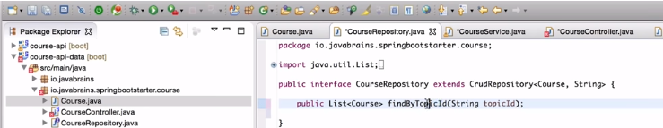
31 Mapping
https://www.youtube.com/watch?v=E7_a-kB46LU&list=PLqq-6Pq4lTTbx8p2oCgcAQGQyqN8XeA1x&index=9
Get all the Courses by topic ID.
Spring Boot way to find All courses in the Course Table by topic ID.

Slide 6
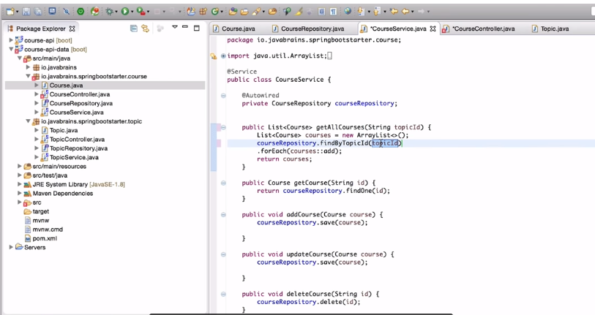
31 Mapping
https://www.youtube.com/watch?v=E7_a-kB46LU&list=PLqq-6Pq4lTTbx8p2oCgcAQGQyqN8XeA1x&index=9
Get all the courses by Topic ID.
Get all the courses by topic ID.

Slide 7
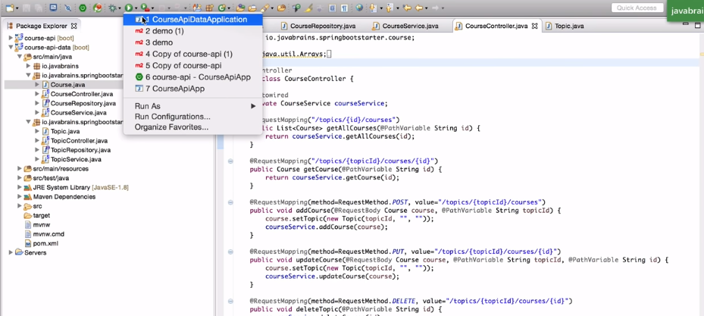
31 Mapping
https://www.youtube.com/watch?v=E7_a-kB46LU&list=PLqq-6Pq4lTTbx8p2oCgcAQGQyqN8XeA1x&index=9
Save and Execute.

Slide 8
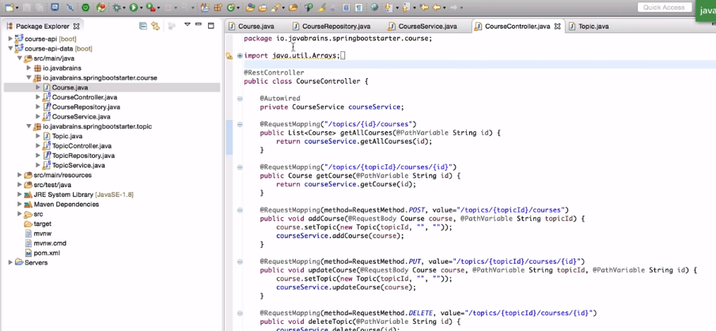
31 Mapping
https://www.youtube.com/watch?v=E7_a-kB46LU&list=PLqq-6Pq4lTTbx8p2oCgcAQGQyqN8XeA1x&index=9
Change the REST controller.

Slide 9
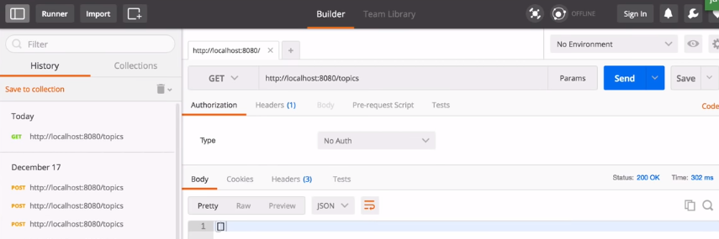
31 Mapping
https://www.youtube.com/watch?v=E7_a-kB46LU&list=PLqq-6Pq4lTTbx8p2oCgcAQGQyqN8XeA1x&index=9
Get the topic. Did not get anything.

Slide 10
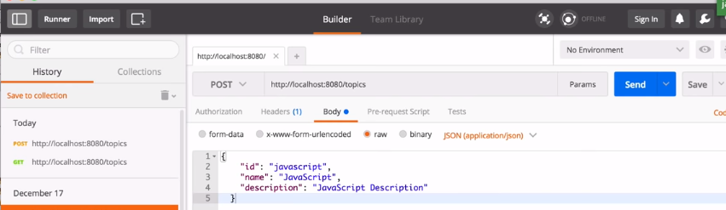
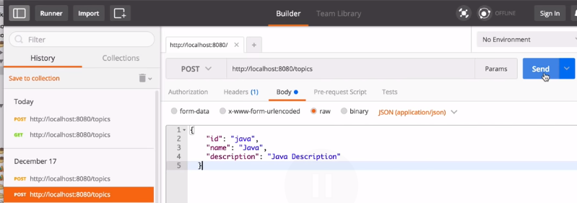
31 Mapping
https://www.youtube.com/watch?v=E7_a-kB46LU&list=PLqq-6Pq4lTTbx8p2oCgcAQGQyqN8XeA1x&index=9
Post JavaScript.
Post Java.

Slide 11
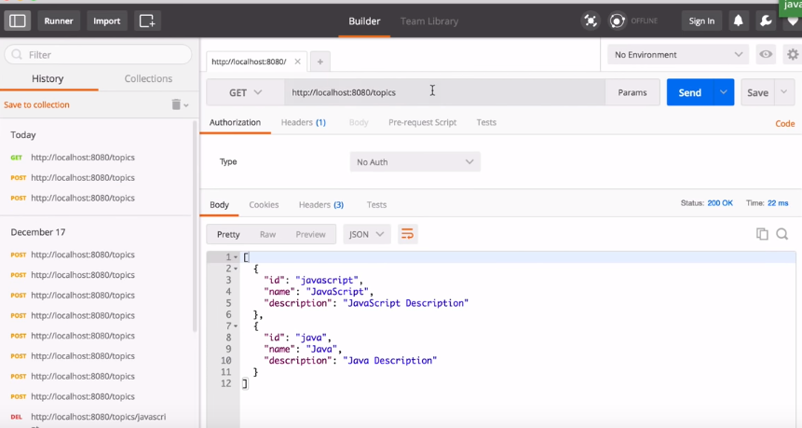
31 Mapping
https://www.youtube.com/watch?v=E7_a-kB46LU&list=PLqq-6Pq4lTTbx8p2oCgcAQGQyqN8XeA1x&index=9
Now we have JavaScript and Java.

Slide 12
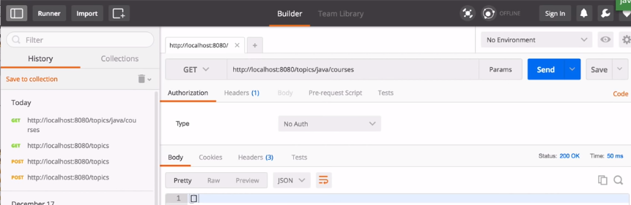
31 Mapping
https://www.youtube.com/watch?v=E7_a-kB46LU&list=PLqq-6Pq4lTTbx8p2oCgcAQGQyqN8XeA1x&index=9
We will create courses.
If we query the course. We got nothing.

Slide 13
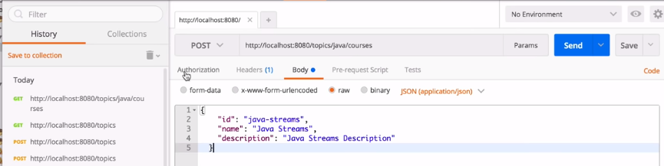
31 Mapping
https://www.youtube.com/watch?v=E7_a-kB46LU&list=PLqq-6Pq4lTTbx8p2oCgcAQGQyqN8XeA1x&index=9
We make a POST.

Slide 14
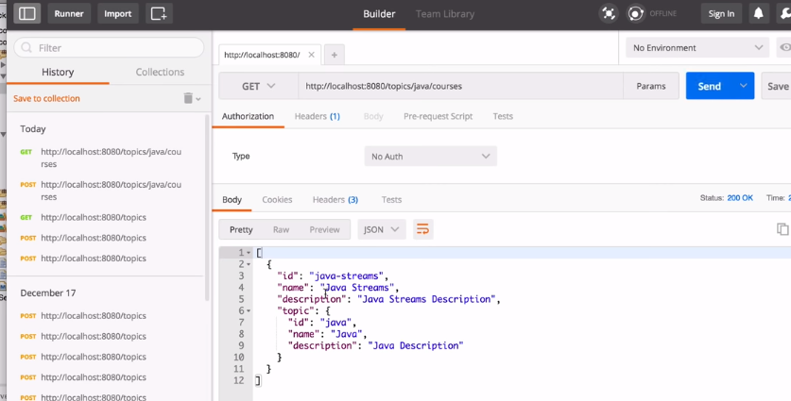
31 Mapping
https://www.youtube.com/watch?v=E7_a-kB46LU&list=PLqq-6Pq4lTTbx8p2oCgcAQGQyqN8XeA1x&index=9
We send a get for topics/java/courses.

Slide 15
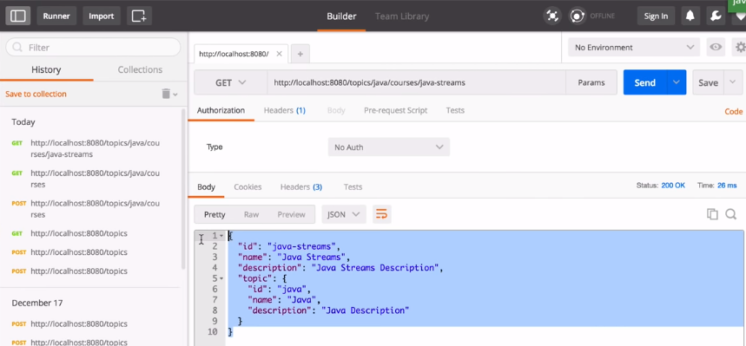
31 Mapping
https://www.youtube.com/watch?v=E7_a-kB46LU&list=PLqq-6Pq4lTTbx8p2oCgcAQGQyqN8XeA1x&index=9
We send a get for topics/java/courses/java-streams.

Slide 16
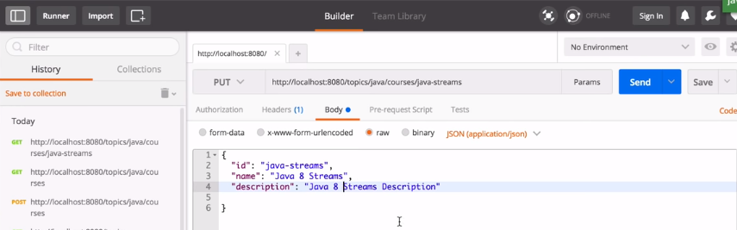
31 Mapping
https://www.youtube.com/watch?v=E7_a-kB46LU&list=PLqq-6Pq4lTTbx8p2oCgcAQGQyqN8XeA1x&index=9
We send a put for topics/java/courses/java-streams.

Slide 17
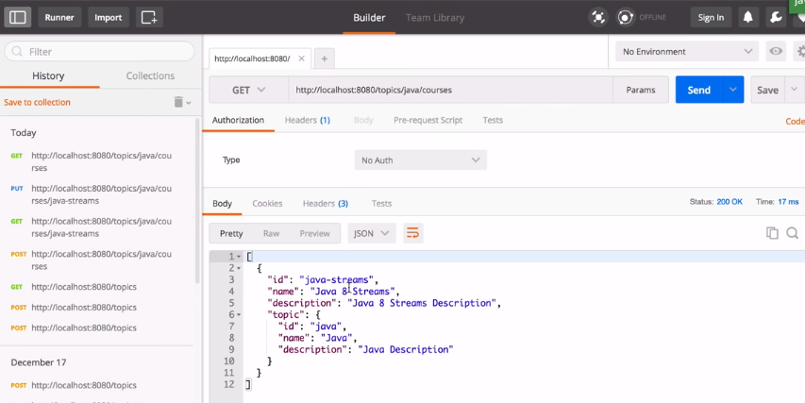
31 Mapping
https://www.youtube.com/watch?v=E7_a-kB46LU&list=PLqq-6Pq4lTTbx8p2oCgcAQGQyqN8XeA1x&index=9
We send a get for topics/java/courses.

Slide 18
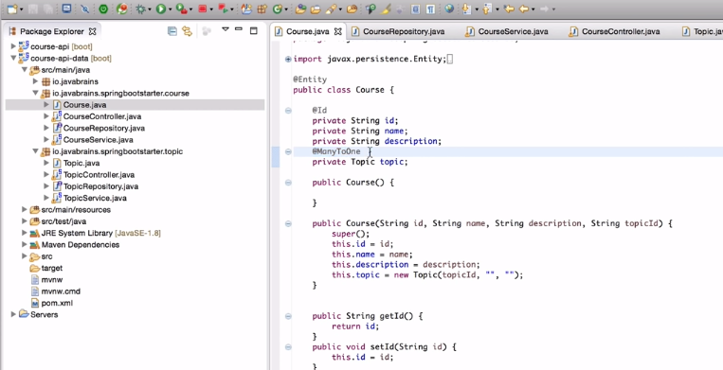
31 Mapping
https://www.youtube.com/watch?v=E7_a-kB46LU&list=PLqq-6Pq4lTTbx8p2oCgcAQGQyqN8XeA1x&index=9
This is q quick introduction of JPA.
The Spring boot help us to build the entity class and map into the relationship.
First, we need “@ManyToOne” annotation.

Slide 19
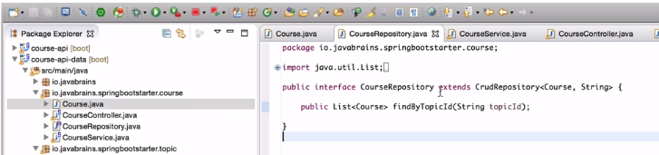
31 Mapping
https://www.youtube.com/watch?v=E7_a-kB46LU&list=PLqq-6Pq4lTTbx8p2oCgcAQGQyqN8XeA1x&index=9
Second, we can define a bunch of method in the interface. For simple CRUD, you do not have to do anything. However, if you find particular field, you need to create a method in the repository interface.
You do not have to implement it, you just need to declare it. The key is the name of the method.
Method name should be “findBy” and then the property “TopicId”. The property is an object.

Slide 20
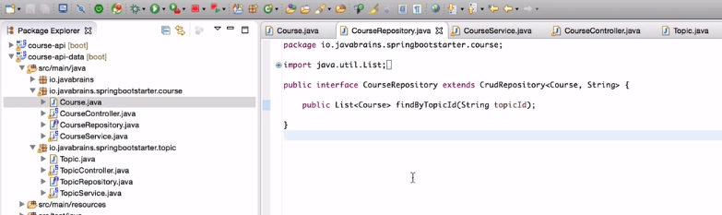
31 Mapping
https://www.youtube.com/watch?v=E7_a-kB46LU&list=PLqq-6Pq4lTTbx8p2oCgcAQGQyqN8XeA1x&index=9
If we wan to have lessons. You can continue to develop more similar functionalities.

Slide 21
End of Chapter

