Slide 1

8 Spring Boot Project
Peter H. Chen

Slide 2
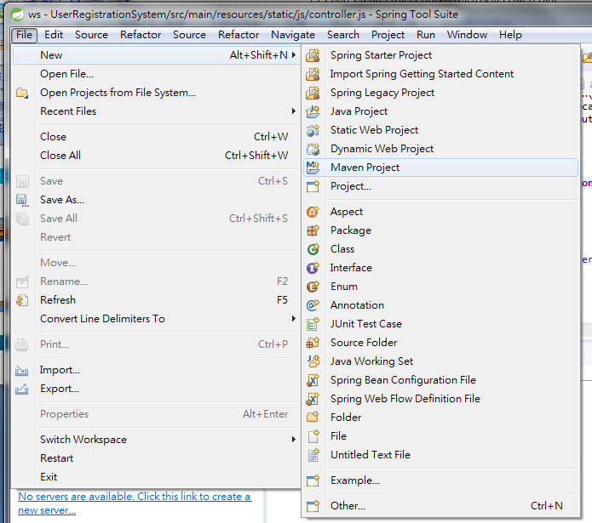
8 Spring Boot Project
https://www.youtube.com/watch?v=E7_a-kB46LU&list=PLqq-6Pq4lTTbx8p2oCgcAQGQyqN8XeA1x&index=9
Start from New Maven Project: File > New > Maven Project
We will create a simple maven project and add the Spring Dependencies.

Slide 3
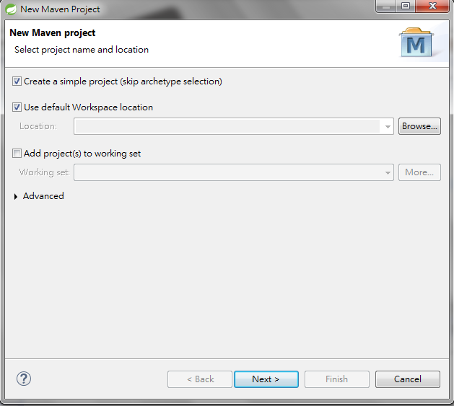
8 Spring Boot Project
https://www.youtube.com/watch?v=E7_a-kB46LU&list=PLqq-6Pq4lTTbx8p2oCgcAQGQyqN8XeA1x&index=9
The default is uncheck, we can get a default pom.xml.
We will do our own maven. Here we check it.
Click Next.

Slide 4
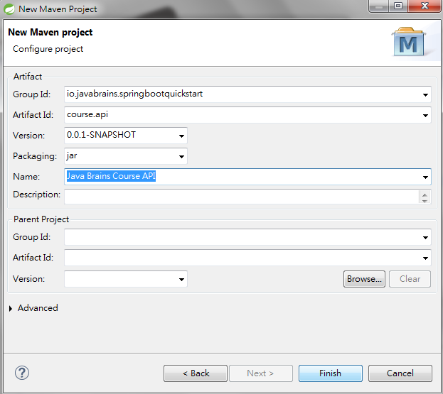
8 Spring Boot Project
https://www.youtube.com/watch?v=E7_a-kB46LU&list=PLqq-6Pq4lTTbx8p2oCgcAQGQyqN8XeA1x&index=9
Group ID likes package name. Unique identify the namespace of my project: we choose “io.javabrains.springbootquickstart”.
Artifact is like a project name: We choose “course.api”
Version is version of component: 0.0.1-SNAPSHOT is the styling version.
Name: more details of name “Java Brains Course API”

Slide 5
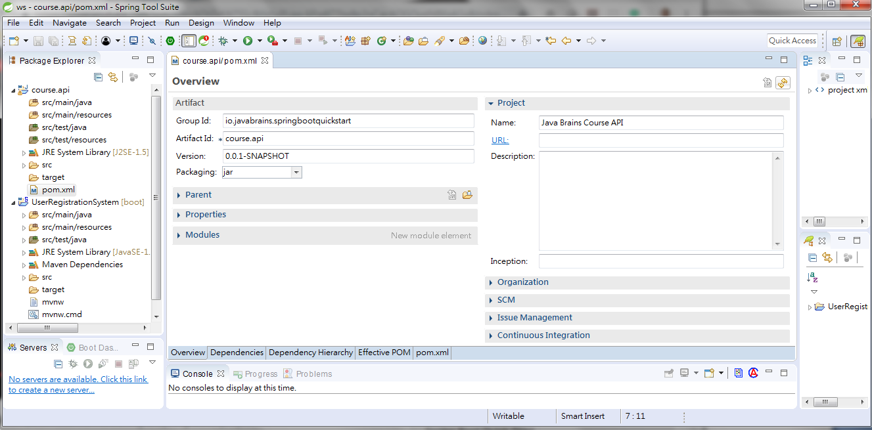
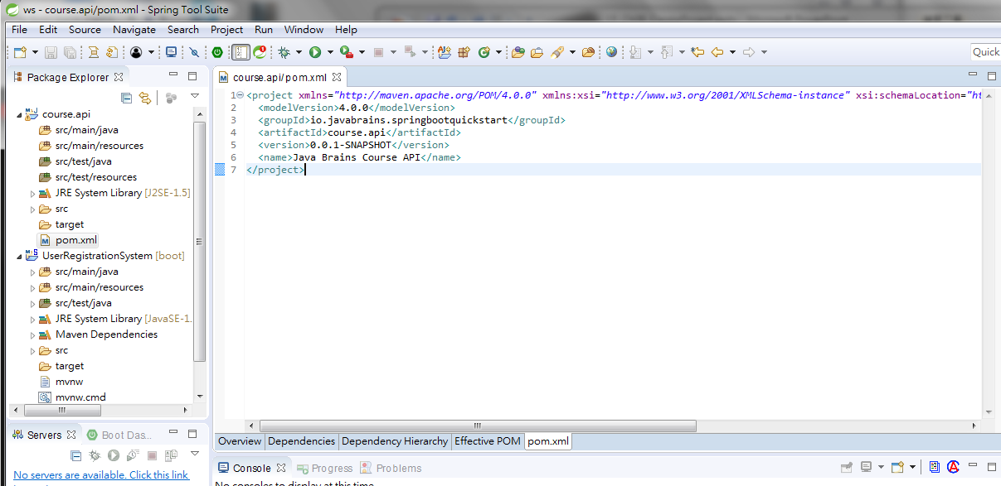
8 Spring Boot Project
https://www.youtube.com/watch?v=E7_a-kB46LU&list=PLqq-6Pq4lTTbx8p2oCgcAQGQyqN8XeA1x&index=9
We are going to download a simple template and going to create the project here.
The “course.api” is the project created and with a bunch of source folders. These folders are empty right now.
It has one dependency which is “JRE System Library [JRE-1.5]
Here is the pom.xml. You can declare the dependencies. Double click pom.xml.
Click the tab below for different view of pom.xml. We got very simple pom.xml.

Slide 6
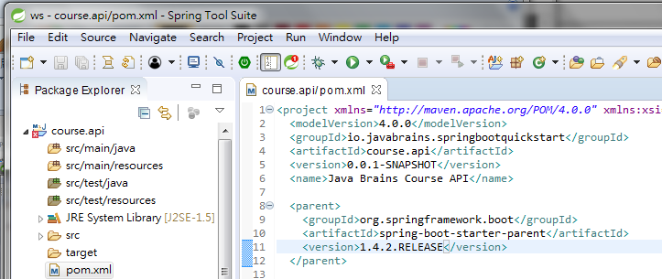
8 Spring Boot Project
https://www.youtube.com/watch?v=E7_a-kB46LU&list=PLqq-6Pq4lTTbx8p2oCgcAQGQyqN8XeA1x&index=9
Enter the parent of our project.
For 80% of users, Spring boot provides default configuration.
Spring boot is opinionate. It creates opinionated maven configuration for 80% of users.
Our project is a child of parent. We inherit all default maven configuration from starter parent.

Slide 7
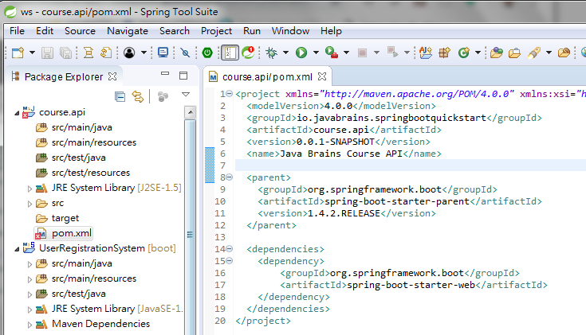
8 Spring Boot Project
https://www.youtube.com/watch?v=E7_a-kB46LU&list=PLqq-6Pq4lTTbx8p2oCgcAQGQyqN8XeA1x&index=9
Add Web dependencies from JARS: artifactID is “spring-boot-starter-web”. Make sure no typo.

Slide 8
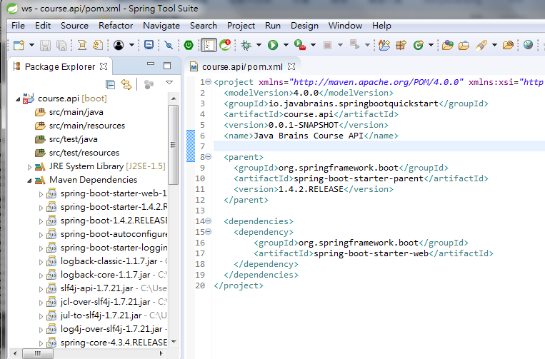
8 Spring Boot Project
https://www.youtube.com/watch?v=E7_a-kB46LU&list=PLqq-6Pq4lTTbx8p2oCgcAQGQyqN8XeA1x&index=9
When we save the pom.xml, the Maven dependencies are automatically downloaded.
You can scroll the dependencies download from repository.

Slide 9
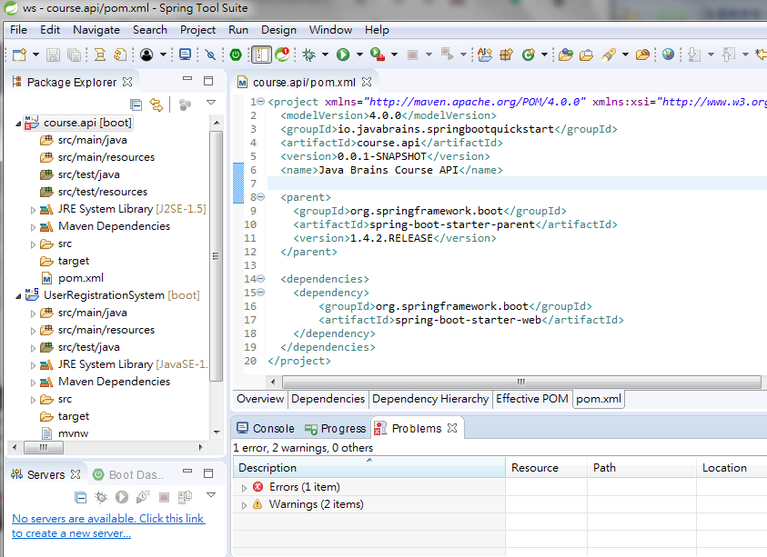
8 Spring Boot Project
https://www.youtube.com/watch?v=E7_a-kB46LU&list=PLqq-6Pq4lTTbx8p2oCgcAQGQyqN8XeA1x&index=9
You see some error here.

Slide 10
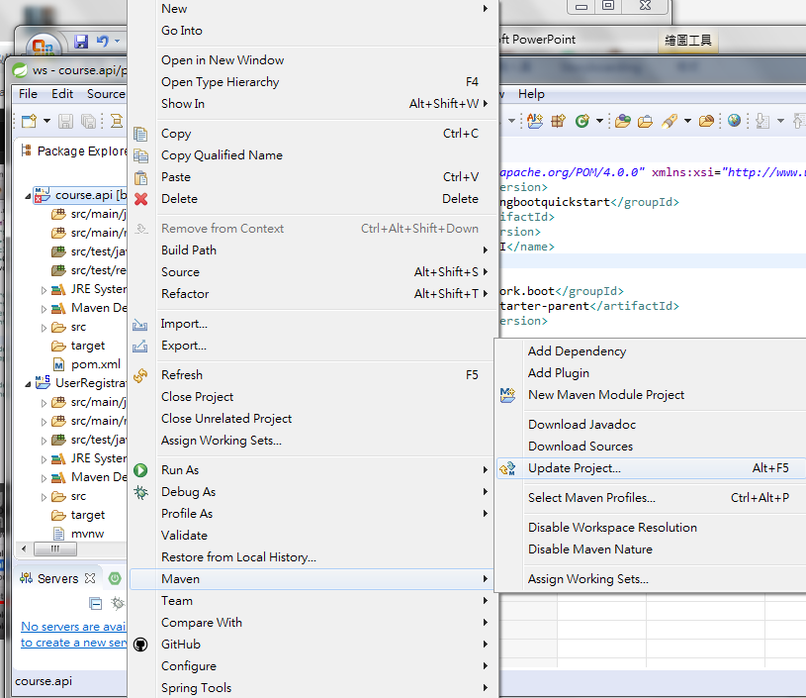
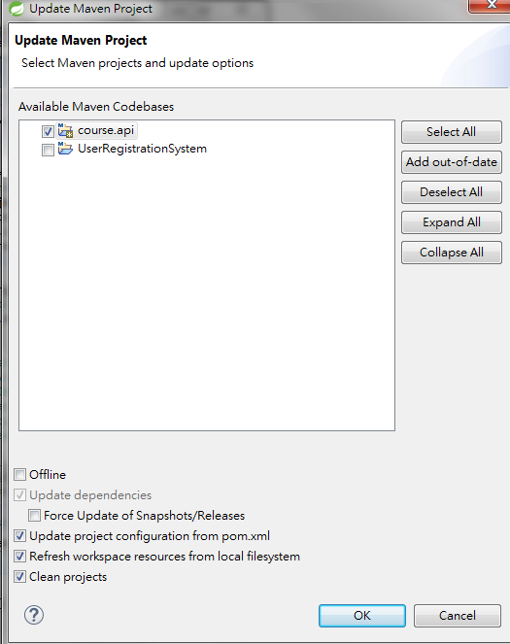
8 Spring Boot Project
https://www.youtube.com/watch?v=E7_a-kB46LU&list=PLqq-6Pq4lTTbx8p2oCgcAQGQyqN8XeA1x&index=9
Click the project “course.api”.
RMB > Maven > Update Project
Click “OK”

Slide 11
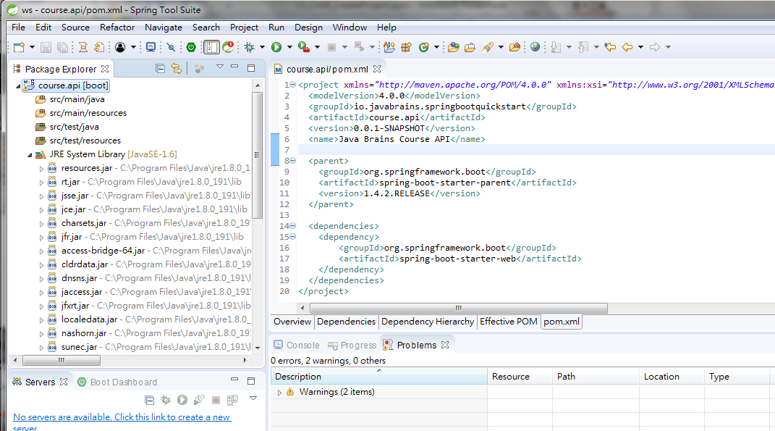
8 Spring Boot Project
https://www.youtube.com/watch?v=E7_a-kB46LU&list=PLqq-6Pq4lTTbx8p2oCgcAQGQyqN8XeA1x&index=9
We have all the update dependencies available over here.
Note that JRE 1.5 version is updated to JRE 1.6.
If you do not like JRE 1.6, you wan to change to latest version of JDK 1.8.

Slide 12
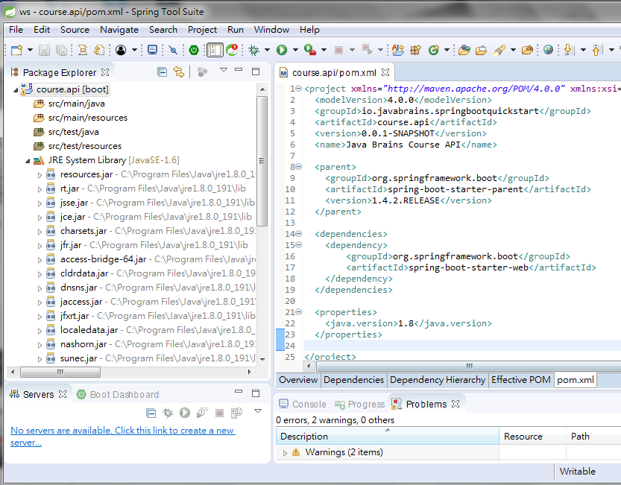
8 Spring Boot Project
https://www.youtube.com/watch?v=E7_a-kB46LU&list=PLqq-6Pq4lTTbx8p2oCgcAQGQyqN8XeA1x&index=9
How do I specify the JRE 1.8?
Add java version:1.8

Slide 13
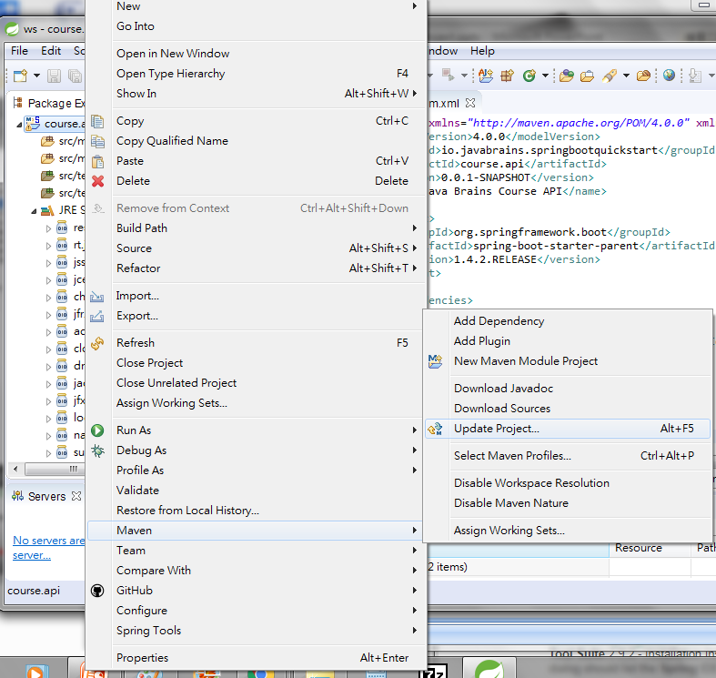
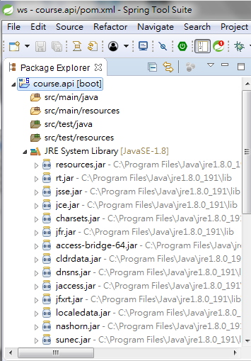
8 Spring Boot Project
https://www.youtube.com/watch?v=E7_a-kB46LU&list=PLqq-6Pq4lTTbx8p2oCgcAQGQyqN8XeA1x&index=9
Save pom.xml.
Select project. RMB > Maven > Update project
JRE System Library (SDK) update to 1.8.

Slide 14
End of Chapter

