Slide 1

10 Spring Boot Startup Step
Peter H. Chen

Slide 2
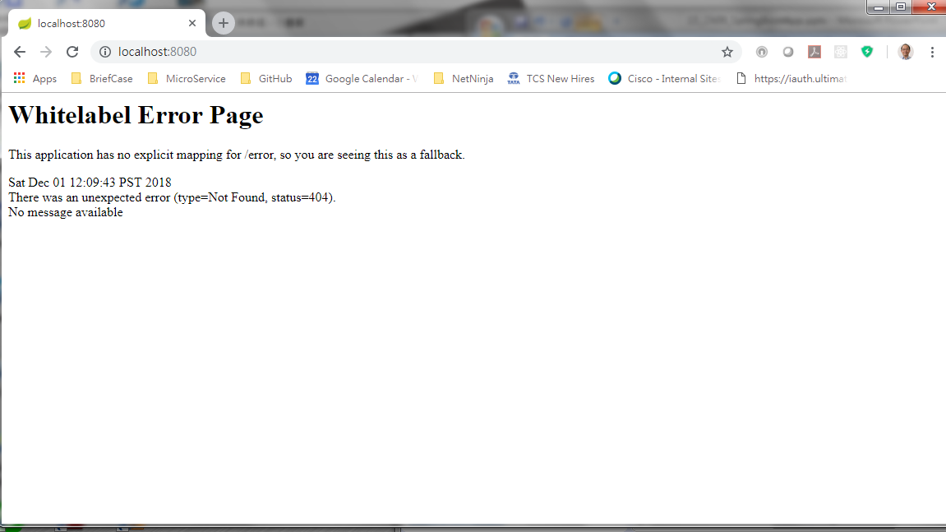
10 Spring Boot Startup Step
https://www.youtube.com/watch?v=E7_a-kB46LU&list=PLqq-6Pq4lTTbx8p2oCgcAQGQyqN8XeA1x&index=9
What happened in the started spring boot error?

Slide 3
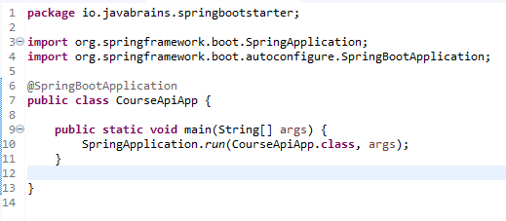
10 Spring Boot Startup Step
https://www.youtube.com/watch?v=E7_a-kB46LU&list=PLqq-6Pq4lTTbx8p2oCgcAQGQyqN8XeA1x&index=9
When Start Spring Boot, the line “SpringApplication.run” take two arguments.
Spring boot has static method called StringApplication.run() and take CourseApiApp.class.
This class has annotation which is a spring annotation and this does a lot for you.

Slide 4
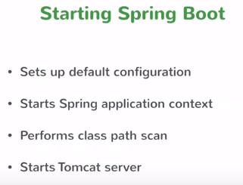
10 Spring Boot Startup Step
https://www.youtube.com/watch?v=E7_a-kB46LU&list=PLqq-6Pq4lTTbx8p2oCgcAQGQyqN8XeA1x&index=9
The “SpringApplication.run” does the following:
The default configuration does 80% framework for user application.
Application context is container for business service and container is what we called application context. Every spring boot has its own application context.
Spring boot also perform class path scan. Spring has to look the class belong to which container (application context). Spring boot treats controller annotation and service annotation differently.
Finally, it starts the tomcat server. Spring boot is a standalone application that means you do not have servlet container. Spring boot is all you need to start their application and start a separate container which is really cool.

Slide 5
End of Chapter

