Slide 1

6 Setup Spring Boot Environment
Peter H. Chen

Slide 2
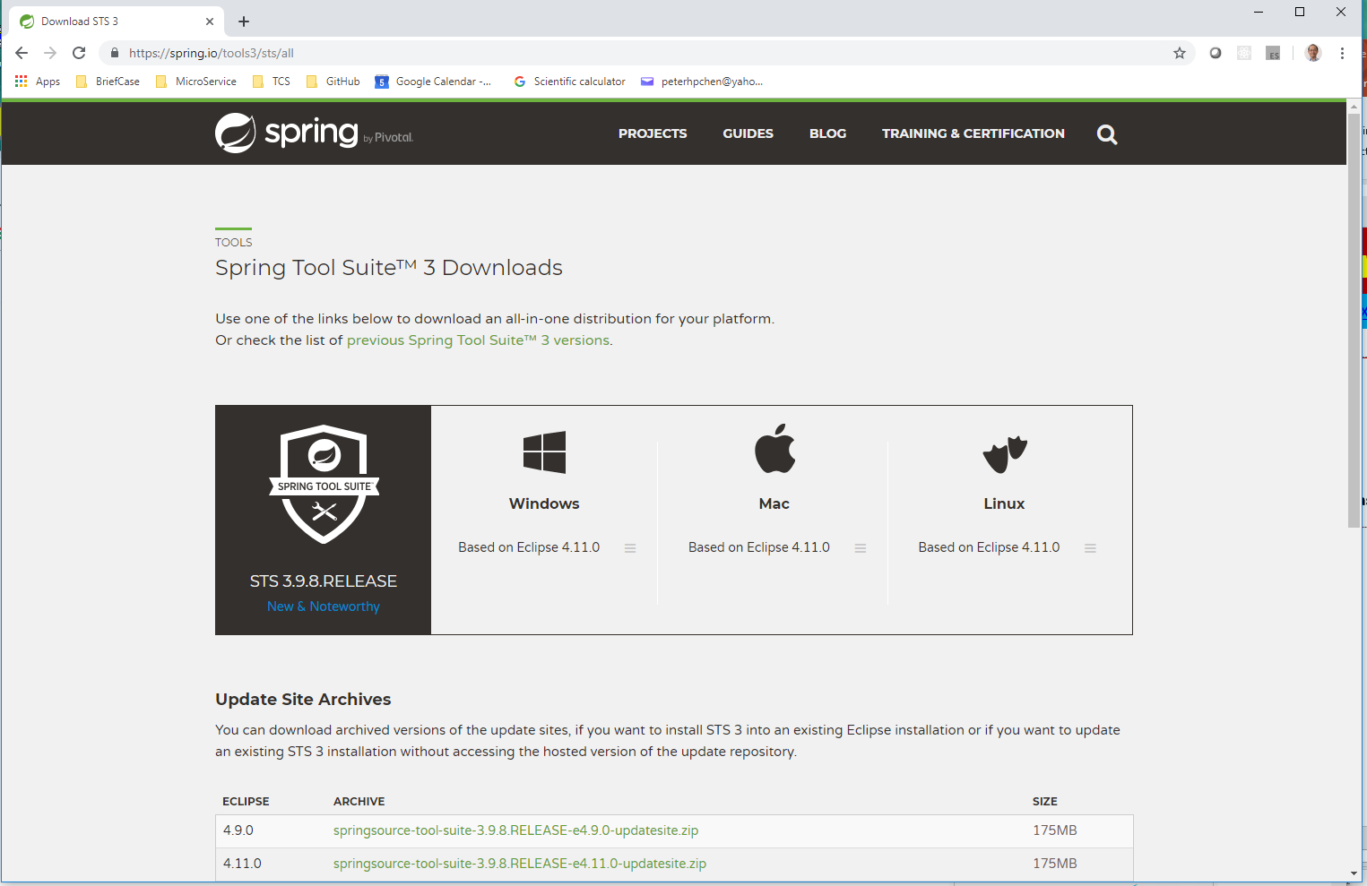
6 Setup Spring Boot Environment
https://www.youtube.com/watch?v=ZWkcWhcjALo&list=PLqq-6Pq4lTTbx8p2oCgcAQGQyqN8XeA1x&index=6
Setup: Java 8 SDK
Spring Boot requires Java 8 SDK. Go to Oracle site to download and install Java 1.8 JDK.
Open a command prompt terminal:
> java -version
$ echo $JAVA_HOME
We will use STS (Sprint Tool Suite) IDE. We can use Eclipse IDE or IntelliJ IDE as well.

Slide 3

6 Setup Spring Boot Environment
https://www.youtube.com/watch?v=ZWkcWhcjALo&list=PLqq-6Pq4lTTbx8p2oCgcAQGQyqN8XeA1x&index=6
Sprint Tools Suite is very similar to Eclipse IDE. Double click STS to start the IDE.

Slide 4
End of Chapter

