Slide 1

26 Spring Data JPA
Peter H. Chen

Slide 2
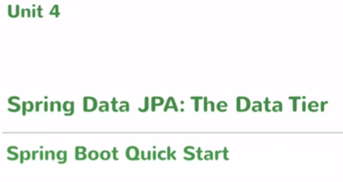
26 Spring Data JPA
https://www.youtube.com/watch?v=E7_a-kB46LU&list=PLqq-6Pq4lTTbx8p2oCgcAQGQyqN8XeA1x&index=9
We have data work on it own but not connect to database yet.
We are going to have our Spring Boot application connect to database and run queries on database and return the result and also may update to database. It is whole CRUD operation.

Slide 3
26 Spring Data JPA
https://www.youtube.com/watch?v=E7_a-kB46LU&list=PLqq-6Pq4lTTbx8p2oCgcAQGQyqN8XeA1x&index=9
We have data work on it own but not connect to database yet.
We are going to have our Spring Boot application connect to database and run queries on database and return the result and also may update to database. It is whole CRUD operation.

Slide 4



26 Spring Data JPA
https://www.youtube.com/watch?v=E7_a-kB46LU&list=PLqq-6Pq4lTTbx8p2oCgcAQGQyqN8XeA1x&index=9
First, what is Spring Data JPA?
JPA stands for Java Persistence API.
This is basically a specification let you do ORM (Object Relational Mapping).
Most of enterprise database is SQL base.

Slide 5

26 Spring Data JPA
https://www.youtube.com/watch?v=E7_a-kB46LU&list=PLqq-6Pq4lTTbx8p2oCgcAQGQyqN8XeA1x&index=9
Most of SQL database is Relational Database.
It has table, keys, foreign keys, primary keys, which are relational.
When you connect Java to database, you need something like JDBC and run SQL query that run on that relational database and then you get the results and then convert it into object instances.

Slide 6
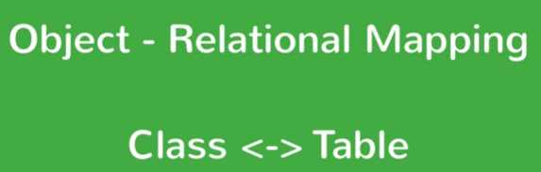
26 Spring Data JPA
https://www.youtube.com/watch?v=E7_a-kB46LU&list=PLqq-6Pq4lTTbx8p2oCgcAQGQyqN8XeA1x&index=9
Right Here is the Java application you have classes and object.
What ORM does is let your map your entity classes into SQL table.
So that when you connect to the database, you provide some meta data in your entity classes.
You don’t have to do the query and then mapping yourself. The framework handles it for you.

Slide 7

26 Spring Data JPA
https://www.youtube.com/watch?v=E7_a-kB46LU&list=PLqq-6Pq4lTTbx8p2oCgcAQGQyqN8XeA1x&index=9
JPA is a way for you.JPA is the API.
JPA is the specification which let you configure your entity classes and give it to a framework so that the framework does the rest.
JPA handles the conversion from your SQL read queries to object instances.
So, this is the JPA only.

Slide 8

26 Spring Data JPA
https://www.youtube.com/watch?v=E7_a-kB46LU&list=PLqq-6Pq4lTTbx8p2oCgcAQGQyqN8XeA1x&index=9
Spring Data JPA is a separate project which let you use these other tools even easier.
We are going to do in this unit.
We are going to how spring data JPA connect to relational database.

Slide 9
End of Chapter

