Slide 1

7 Maven
Peter H. Chen

Slide 2
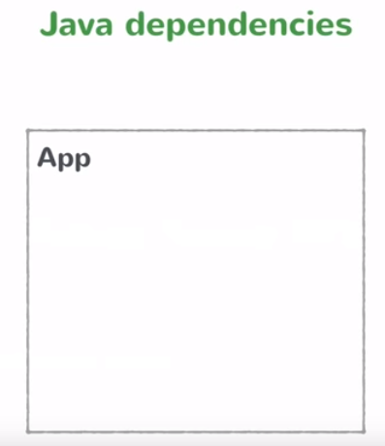
7 Maven
https://www.youtube.com/watch?v=nXApK2xrgJk&list=PLqq-6Pq4lTTbx8p2oCgcAQGQyqN8XeA1x&index=7
We will build Spring Application.
We need to manage the dependencies.
We need to import the jars that are the required for the Spring Application to work.

Slide 3
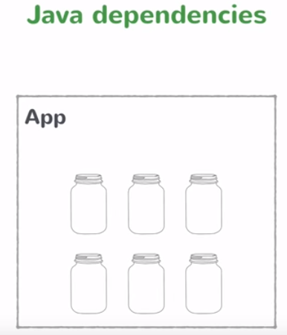
7 Maven
https://www.youtube.com/watch?v=nXApK2xrgJk&list=PLqq-6Pq4lTTbx8p2oCgcAQGQyqN8XeA1x&index=7
Typically, we handle the dependencies in Java. You get the jars and you add it to the class path.
The app has the jars available all those classes in those jars are available to your application.
We are not going to do this. We are going to be using a tool called Maven.
We used Maven when we do the Java Application development.

Slide 4
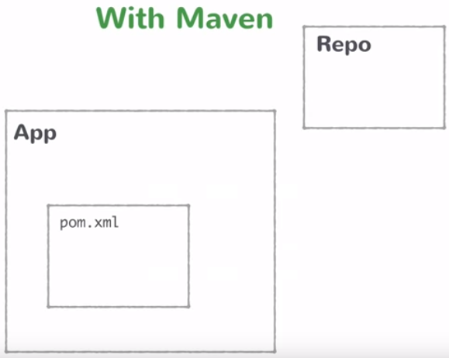
7 Maven
https://www.youtube.com/watch?v=nXApK2xrgJk&list=PLqq-6Pq4lTTbx8p2oCgcAQGQyqN8XeA1x&index=7
Maven let you declare all the dependencies that you want in a single file.
You do not need to download the jars and add it to your class path.
You mentioned what the jars you need are into this file which is called pom.xml.
The pom.xml file contains a list of all your dependencies that Maven needs to know.

Slide 5
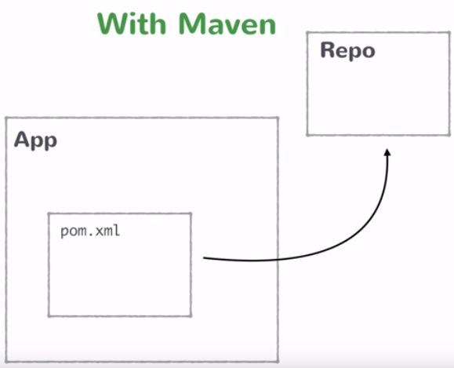
7 Maven
https://www.youtube.com/watch?v=nXApK2xrgJk&list=PLqq-6Pq4lTTbx8p2oCgcAQGQyqN8XeA1x&index=7
Maven is the dependencies management tool. Then, you run the Maven command and Maven is going to look at your dependencies.
These are all the things that this app needs to run and it goes to this repository which has all the list of the dependencies that you would ever need and download load all the jars files.

Slide 6
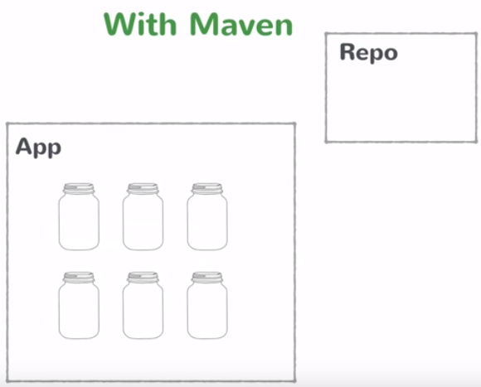
7 Maven
https://www.youtube.com/watch?v=nXApK2xrgJk&list=PLqq-6Pq4lTTbx8p2oCgcAQGQyqN8XeA1x&index=7
Maven will downloaded all the jars files to the class path.
Maven is a build in dependencies management tool that we are going to use be using for Spring Boot Application.
You need to add the dependencies and add it to the class path, run the Maven command, and let the Maven downloaded the jars files for you.
For the first time, you need to create the pom.xml by Spring Initializr. The Spring Initializr creates a pom.xml template.
You create a project with pom.xml and Maven is going to download for you.

Slide 7
End of Chapter

