Slide 1

19 Create New Resource by POST
Peter H. Chen

Slide 2
19 Create New Resource by POST
https://www.youtube.com/watch?v=E7_a-kB46LU&list=PLqq-6Pq4lTTbx8p2oCgcAQGQyqN8XeA1x&index=9
We implemented the get request and get API in the last previous chapter.
Let’s move on the POST to create a new document.
To do that, we need to make a POST request “/topics/POST”.

Slide 3
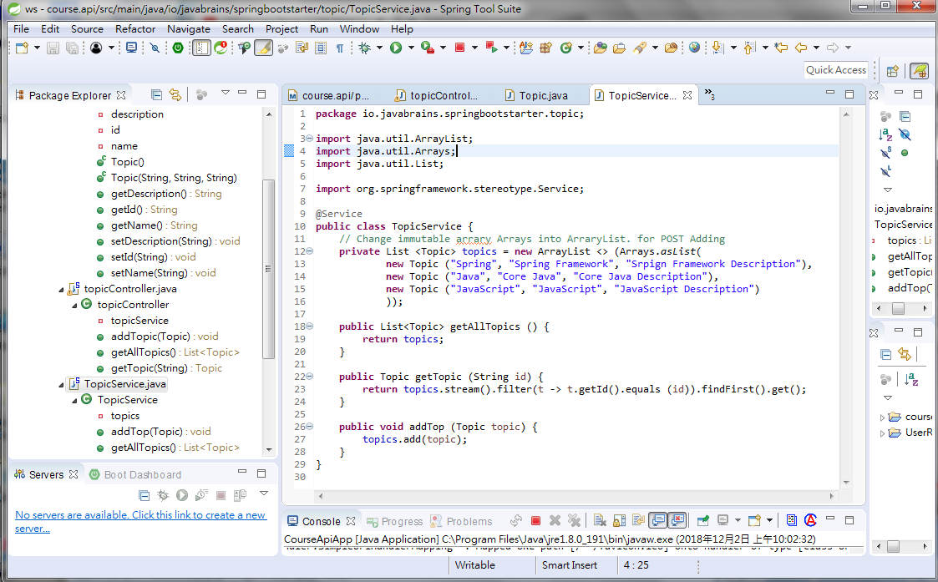
19 Create New Resource by POST
https://www.youtube.com/watch?v=E7_a-kB46LU&list=PLqq-6Pq4lTTbx8p2oCgcAQGQyqN8XeA1x&index=9
TopicService: topicsArrays is immutable. Modify into ArrayList <> for mutable ArrayList.
Add addTop () to add topic into ArrayList topics.

Slide 4
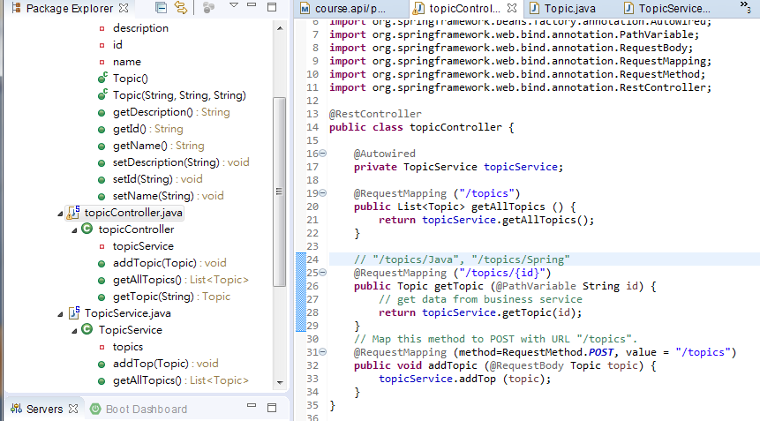
19 Create New Resource by POST
https://www.youtube.com/watch?v=E7_a-kB46LU&list=PLqq-6Pq4lTTbx8p2oCgcAQGQyqN8XeA1x&index=9
For POST, we need to tell Spring boot the POST method and URL with @RequestMapping (method = RequestMethod.POST, value =“/topics”)
We also need to tell Spring Boot the passing parameter with @RequestBody in addTopic ()

Slide 5
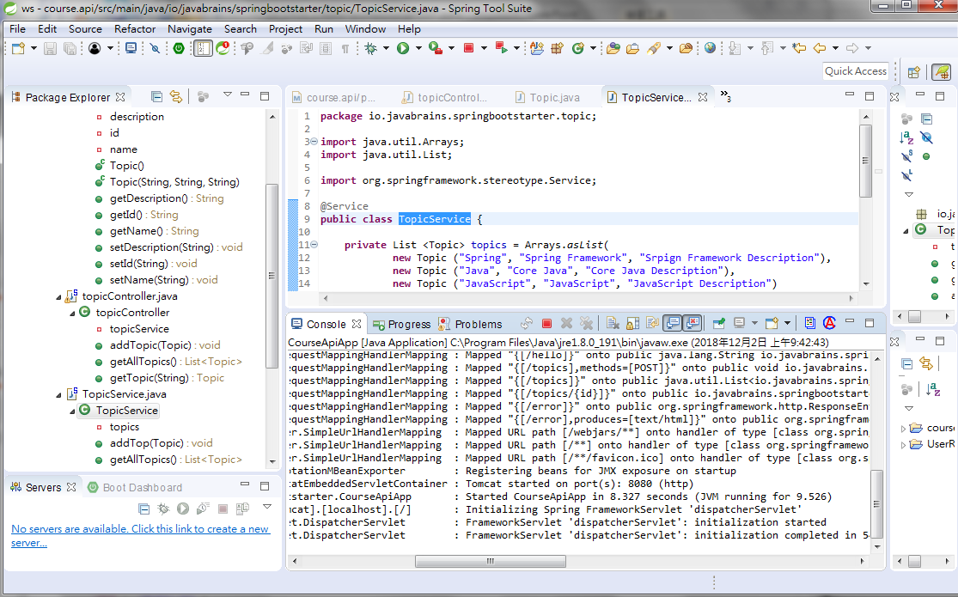
19 Create New Resource by POST
https://www.youtube.com/watch?v=E7_a-kB46LU&list=PLqq-6Pq4lTTbx8p2oCgcAQGQyqN8XeA1x&index=9
In order to test POST, we need a “postman” software.
Install the postman software. We test GET first.
Stop and Run your application. Make sure 8080 port is fine.

Slide 6
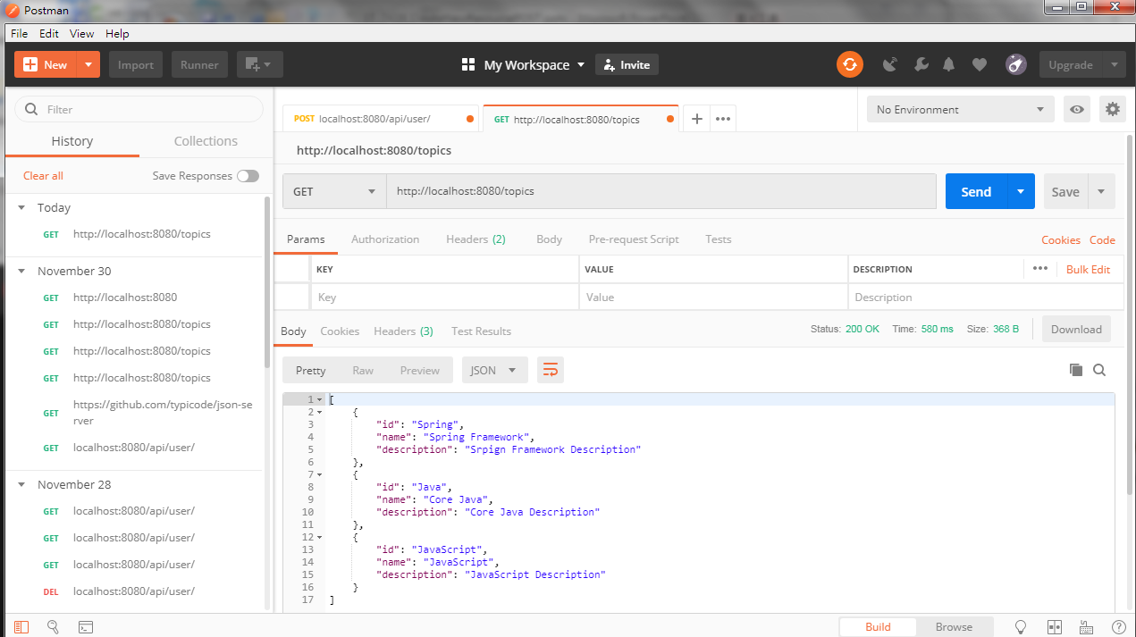
19 Create New Resource by POST
https://www.youtube.com/watch?v=E7_a-kB46LU&list=PLqq-6Pq4lTTbx8p2oCgcAQGQyqN8XeA1x&index=9
Bring up the postman working properly with GET:
Select GET, enter “localhost:8080/topics”
Click “SEND”, the JSON format database is displayed.

Slide 7
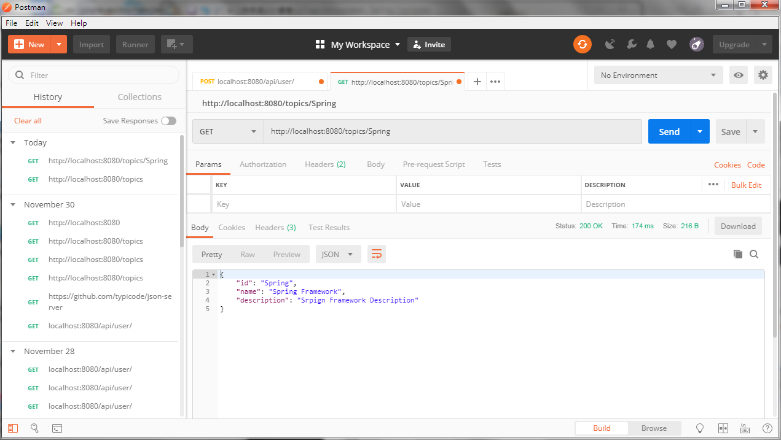
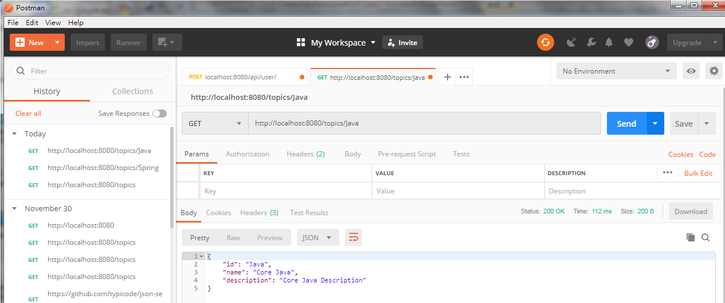
19 Create New Resource by POST
https://www.youtube.com/watch?v=E7_a-kB46LU&list=PLqq-6Pq4lTTbx8p2oCgcAQGQyqN8XeA1x&index=9
Bring up the postman working properly with GET:
Select GET, enter “localhost:8080/topics/Spring” or “localhost:8080/topics/Java”
Click “SEND”, the JSON format database is displayed.

Slide 8
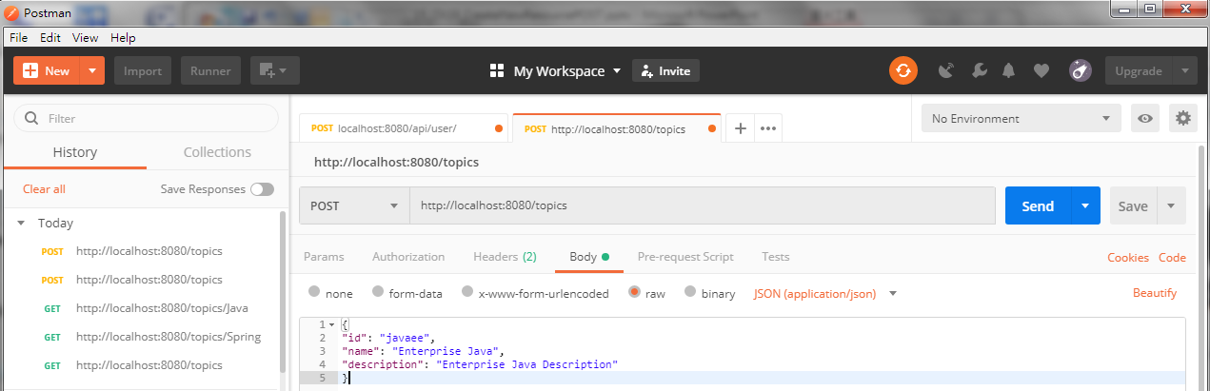
19 Create New Resource by POST
https://www.youtube.com/watch?v=E7_a-kB46LU&list=PLqq-6Pq4lTTbx8p2oCgcAQGQyqN8XeA1x&index=9
We want to use postman to test POST.
The postman help http communication debugging.
First, click “Body”, “raw”, and setup the message we want to send:

Slide 9
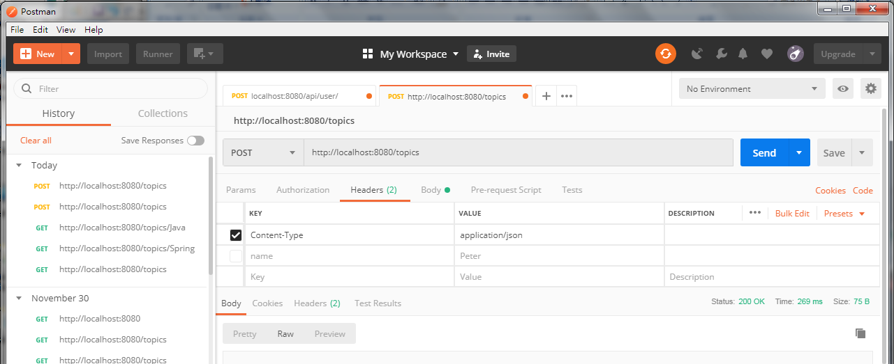
19 Create New Resource by POST
https://www.youtube.com/watch?v=E7_a-kB46LU&list=PLqq-6Pq4lTTbx8p2oCgcAQGQyqN8XeA1x&index=9
Then, we setup click Headers
Setup http headers standards with KEYS = “Content-Type” and VALUES = ‘application/json”

Slide 10
19 Create New Resource by POST
https://www.youtube.com/watch?v=E7_a-kB46LU&list=PLqq-6Pq4lTTbx8p2oCgcAQGQyqN8XeA1x&index=9
Select “POST”, “localhost:8080/topics”
Click “Send”

Slide 11
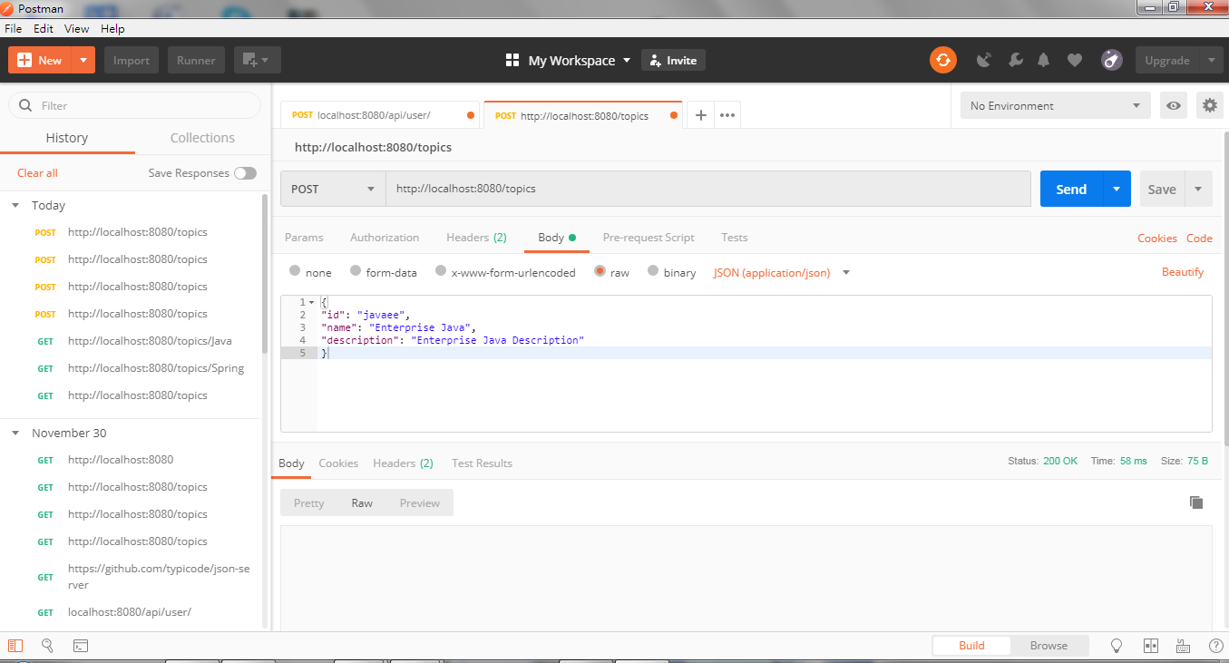
19 Create New Resource by POST
https://www.youtube.com/watch?v=E7_a-kB46LU&list=PLqq-6Pq4lTTbx8p2oCgcAQGQyqN8XeA1x&index=9
No Error message.
The POST worked.

Slide 12
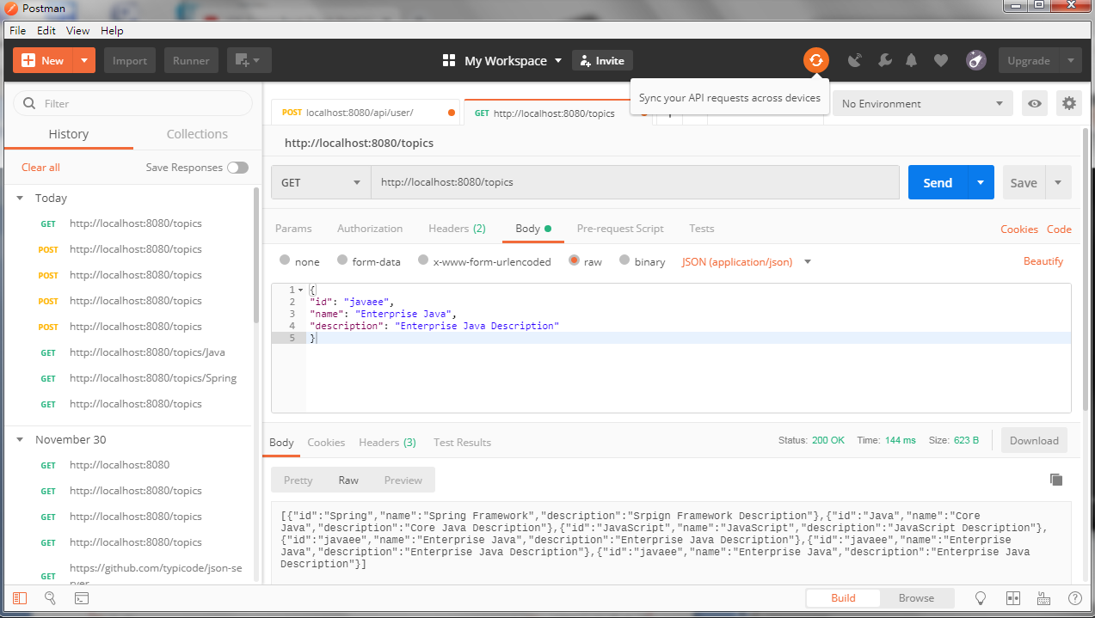
19 Create New Resource by POST
https://www.youtube.com/watch?v=E7_a-kB46LU&list=PLqq-6Pq4lTTbx8p2oCgcAQGQyqN8XeA1x&index=9
Select GET and send again.
We can see the “javaee” data in insert into the ArrayList.

Slide 13
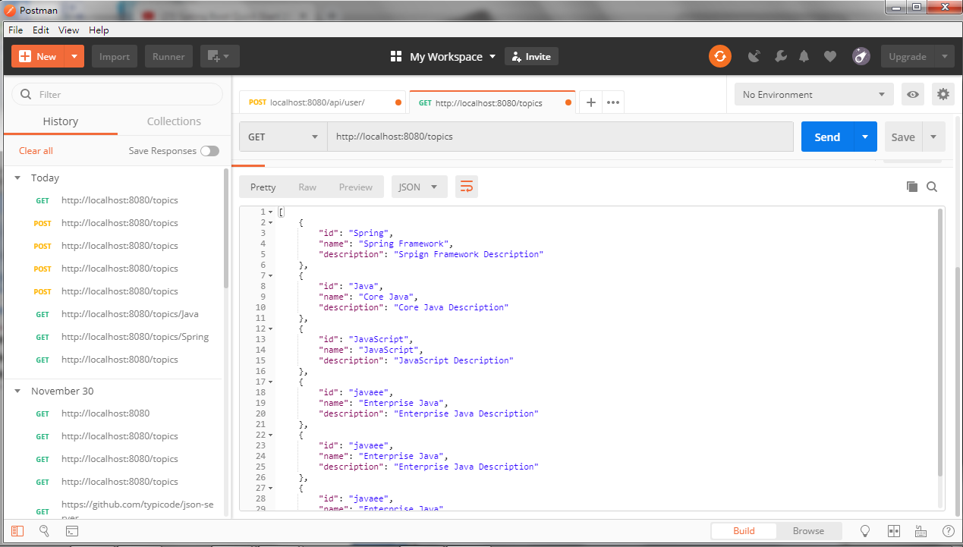
19 Create New Resource by POST
https://www.youtube.com/watch?v=E7_a-kB46LU&list=PLqq-6Pq4lTTbx8p2oCgcAQGQyqN8XeA1x&index=9
Click “Pretty” to see better format.

Slide 14
19 Create New Resource by POST
https://www.youtube.com/watch?v=E7_a-kB46LU&list=PLqq-6Pq4lTTbx8p2oCgcAQGQyqN8XeA1x&index=9
Summary:
Array is non-mutable.
ArrayList is mutable.
To add the topic, we have to set the topics to mutable ArrayList instead of Array.

Slide 15
End of Chapter

