Slide 1

27 Add Spring Data JSP
Peter H. Chen

Slide 2
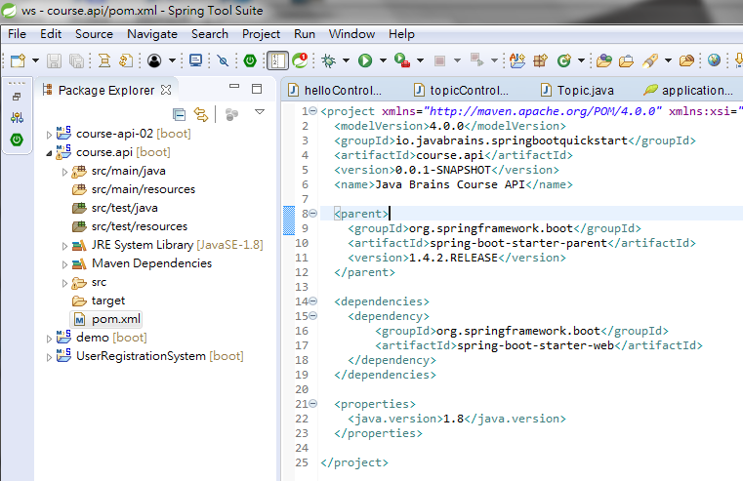
27 Add Spring Data JSP
https://www.youtube.com/watch?v=E7_a-kB46LU&list=PLqq-6Pq4lTTbx8p2oCgcAQGQyqN8XeA1x&index=9
Open pom.xml in course.api Project, we add a few more dependencies.

Slide 3
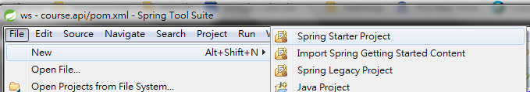
27 Add Spring Data JSP
https://www.youtube.com/watch?v=E7_a-kB46LU&list=PLqq-6Pq4lTTbx8p2oCgcAQGQyqN8XeA1x&index=9
In order to be able to connect to the database and the last unit we talked about how we can know what the dependencies are.
You can to go https://start.spring.io. Figure all the dependencies you need.
You are going to get a pom.xml that you know the maven dependencies added in it.
I am going to have this as a separate copy.
We start a new spring starter project that we learnt in the last unit.
File > new > Spring Starter Project

Slide 4
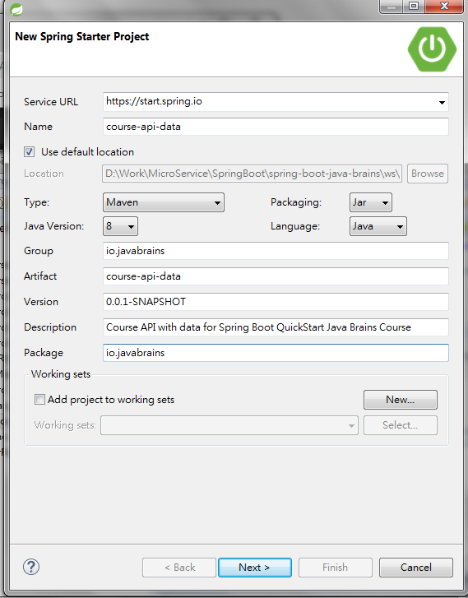
27 Add Spring Data JSP
https://www.youtube.com/watch?v=E7_a-kB46LU&list=PLqq-6Pq4lTTbx8p2oCgcAQGQyqN8XeA1x&index=9
Name: course-api-data
Group: io.javabrains
Artifact: Course-api-data
Description: Course API for Spring Boot Quick Start Java Brains Course
Package: io.javabrains

Slide 5
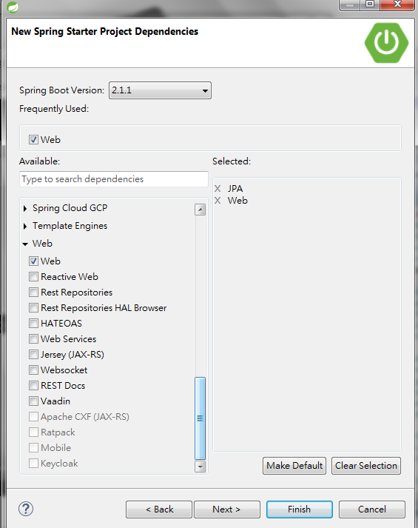
27 Add Spring Data JSP
https://www.youtube.com/watch?v=E7_a-kB46LU&list=PLqq-6Pq4lTTbx8p2oCgcAQGQyqN8XeA1x&index=9
Select the “web”

Slide 6
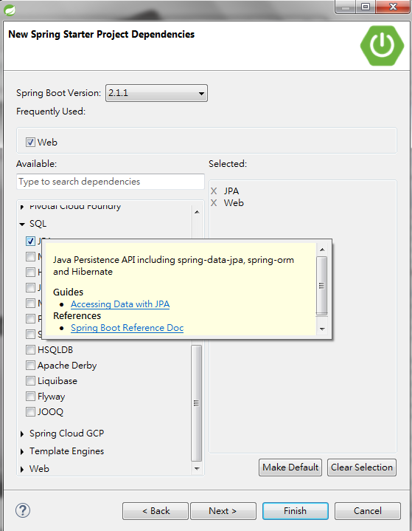
27 Add Spring Data JSP
https://www.youtube.com/watch?v=E7_a-kB46LU&list=PLqq-6Pq4lTTbx8p2oCgcAQGQyqN8XeA1x&index=9
Click SQL.
Select JPA. We choose JAP. This JPA is not just JPA but it brings Spring Data JPA.
If I hover mouse over JPA, you see this Java Persistence API including spring-data-jpa, spring-orm, and Hibernate. These are all we need.

Slide 7
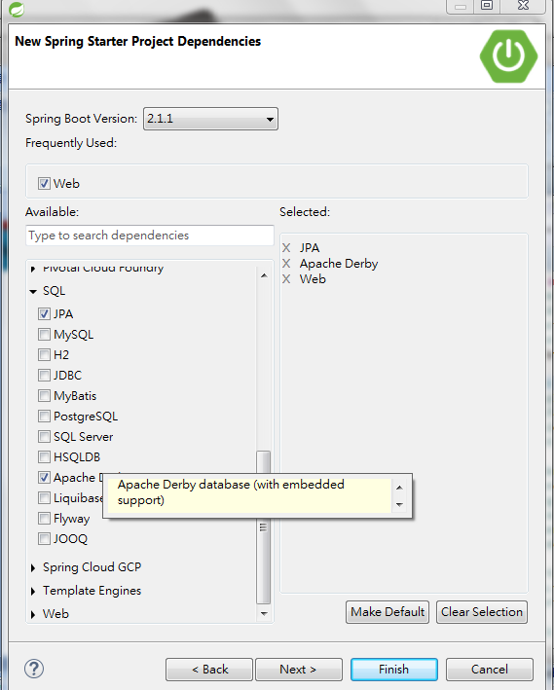
27 Add Spring Data JSP
https://www.youtube.com/watch?v=E7_a-kB46LU&list=PLqq-6Pq4lTTbx8p2oCgcAQGQyqN8XeA1x&index=9
Next thing we need is the database we need to work with.
Apache Derby is an embedded database.
What this does is actually download a jar into your classpath which is Apache Derby database. It actually start a database for you when you start your application.
This is typically not used in a production version but when you are just building an application for development for test database available in classpath.

Slide 8
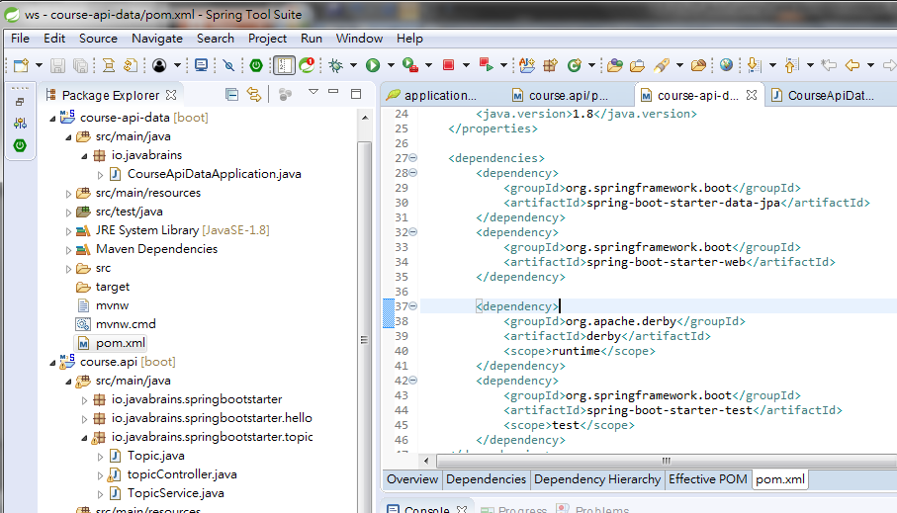
27 Add Spring Data JSP
https://www.youtube.com/watch?v=E7_a-kB46LU&list=PLqq-6Pq4lTTbx8p2oCgcAQGQyqN8XeA1x&index=9
Check the pom.xml, we have Spring Data JPA and Apache Derby Embedded Database.

Slide 9
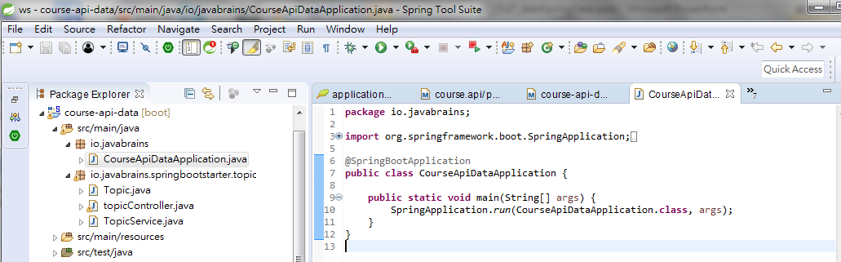
27 Add Spring Data JSP
https://www.youtube.com/watch?v=E7_a-kB46LU&list=PLqq-6Pq4lTTbx8p2oCgcAQGQyqN8XeA1x&index=9
Check the main program to bootstrap CourseApiDataApplication.class

Slide 10
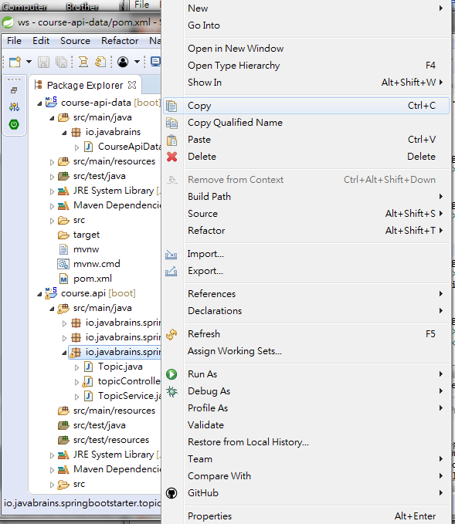
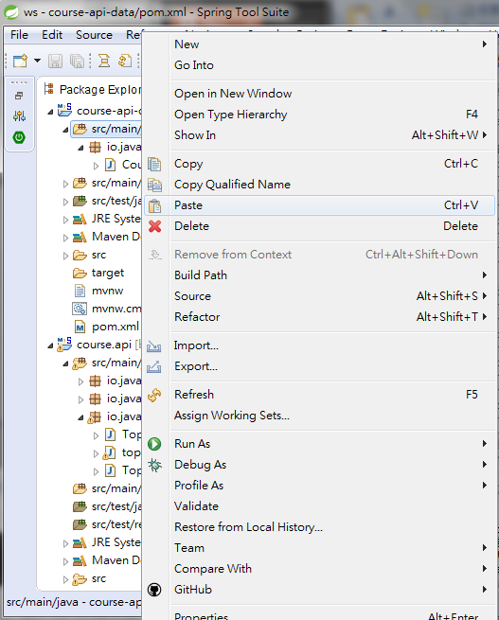
27 Add Spring Data JSP
https://www.youtube.com/watch?v=E7_a-kB46LU&list=PLqq-6Pq4lTTbx8p2oCgcAQGQyqN8XeA1x&index=9
Now, we copy the Java Topic folder in project course-api into project-api-data
Copy topic package from
course-api/java folder
and paste into
course-api-data/java folder

Slide 11
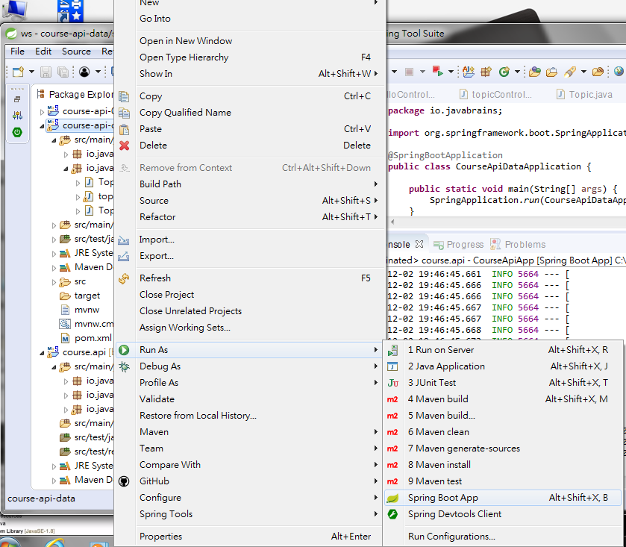
27 Add Spring Data JSP
https://www.youtube.com/watch?v=E7_a-kB46LU&list=PLqq-6Pq4lTTbx8p2oCgcAQGQyqN8XeA1x&index=9
Make sure new project “course-api-data” is running.
Click Project “course-api-data”
Stop and Run as “Spring Boot App”

Slide 12
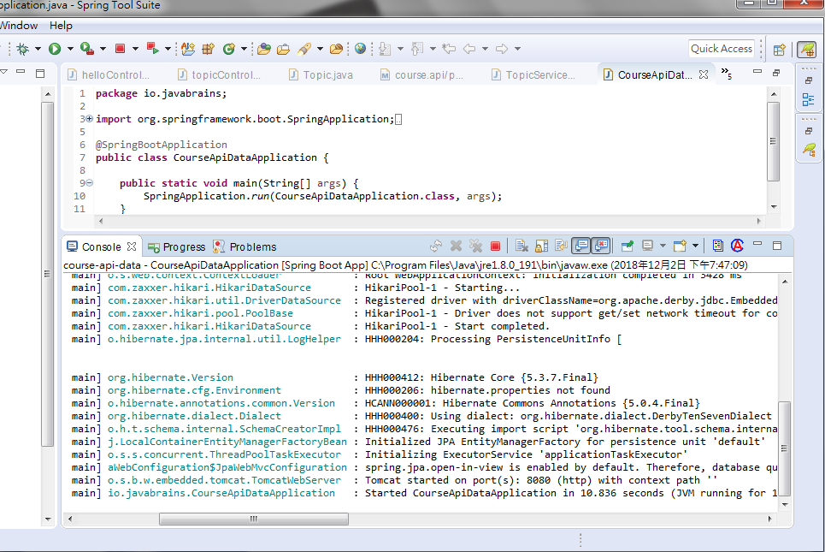
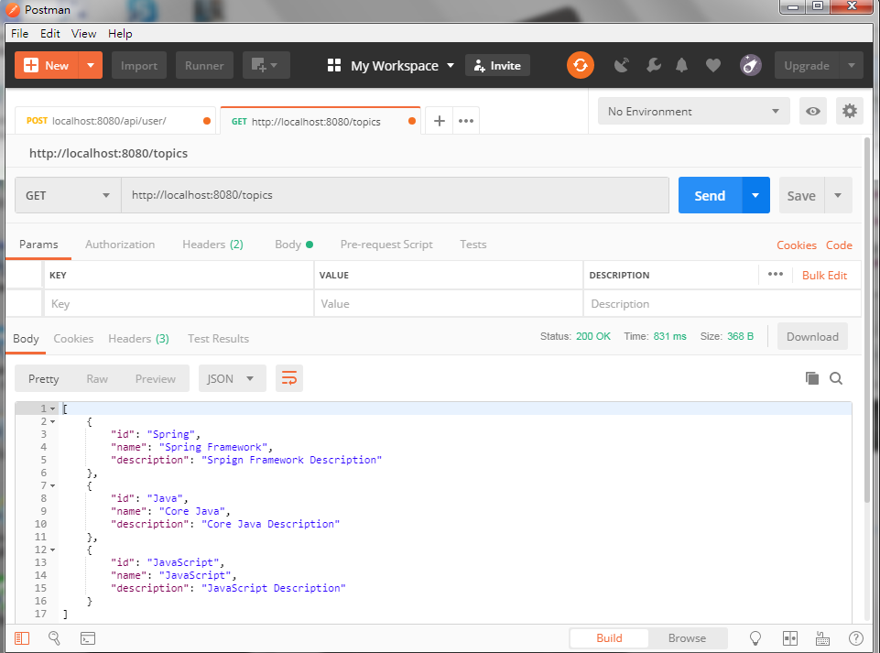
27 Add Spring Data JSP
https://www.youtube.com/watch?v=E7_a-kB46LU&list=PLqq-6Pq4lTTbx8p2oCgcAQGQyqN8XeA1x&index=9
Port 8080 is fine
Open Postman and GET “localhost:8080/topics”

Slide 13
End of Chapter

