Slide 1

28 Create Spring Data Repository
Peter H. Chen

Slide 2
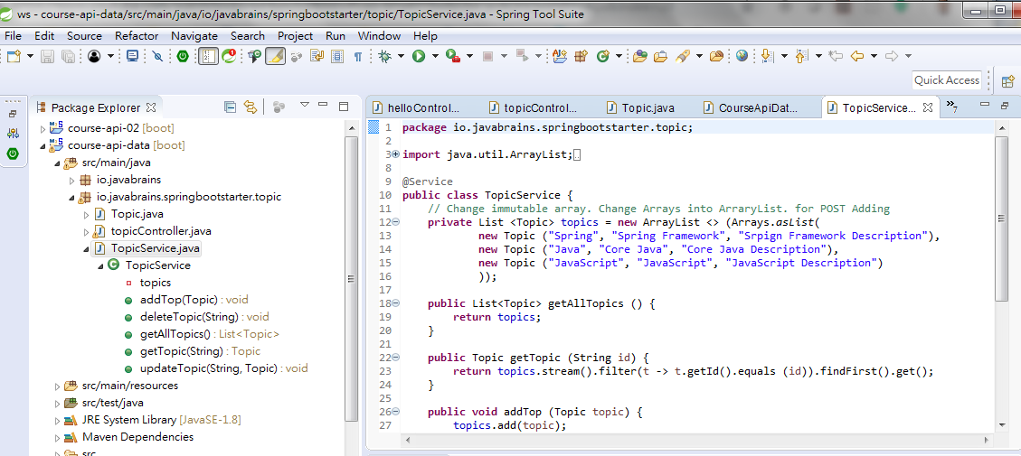
28 Create Spring Data Repository
https://www.youtube.com/watch?v=E7_a-kB46LU&list=PLqq-6Pq4lTTbx8p2oCgcAQGQyqN8XeA1x&index=9
We want to remove the hard-coded data.

Slide 3
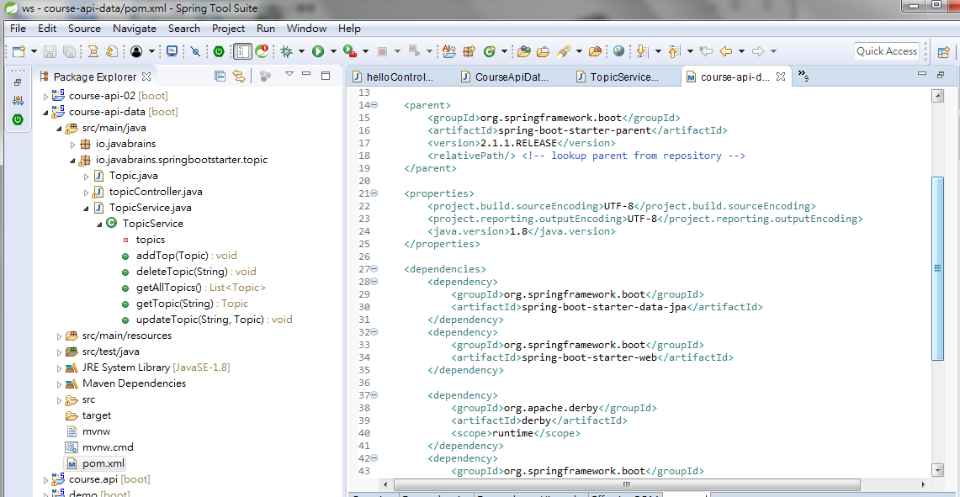
28 Create Spring Data Repository
https://www.youtube.com/watch?v=E7_a-kB46LU&list=PLqq-6Pq4lTTbx8p2oCgcAQGQyqN8XeA1x&index=9
We add the JPA support in the last chapter.

Slide 4
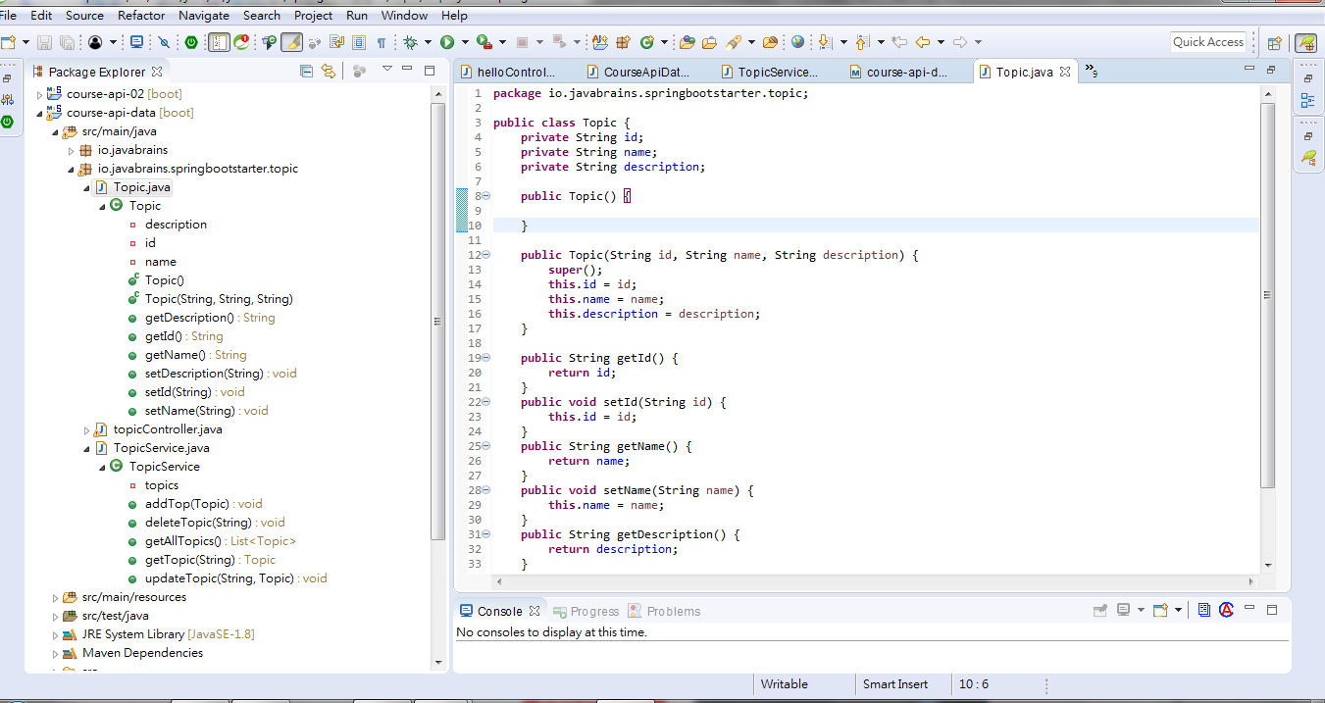
28 Create Spring Data Repository
https://www.youtube.com/watch?v=E7_a-kB46LU&list=PLqq-6Pq4lTTbx8p2oCgcAQGQyqN8XeA1x&index=9
How to add the entity class?
First, open the Model class (The data class), this is the entity class, the Topic Class.
The Topic class need to tell the JPA, these things (Data and Method) need to store to the database. We need to map these objects of this topic class to the relational database table.

Slide 5
28 Create Spring Data Repository
https://www.youtube.com/watch?v=E7_a-kB46LU&list=PLqq-6Pq4lTTbx8p2oCgcAQGQyqN8XeA1x&index=9
So, I would like to create a database and each instance of this topic class should go as rows in that table.

Slide 6
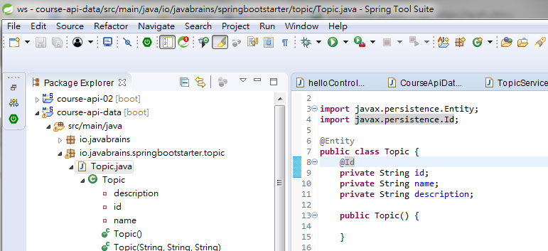
28 Create Spring Data Repository
https://www.youtube.com/watch?v=E7_a-kB46LU&list=PLqq-6Pq4lTTbx8p2oCgcAQGQyqN8XeA1x&index=9
I would like to mark the class to tell JPA that this is an entity class.
From @Entity, JPA know to create the table called Topic and that table have three column, id column, name column, and description column. And all of the columns are text columns.
I need to tell JPA one more thing.
What is the primary keys in the relational database table. Each table should have a primary key.
First, use “@Entity” for table and “@Id” for primary key.

Slide 7
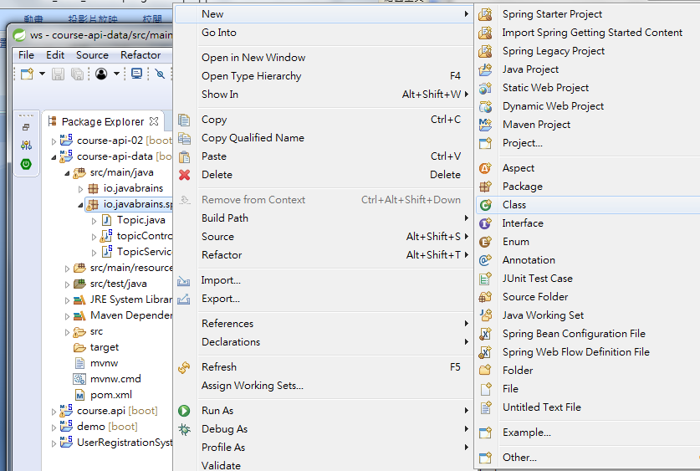
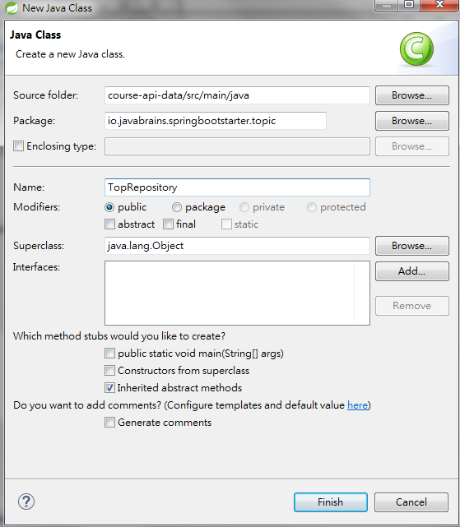
28 Create Spring Data Repository
https://www.youtube.com/watch?v=E7_a-kB46LU&list=PLqq-6Pq4lTTbx8p2oCgcAQGQyqN8XeA1x&index=9
Second, connect to database and run those commands.
Click package “io.javabrains.springbootstarter.topic” and create a class “TopRepository”

Slide 8
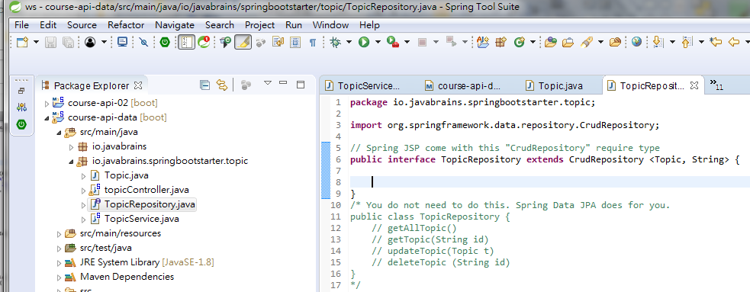
28 Create Spring Data Repository
https://www.youtube.com/watch?v=E7_a-kB46LU&list=PLqq-6Pq4lTTbx8p2oCgcAQGQyqN8XeA1x&index=9
Second, connect to database and run those commands.
Click package “io.javabrains.springbootstarter.topic” and create a class “TopicRepository”
We do not need the “TopicRepository” class since Spring Data JSP already create for us.
We just need an interface TopicRepository with extends CrudRepository <Topic, String>

Slide 9
End of Chapter

