Slide 1

11 Add REST Controller
Peter H. Chen

Slide 2
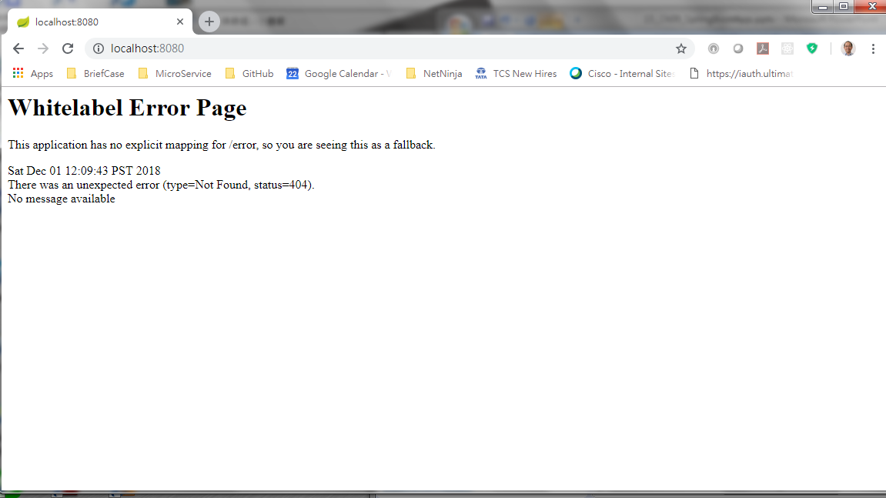
11 Add REST Controller
https://www.youtube.com/watch?v=E7_a-kB46LU&list=PLqq-6Pq4lTTbx8p2oCgcAQGQyqN8XeA1x&index=9
Now, we have running servlet container but it does not do anything. You can request but it just throw an error page.

Slide 3
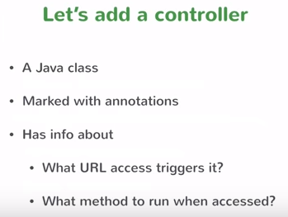
11 Add REST Controller
https://www.youtube.com/watch?v=E7_a-kB46LU&list=PLqq-6Pq4lTTbx8p2oCgcAQGQyqN8XeA1x&index=9
What we want to do is to handle the request. We have to add the controller in spring.
A controller is a java class has certain annotation marked in it.
The annotation is to let spring know what is the URL that you mapping into what should happen when there is a request comes to that URL.
So there are two pieces of information (Where is URL and what to do) that spring needs to know.
You have to provide two annotation information of that class.

Slide 4
11 Add REST Controller
https://www.youtube.com/watch?v=E7_a-kB46LU&list=PLqq-6Pq4lTTbx8p2oCgcAQGQyqN8XeA1x&index=9
So we create a class as a controller. We have to mark annotations.
Map to URL: First, These annotations are going to mark the controller and it also provides the this information what URL access needs to trigger that controller to execute.
Run the method: Second, then trigger the method when URL is called. That method need to run.

Slide 5
11 Add REST Controller
https://www.youtube.com/watch?v=E7_a-kB46LU&list=PLqq-6Pq4lTTbx8p2oCgcAQGQyqN8XeA1x&index=9
We have error when we have “localhost:8000”. We want to see “Hi” or “Hello” in different path. We need to create a controller to do that.
The spring framework is called MVC. The MVC is child project under spring framework umbrella.
If we enter “localhost:8080/hello” or “localhost:8080/hi”, we want to see different response.

Slide 6
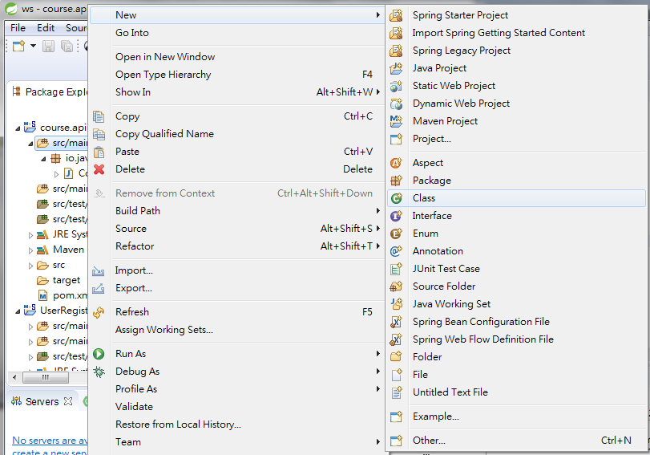
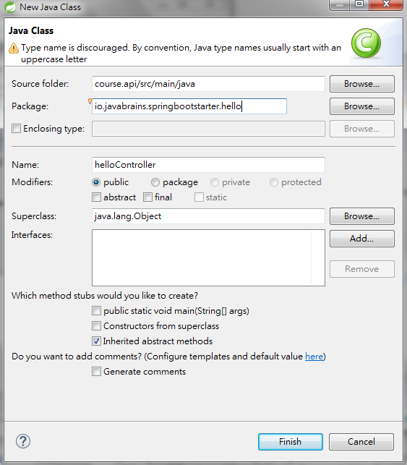
11 Add REST Controller
https://www.youtube.com/watch?v=E7_a-kB46LU&list=PLqq-6Pq4lTTbx8p2oCgcAQGQyqN8XeA1x&index=9
Create a new class: File > New > class
Package Name: “io.javabrains.sprinbootstarter.hello
Class Name: helloController

Slide 7
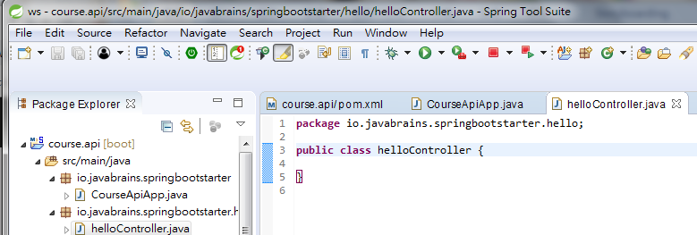
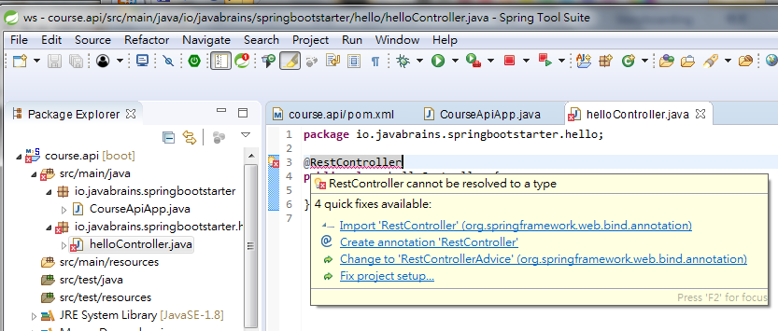
11 Add REST Controller
https://www.youtube.com/watch?v=E7_a-kB46LU&list=PLqq-6Pq4lTTbx8p2oCgcAQGQyqN8XeA1x&index=9
We will make class helloController into a controller.
Add @RestController to class helloController.
Click “@RestController” to add “import …”

Slide 8
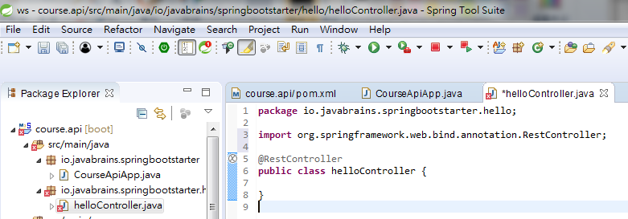
11 Add REST Controller
https://www.youtube.com/watch?v=E7_a-kB46LU&list=PLqq-6Pq4lTTbx8p2oCgcAQGQyqN8XeA1x&index=9
We will make class helloController into a controller.
Add @RestController to class helloController.
Click “@RestController” to add “import …”
In @RestController, you can have method here to map the request.

Slide 9
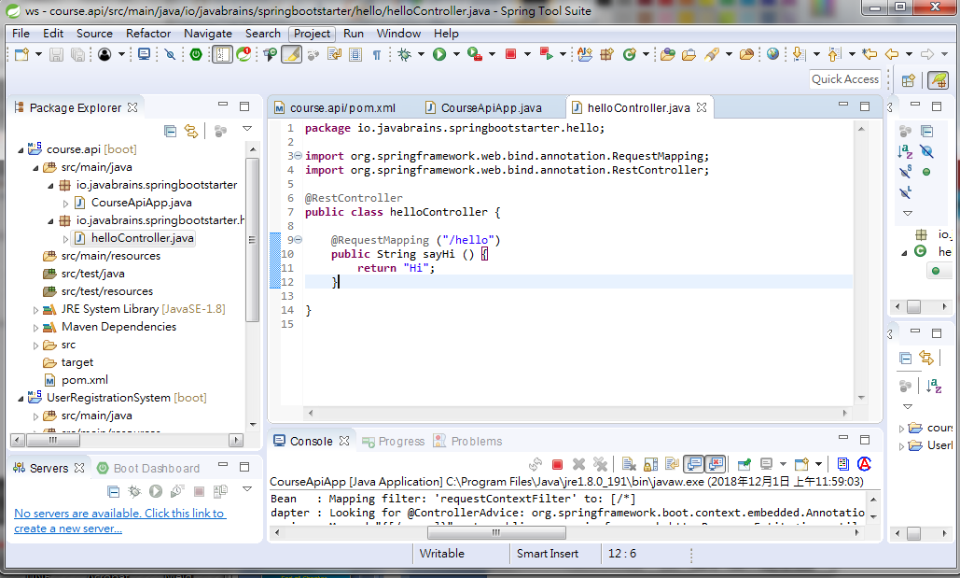
11 Add REST Controller
https://www.youtube.com/watch?v=E7_a-kB46LU&list=PLqq-6Pq4lTTbx8p2oCgcAQGQyqN8XeA1x&index=9
Two annotations: @RestController and @RequestMapping are needed for RESTful controller.
The @RestController is used for class “helloController” as a controller.
The @RequestMapping (“/hello”) is used to map “hello” into the method sayHi.
Now, how to plug in the class helloController?

Slide 10
11 Add REST Controller
https://www.youtube.com/watch?v=E7_a-kB46LU&list=PLqq-6Pq4lTTbx8p2oCgcAQGQyqN8XeA1x&index=9
We have two classes: CourseApiApp and helloControll. The spring scan all the class and look at who has the @RestController and @RequestMapping.
Whenever there is a request “hello”, Spring boot will call the method with @RequestMapping (“/hello”) and execute sayHi() and then return the string “Hi”.

Slide 11
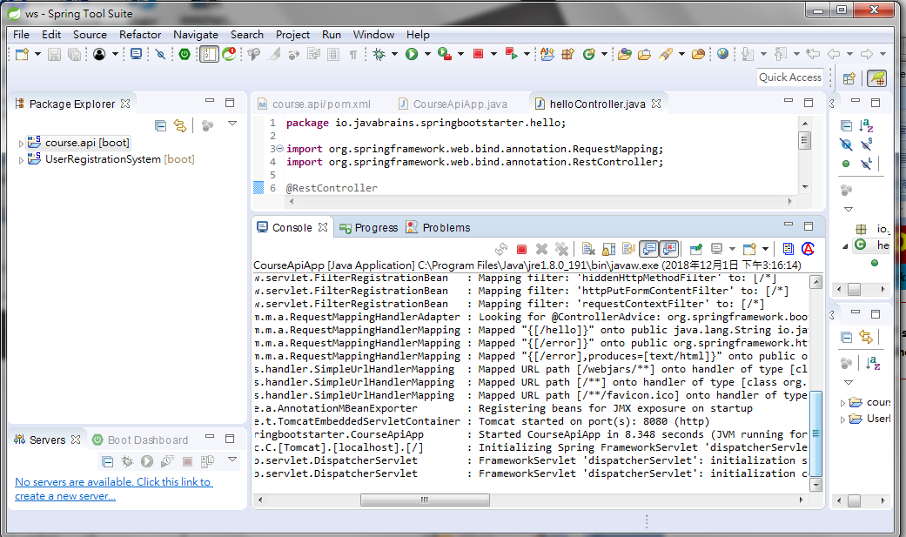
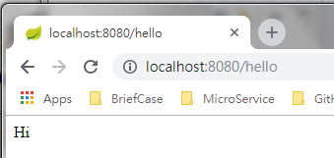
11 Add REST Controller
https://www.youtube.com/watch?v=E7_a-kB46LU&list=PLqq-6Pq4lTTbx8p2oCgcAQGQyqN8XeA1x&index=9
Click “Run” button.
Check the console with “8080” started
Open Chrome and enter “localhost:8080/hello”
We will see “Hi” on browser.

Slide 12
11 Add REST Controller
https://www.youtube.com/watch?v=E7_a-kB46LU&list=PLqq-6Pq4lTTbx8p2oCgcAQGQyqN8XeA1x&index=9
This chapter mapping the request (“hello”) into a call method sayHi () to return a string “Hi”.

Slide 13
End of Chapter

