Slide 1

4 What is Spring?
Peter H. Chen

Slide 2
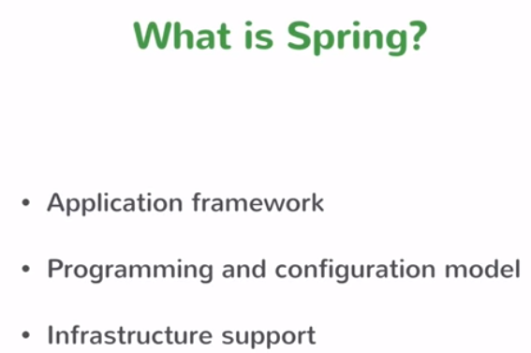
4 What is Spring?
https://www.youtube.com/watch?v=YXlSkWq04jk&list=PLqq-6Pq4lTTbx8p2oCgcAQGQyqN8XeA1x&index=4
To really understand the Spring Boot, we have to understand the Spring.
What is the Spring?

Slide 3
4 What is Spring?
https://www.youtube.com/watch?v=YXlSkWq04jk&list=PLqq-6Pq4lTTbx8p2oCgcAQGQyqN8XeA1x&index=4
To answer the question, Spring is something related to Dependency Injection.
That is the perfect answer of 2006. As for today, it is no longer the case.
Spring is much more than the Dependency Injection.
Spring is the whole application framework. Spring has the origin the concept of Dependency Injection. Spring does a lot of more. Spring is something to build Enterprise Java Application.
There are hundred of zillions of enterprise java applications out there and there are all do things but underlying foundation of all those enterprise Java applications have a lot of similarities.
When you write a business service, you do similar things for every business service no mater what business problem they try to solve. Things like transactional services you want to establish a transaction to connect to the database. Those are common problems. There are common things that every enterprise application needs to solve and Spring handles all the those things.

Slide 4
4 What is Spring?
https://www.youtube.com/watch?v=YXlSkWq04jk&list=PLqq-6Pq4lTTbx8p2oCgcAQGQyqN8XeA1x&index=4
Spring provides a template, Spring provides a framework which lets you build those enterprise applications. Spring also has a programming and configuration model.
Spring lets you focus on building your business services and Spring handles a lot of these common concerns for things like connecting to the database running query. Things like handling HTTP request having MVC layer.
What Spring does is building the classes which are simple POJO. Spring has annotation on them which did not what they are. For example, you are writing business services with the code containing only the logic that is specific to your business application.
Spring annotate that business service in a class. Spring knows the class to be a service and manages the lifecycle of the class. So the class acts as a service.
When you building your application, you focus on your business problem and let Spring handle the rest. Spring provides the model for you to build those applications.
Spring supports infrastructure for database, such as, IBM database or MongoDB. Spring has infrastructure supports for it.

Slide 5
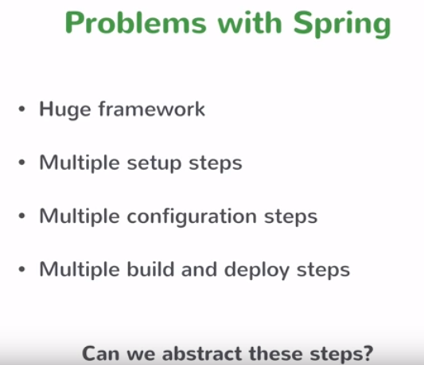
4 What is Spring?
https://www.youtube.com/watch?v=YXlSkWq04jk&list=PLqq-6Pq4lTTbx8p2oCgcAQGQyqN8XeA1x&index=4
Problem with Spring:

Slide 6
4 What is Spring?
https://www.youtube.com/watch?v=YXlSkWq04jk&list=PLqq-6Pq4lTTbx8p2oCgcAQGQyqN8XeA1x&index=4
The first problem: Spring is a huge framework. Spring start trying to solve the common concerns that people could have when they are building enterprise applications. These common concerns are not just one thing. There are so many different things and ways in which you can build an enterprise application and Spring tried to address all those different ways and provide support for all those different ways. Spring become a huge framework in the process. How do I start with a Spring Application?
The second problem: Multiple setup steps. Spring can connect to MongoDB, can connect to DBMS, and etc.
The third problem: Since Spring does whole lot, it needs a whole lot of configuration for exactly you want to do. You required a lot of setup and configuration.
The fourth problem: You need to multiple build and deploy steps. The import things here is that Spring has a lot of capabilities and flexibilities. Capability and flexibility comes with the cost. Since Spring does a lot, you do not have really the starting point. There is no pathway for you to start with.

Slide 7
4 What is Spring?
https://www.youtube.com/watch?v=YXlSkWq04jk&list=PLqq-6Pq4lTTbx8p2oCgcAQGQyqN8XeA1x&index=4
Can we abstract these steps? This is where Spring Boot comes in in handy. You could somehow abstract these steps out again back to the original promise of Spring. You want to have something that is abstracting away all these infrastructure concerns: all these setup and configuration concerns, and you just focus on your business logic.
There are 100 ways to build a Spring application but if only somebody could tell you that this is for 80% of the cases the right way to do it and then for the rest 20% you just configure it ant tweak it a little bit so it works differently.
This is the majority use case if you have some of an opinionated framework and opinionated configuration. This is the way you start with and then tweak it if necessary. That would be really good and that is what Spring Boot does.

Slide 8
End of Chapter

