Slide 1

4 Setup
Peter H. Chen

Slide 2
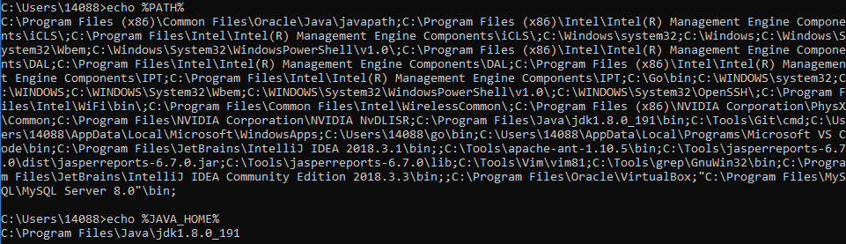
4 Setup
https://www.tutorialspoint.com/spring/
This chapter will guide you on how to prepare a development environment to start your work with Spring Framework.
It will also teach you how to set up JDK, Tomcat and Eclipse on your machine before you set up Spring Framework −
Step 1 - Setup Java Development Kit (JDK)

Slide 3
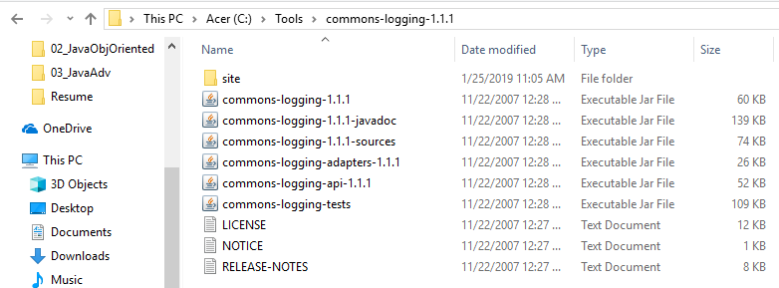
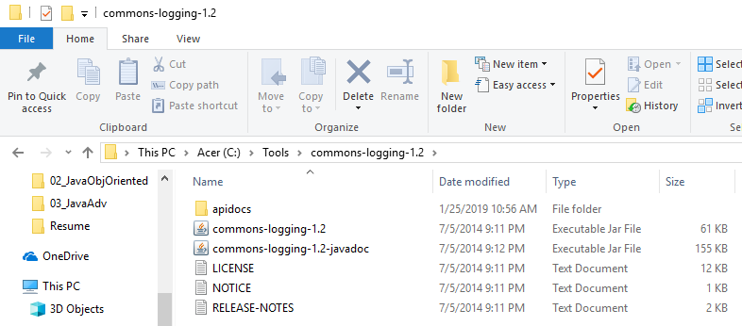
4 Setup
https://www.tutorialspoint.com/spring/
Step 2 - Install Apache Common Logging API
You can download
the latest version of Apache Commons Logging API for current version download at: https://commons.apache.org/logging/.
For version 1.1.1: https://archive.apache.org/dist/commons/logging/binaries/
Once you download the installation, unpack the binary distribution into a convenient location. For example, in C:Tools\commons-logging-1.1.1 on Windows.
This directory will have the following jar files and other supporting documents, etc.
Assign the CLASSPATH for “C:\Tools\commons-logging-1.1.1”.

Slide 4
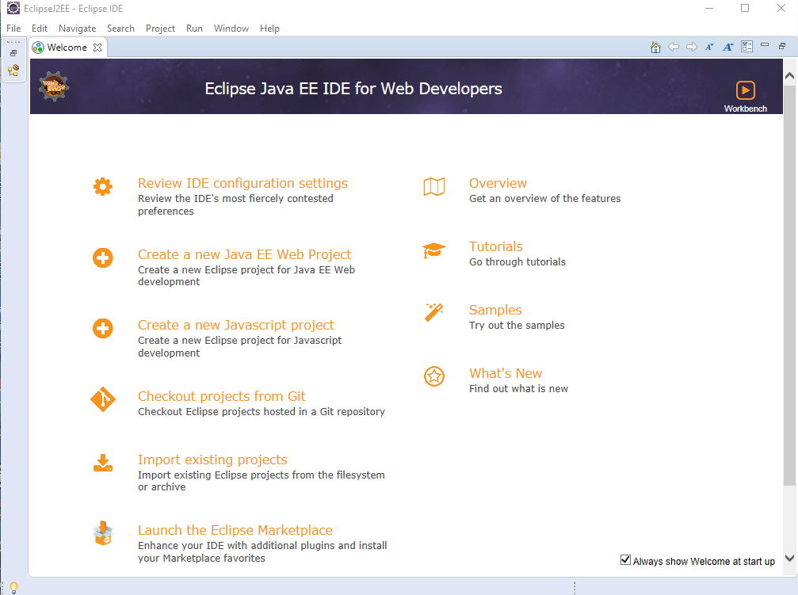
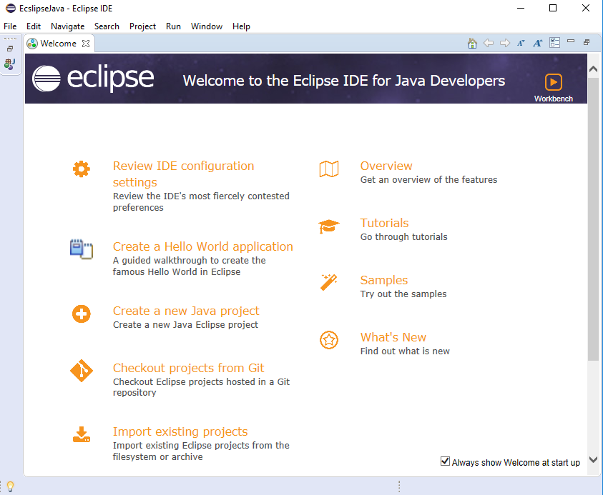
4 Setup
https://www.tutorialspoint.com/spring/
Step 3 - Setup Eclipse IDE
All the examples in this tutorial have been written using Eclipse IDE. So we would suggest you should have the latest version of Eclipse installed on your machine.
To install Eclipse IDE, download the latest Eclipse binaries from https://www.eclipse.org/downloads/. Once you download the installation, unpack the binary distribution into a convenient location. For example, in C:\eclipse on Windows, or /usr/local/eclipse on Linux/Unix and finally set PATH variable appropriately.
Eclipse can be started by executing the following commands on Windows machine, or you can simply double-click on eclipse.exe
Eclipse Java EE IDE for Web Developer
Eclipse IDE for Java Developer

Slide 5
4 Setup
https://www.tutorialspoint.com/spring/
Step 4 - Setup Spring Framework Libraries
Now if everything is fine, then you can proceed to set up your Spring framework. Following are the simple steps to download and install the framework on your machine.
Make a choice whether you want to install Spring on Windows or Unix, and then proceed to the next step to download .zip file for Windows and .tz file for Unix.
Download the latest version of Spring framework binaries from https://repo.spring.io/release/org/springframework/spring.
At the time of developing this class, spring-framework-4.1.6.RELEASE-dist.zip was downloaded on Windows machine. After the downloaded file was unzipped, it gives the following directory structure inside E:\spring.
You will find all the Spring libraries in the directory E:\spring\libs. Make sure you set your CLASSPATH variable on this directory properly otherwise you will face a problem while running your application. If you are using Eclipse, then it is not required to set CLASSPATH because all the setting will be done through Eclipse.

Slide 6
End of Chapter

