Slide 1

7 Draw Box on Matched Face
Peter H. Chen

Slide 2
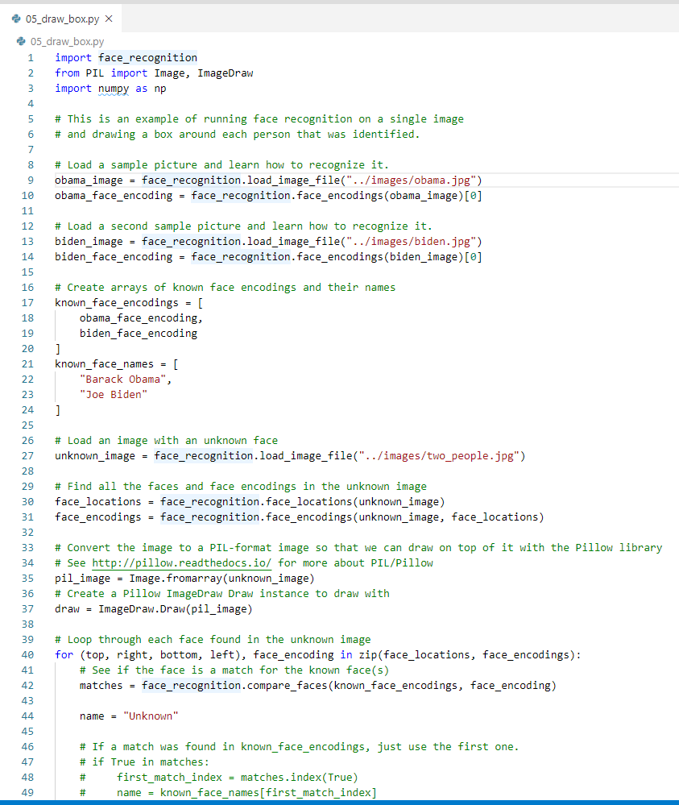
7 Draw Box on Matched Face
https://pypi.org/project/face-recognition/
Draw Box on Matched Faces
> python 05_draw_box.py

Slide 3
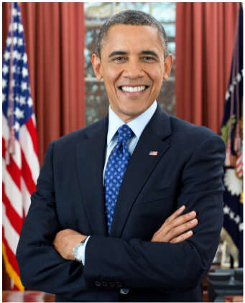
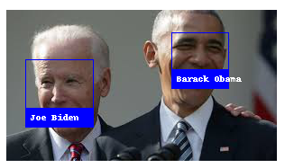
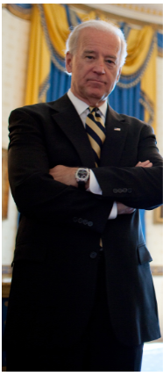
7 Draw Box on Matched Face
https://pypi.org/project/face-recognition/
Draw Box on Macthed Faces
> python 05_draw_box.py

Slide 4
End of Chapter

