Slide 1

8 Face Recognition
Peter H. Chen

Slide 2
8 Face Recognition
https://www.youtube.com/watch?v=D5xqcGk6LEc
Face Detection
You can test as many faces as you want.
Face recognition is very useful framework and script.
Problem:
Given a know image with name and a set of unknown images.
We want to draw boxes around the faces and identify based on our given named images and a set of unknown images.

Slide 3
8.1 Setup

Slide 4
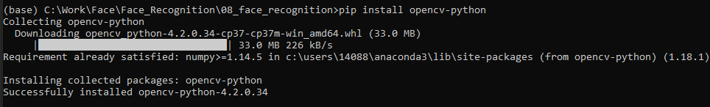
8.1 Setup
https://www.youtube.com/watch?v=D5xqcGk6LEc
Face Detection
> pip install opencv-python

Slide 5
8.2 Read Named Images

Slide 6
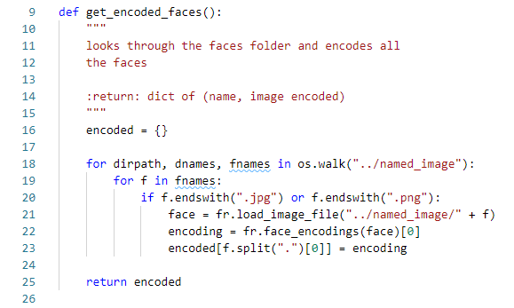
88.2 Read Named Images
https://www.youtube.com/watch?v=D5xqcGk6LEc
Get_encoded_faces:
Rad through all the named faces in the “named_image” folder.
Encoded the faces into a format that machine learning model inside the face recognition can use.

Slide 7
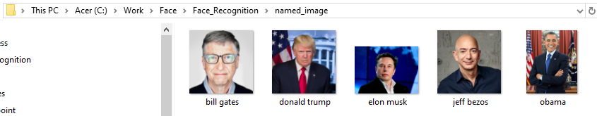
8.2 Read Named Images
https://www.youtube.com/watch?v=D5xqcGk6LEc
Face Detection
Put the images files with labeled name, such as, bill gates, donald trump, elon musk, jeff bezos, Obama, and etc. in the folder “named_image”
Make sure all the images have the correct names (or labels).

Slide 8
8.3 Test Image

Slide 9
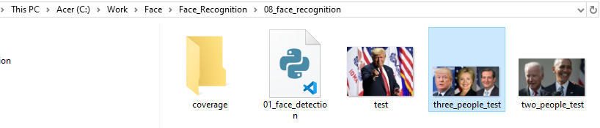
8.3 Test Image
https://www.youtube.com/watch?v=D5xqcGk6LEc
Test Image
Put the image we want to image with the name “test.jpg”, “two_peole_test.jpg”, or “three_people_test.jpg” in the same folder as 01_face_detection.py.

Slide 10

8.3 Test Image
https://www.youtube.com/watch?v=D5xqcGk6LEc
Test Image
Call classify_face (“test_image_name”) to test the image.

Slide 11
8.4 Identify Face

Slide 12
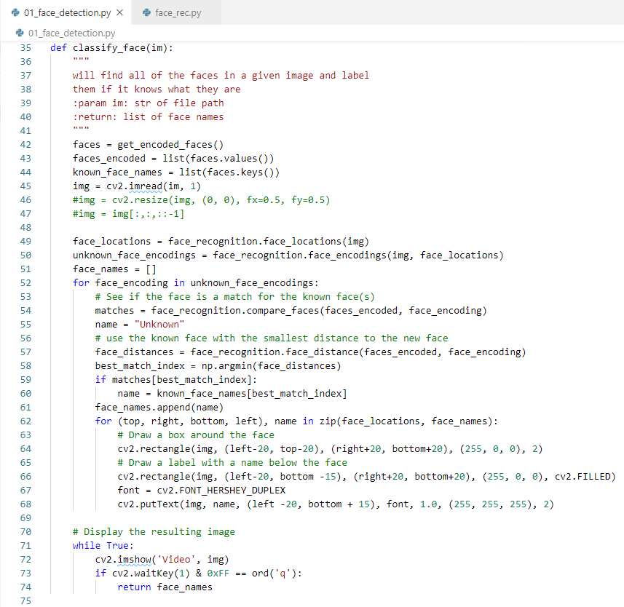
8.3 Identify Face
https://www.youtube.com/watch?v=D5xqcGk6LEc
Face Detection
It find all the faces in the test images, draw a box, put the name around the box.
It wait for user input ‘q’ to exit.

Slide 13
8.5 Verify

Slide 14
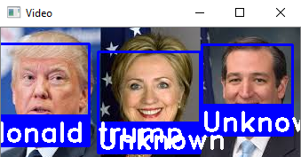
8.5 Verify
https://www.youtube.com/watch?v=D5xqcGk6LEc
Face Detection
> python 01_face_detection.py
Type ‘q’ to exit the program.
You can see two people are unknown (That is because we did not provide the “named image”) and “donald trump” is identify.

Slide 15
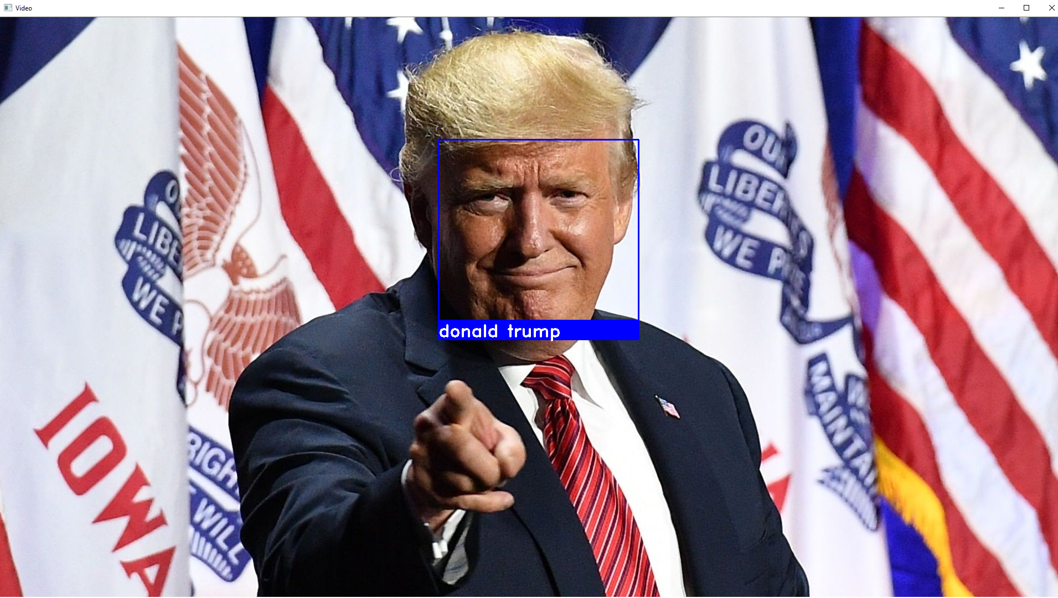
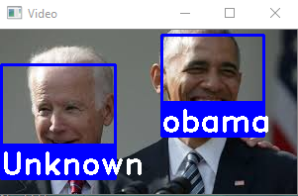
8.5 Verify
https://www.youtube.com/watch?v=D5xqcGk6LEc
Face Detection
> python 01_face_detection.py
We can test others images as well.

Slide 16
End of Chapter

