Slide 1

1 Face Recognition
Peter H. Chen

Slide 2
1 Face Recognition
https://pypi.org/project/face-recognition/
Face Recognition
Python simple face recognition library.
Python Face Recognition based on face recognition C++ library dlib.
Requirements:
Python 3.7
Ubuntu OS

Slide 3
1.1 Setup

Slide 4
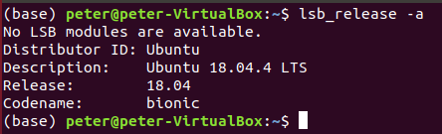


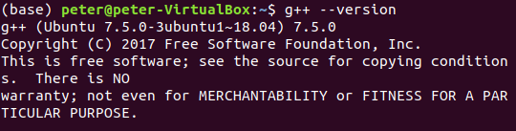
1.1 Setup
https://gist.github.com/ageitgey/629d75c1baac34dfa5ca2a1928a7aeaf
Setup
Install Oracle Virtual Box (6.1), install Ubuntu OS, and install Anaconda.
Start the Ubuntu
Check the setup
> lsb_release -a # 18.04
> anaconda --version # 1.7.2
> python --version # 3.7.2
> g++ --version # 7.5.0

Slide 5
1.2 Install dlib

Slide 6
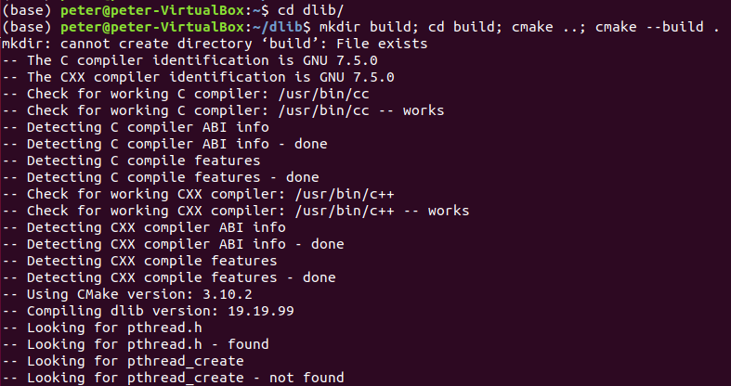
1.2 Install dlib
https://gist.github.com/ageitgey/629d75c1baac34dfa5ca2a1928a7aeaf
Install dlib
> git clone https://github.com/davisking/dlib.git
> cd dlib
> mkdir build; cd build; cmake ..; cmake --build .
>> ~/dlib/build
…

Slide 7
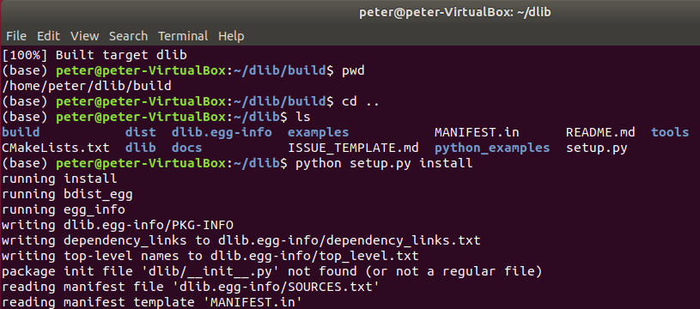
1.2 Install dlib
https://gist.github.com/ageitgey/629d75c1baac34dfa5ca2a1928a7aeaf
Install dlib
Current directory is ~/dlib/build
> cd ..
>> dlib
> ls
> python setup.py install
…

Slide 8
1.3 Install face_recognition

Slide 9
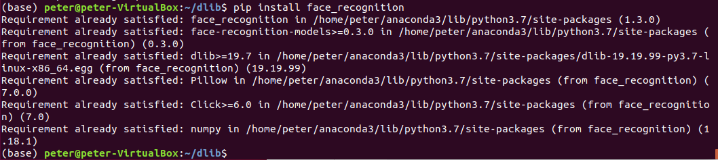
1.3 Install face_recognition
https://pypi.org/project/face-recognition/
Install face_reconition
> pip3 install face_recognition

Slide 10
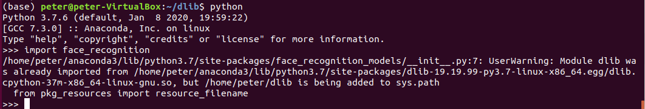
1.3 Install face_recognition
https://pypi.org/project/face-recognition/
Install face_reconition
> python
>>> import face_recognition

Slide 11
End of Chapter

