Slide 1

3 Find Face Location
Peter H. Chen

Slide 2
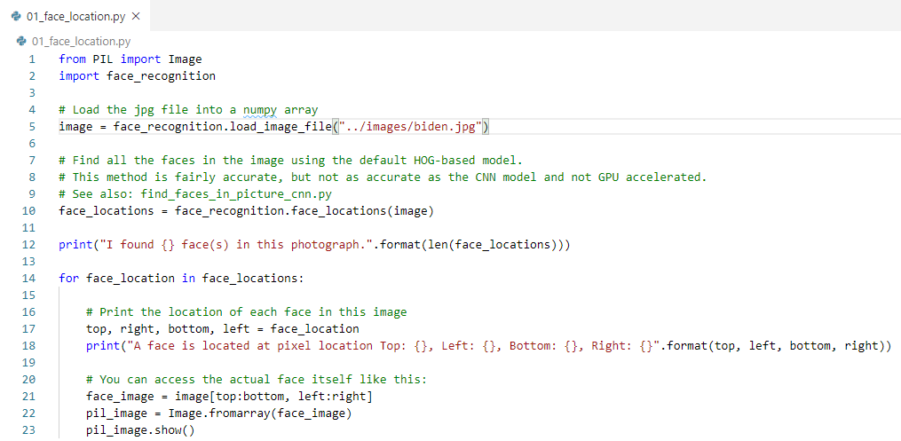
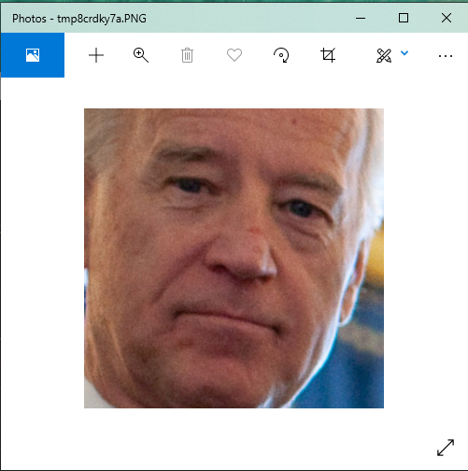

3 Find Face Location
https://pypi.org/project/face-recognition/
Find all faces in image
> python 01_face_location.py

Slide 3
End of Chapter

