Slide 1

4 Deep Learning Face Detection
Peter H. Chen

Slide 2
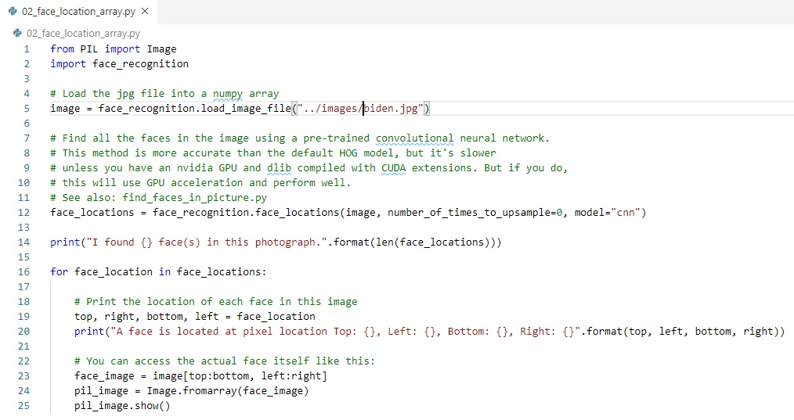
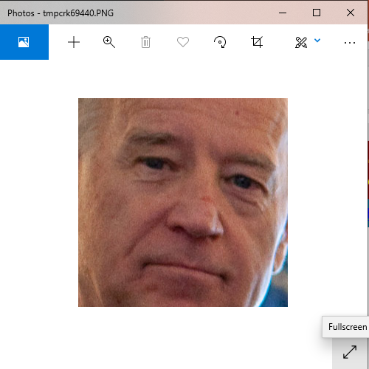

4 Deep Learning Face Detection
https://pypi.org/project/face-recognition/
Deep Learning Face Detection
> python 02_face_location_array.py

Slide 3
End of Chapter

