Slide 1

5 Face and Feature Extraction
Peter H. Chen

Slide 2
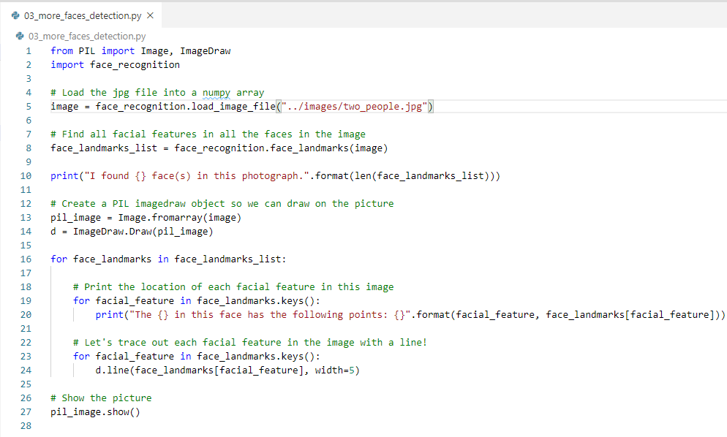
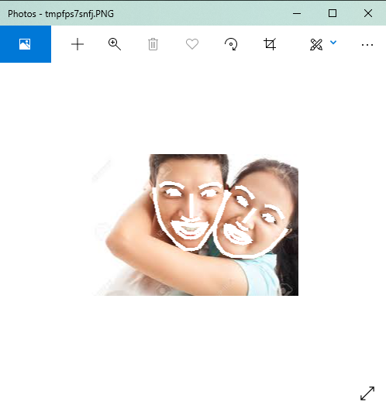
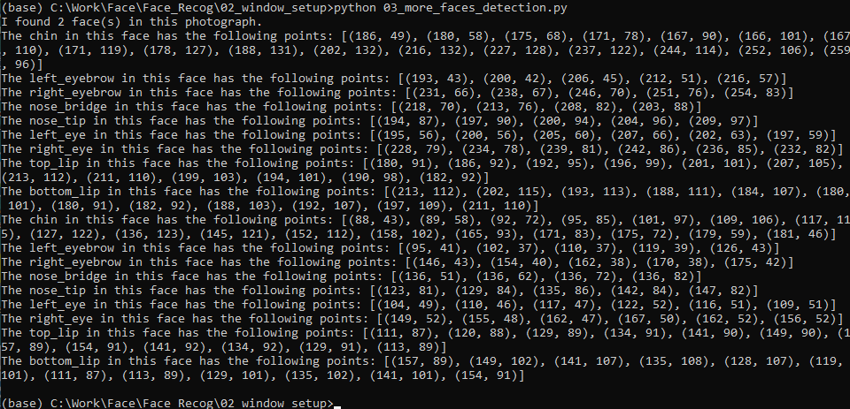
5 Face and Feature Extraction
https://pypi.org/project/face-recognition/
Face Features Extraction
> python 03_more_faces_detection.py

Slide 3
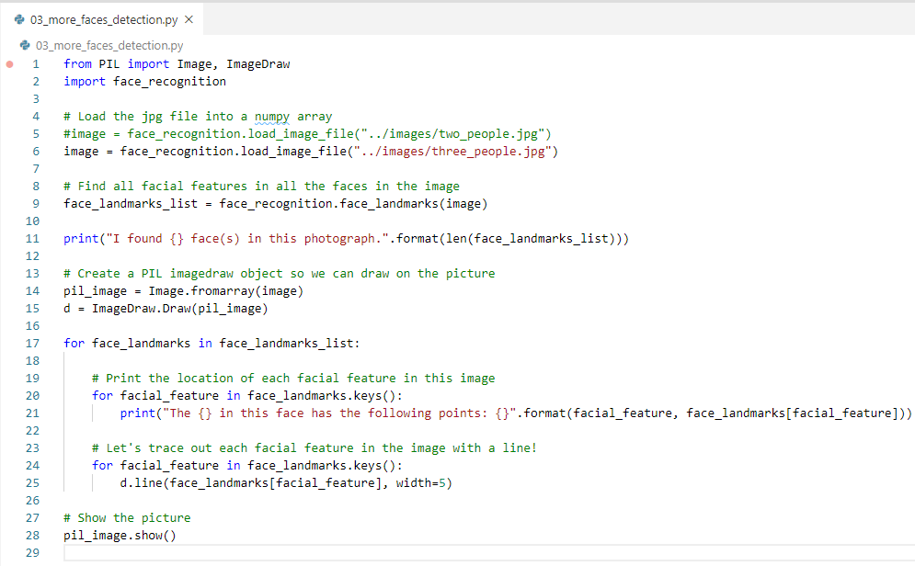
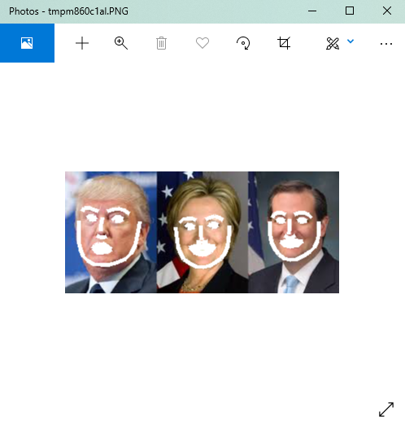
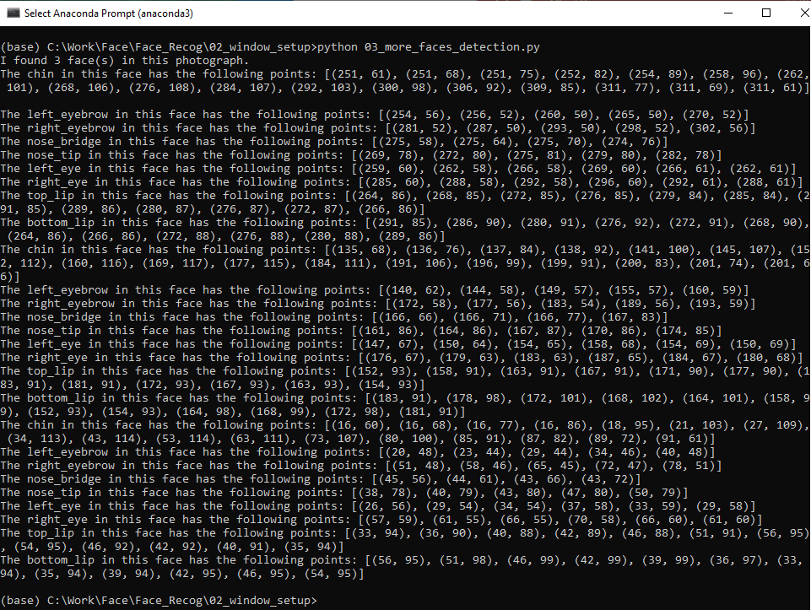
5 Face and Feature Extraction
https://pypi.org/project/face-recognition/
Face Features Extraction
> python 03_more_faces_detection.py

Slide 4
End of Chapter

