Slide 1

6 Identify Face
Peter H. Chen

Slide 2
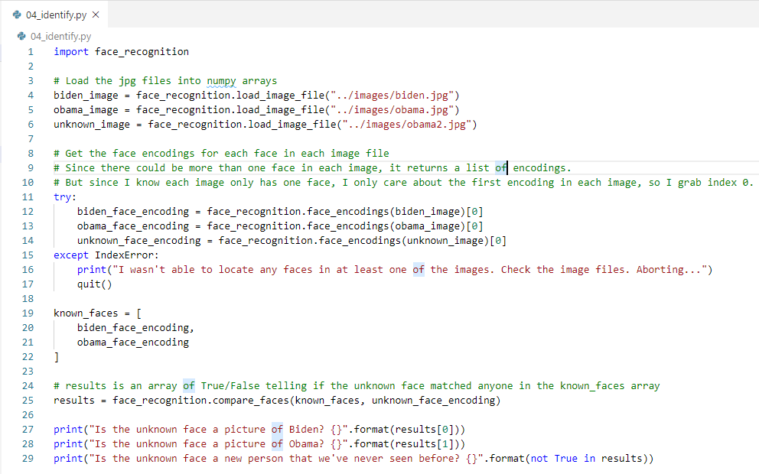
6 Identify Face
https://pypi.org/project/face-recognition/
Identify Face
> python 04_identify.py

Slide 3
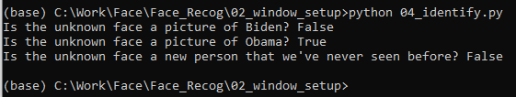
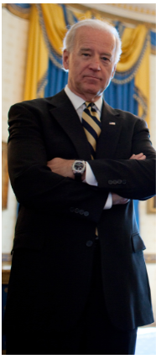
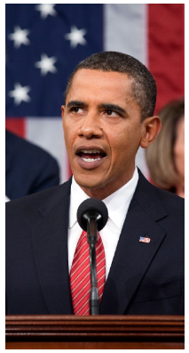
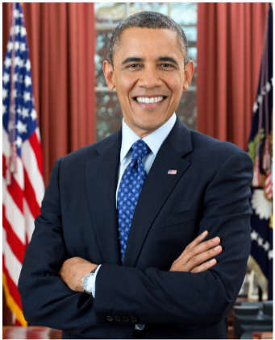
6 Identify Face
https://pypi.org/project/face-recognition/
Identify Face
> python 04_identify.py
False
True
Unknown
(obama2)

Slide 4
End of Chapter

