Slide 1

9 Face Recognition for Videos
Peter H. Chen

Slide 2
9 Face Recognition for Videos
https://github.com/ageitgey/face_recognition/blob/master/examples/facerec_from_webcam_faster.py
Face Recognition for Video
We discuss the Face Recognition for Video.
We use the web camera from your computer to display the image and use the named images to identify the face on the camera.

Slide 3
8.1 Load Named Images

Slide 4
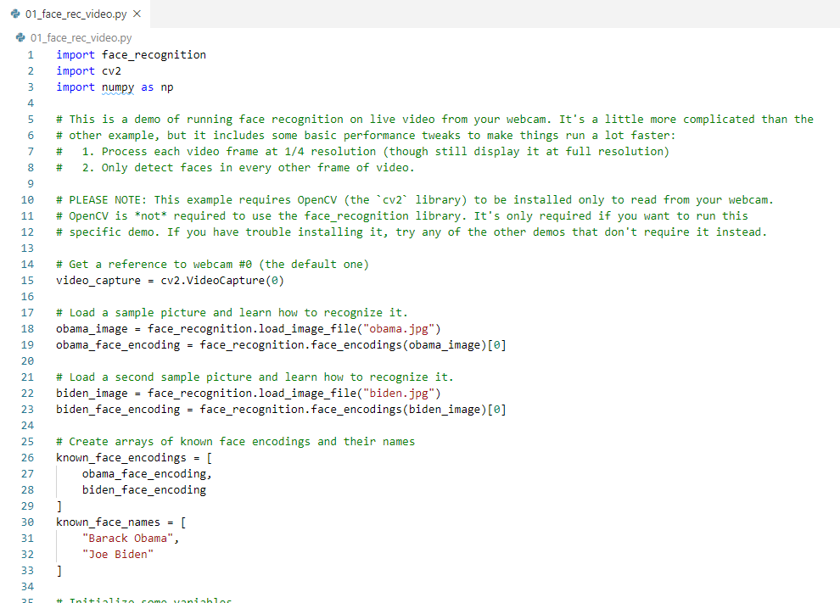
8.1 Load Named Images
https://github.com/ageitgey/face_recognition/blob/master/examples/facerec_from_webcam_faster.py
Load Named Images
Load two given named images, i.e., Obama and Biden, in the current folder.

Slide 5
8.2 Identify Faces on Video

Slide 6
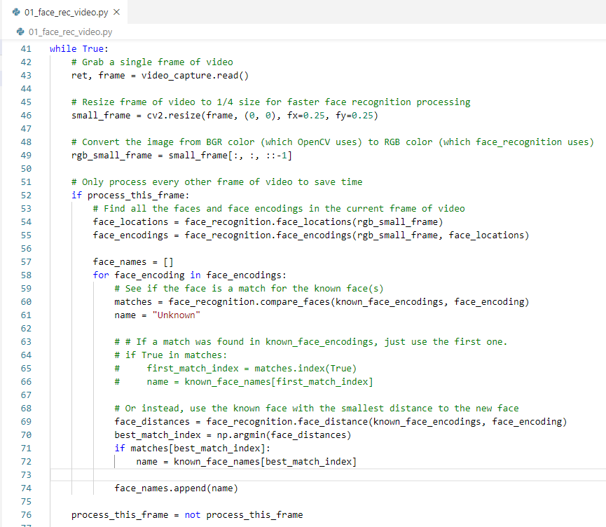
8.2 Identify Faces on Video
https://github.com/ageitgey/face_recognition/blob/master/examples/facerec_from_webcam_faster.py
Identify Faces on Video

Slide 7
8.3 Draw Box and Text

Slide 8
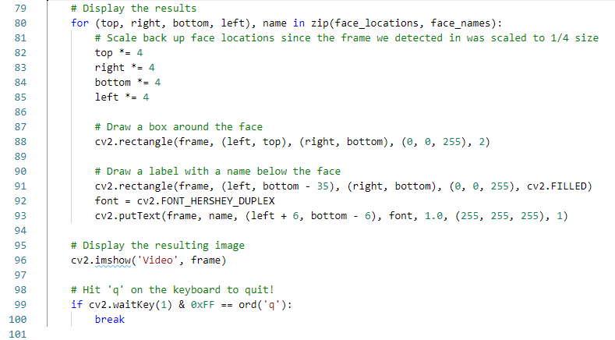
8.3 Draw Box and Text
https://github.com/ageitgey/face_recognition/blob/master/examples/facerec_from_webcam_faster.py
Draw Box and Text

Slide 9
8.4 User Input ‘q’ to Exit

Slide 10

8.4 User Input ‘q’ to Exit
https://github.com/ageitgey/face_recognition/blob/master/examples/facerec_from_webcam_faster.py
User Input ‘q’ to Exit

Slide 11
8.5 Verify

Slide 12
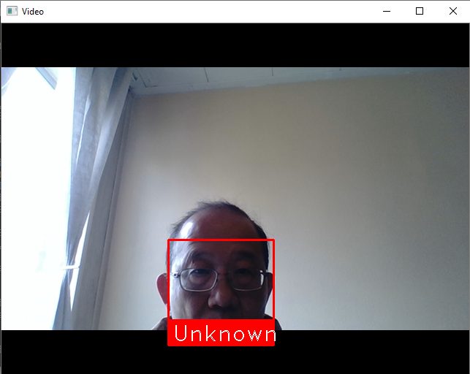
8.5 Verify
https://github.com/ageitgey/face_recognition/blob/master/examples/facerec_from_webcam_faster.py
Verify
Click ‘q’ to exit.

Slide 13
End of Chapter

