Slide 1
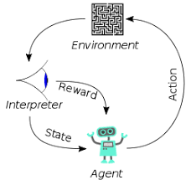
001 Palo Alto 2581 - 2585
Peter H. Chen

Slide 2
001 Palo Alto 2581 - 2585
https://www.hsinchu.gov.tw/cp.aspx?n=982&s=263
25’
Palo Alto 2581 to 2587
20’
17’
30’
19’
19’
22’
33’
25’
40’
15’
40’

Slide 3
001 Palo Alto 2581 - 2585
https://www.hsinchu.gov.tw/cp.aspx?n=982&s=263
Palo Alto 2581 to 2587
Front yard parking lot.
8’
9’
9’
9’
4’
25’
18’
12’
7’
5’
15’
39’

Slide 4
001 Palo Alto 2581 - 2585
https://www.hsinchu.gov.tw/cp.aspx?n=982&s=263
Palo Alto 2581 to 2587
Front yard parking lot.
32”
9’
25’
8’
8’
5’
15’
39’

Slide 5
001 Palo Alto 2581 - 2585
https://www.hsinchu.gov.tw/cp.aspx?n=982&s=263
Palo Alto 2581 to 2587
Front yard parking lot.
13’
13’
13’
25’
5’
15’
39’

Slide 6
End

