Slide 1

001 Palo Alto 2581 - 2587
Peter H. Chen

Slide 2
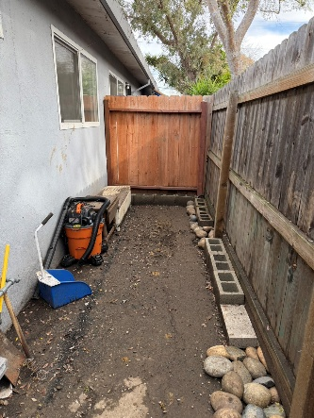
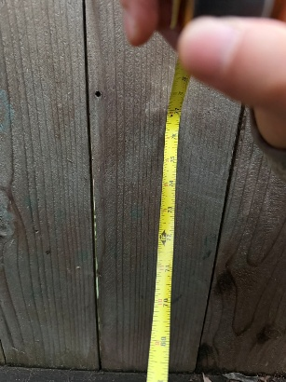
001 Palo Alto 2581 - 2581
https://www.hsinchu.gov.tw/cp.aspx?n=982&s=263
Palo Alto 2581 to 2587
Window
6 ft
6 ft
2” x 4” x 8’
6 ft (76”)
Front View
Side View
4” x 4” x 8’

Slide 3
End

