Slide 1
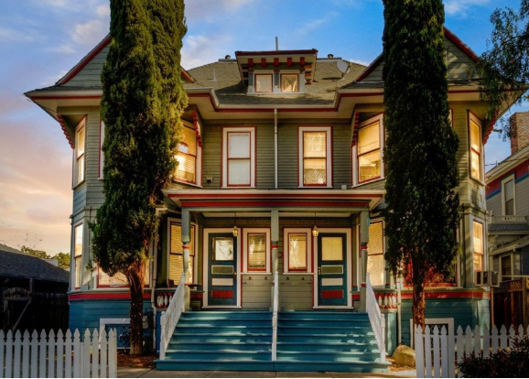
90 N 8th Street
Peter H. Chen

Slide 2
1.1 Remodel

Slide 3
1.1 Remodel
https://www.google.com/maps/place/90+N+8th+St,+San+Jose,+CA+95112/data=!4m2!3m1!1s0x808fcc95f7d47979:0x690c13fe2b3d2333?sa=X&ved=2ahUKEwicq7CZoYHwAhUHsJ4KHUE_D_cQ8gEwAHoECAMQAQ
Remodel Estimate
 | Unit A | Unit B | Unit C | Unit D | Common | SUM | ASSUMPTIONS
Kitchen | $7,000 | $- | $- | $- |  | $7,000 | Replacement of existing kitchen cabinets (minimal reconfiguration)
Bath | $5,000 | $- | $- | $- |  | $5,000 | Replacement of existing bathroom cabinets/fixtures/bathtub/vanity (minimal reconfiguration)
Floor | $6,300 | $- | $- | $- |  | $6,300 | Assumes 900SF @ $7/SFt, laminate to engineered wood floor planks
Paint | $2,500 | $- | $- | $- |  | $2,500 | Assumes single color + ceilings, and semi-gloss for kitchen & bathroom
Appliances | $5,100 | $- | $- | $- |  | $5,100 | Standard grade stove, dishwasher, refrigerator, washer/dryer
Windows | $18,000 | $- | $- | $- |  | $18,000 | Assumes 9 windows @ $2,000/window
Permit | $900 |  |  |  |  | $900 | Will require permits for addition of washer/dryer, electrical, HVAC, etc.
Hallway/Stairs 1 |  |  |  |  | $3,600 | $3,600 | Assumes 20 steps @ $180/step
Hallway/Stairs 2 |  |  |  |  | $3,600 | $3,600 | Assumes 20 steps @ $180/step
Exterior Paint |  |  |  |  | $19,200 | $19,200 | ~6,400SF of wall @ $3/SFt
Parking Reconfig |  |  |  |  | $3,000 | $3,000 | Assumes design, measurement survey, marking, re-striping
Compliance |  |  |  |  | $27,600 | $27,600 | Unit B/C/D, Permit, electric, plumbing, carpentry, HVAC, design, 20% contingency
SUB-TOTAL | $44,800 | $- | $- | $- | $57,000 | $101,800 | Rough Order of Magnitude Cost Estimate to Complete Listed Items.

Slide 4
1.2 Outside Dimension

Slide 5
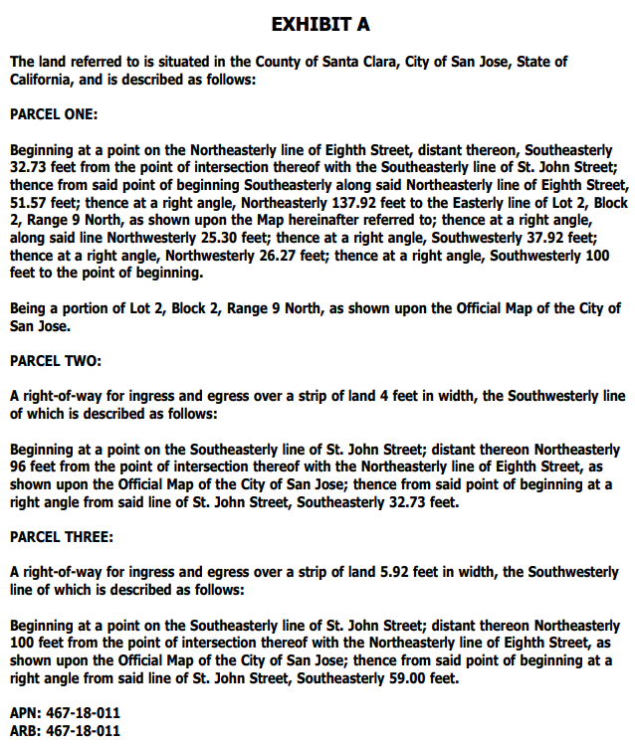
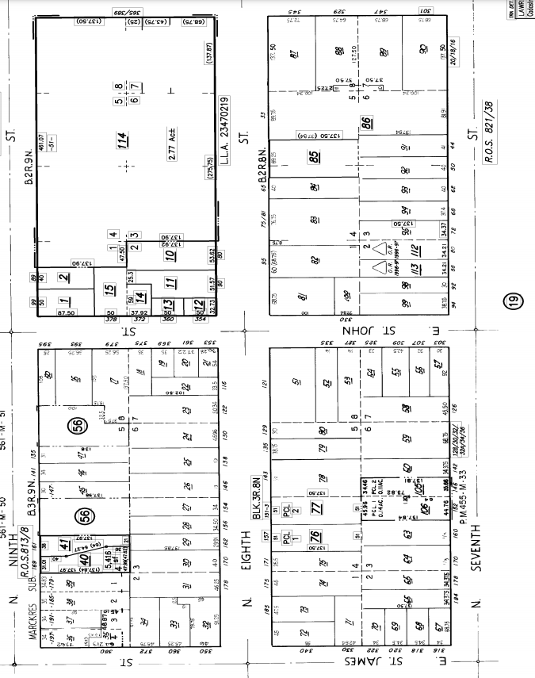
1.2 Outside Dimension
https://www.google.com/maps/place/90+N+8th+St,+San+Jose,+CA+95112/data=!4m2!3m1!1s0x808fcc95f7d47979:0x690c13fe2b3d2333?sa=X&ved=2ahUKEwicq7CZoYHwAhUHsJ4KHUE_D_cQ8gEwAHoECAMQAQ
Outside Dimension: 25.3’ x 37.92’ + 51.57’ x 100’ = 959.376 + 5157 = 6116.376 sq ft
1: 51.57’, 2: 137.92’, 3: 25.30’, 4:37.92’, 5: 26.27’, 6: 100’
4’ x 32.73’

Slide 6
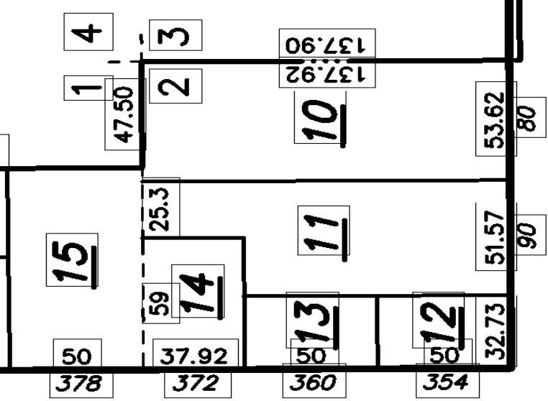
1.2 Outside Dimension
https://www.google.com/maps/place/90+N+8th+St,+San+Jose,+CA+95112/data=!4m2!3m1!1s0x808fcc95f7d47979:0x690c13fe2b3d2333?sa=X&ved=2ahUKEwicq7CZoYHwAhUHsJ4KHUE_D_cQ8gEwAHoECAMQAQ
Outside Dimension: 25.3’ x 37.92’ + 51.57’ x 100’ = 959.376 + 5157 = 6116.376 sq ft
137.92’
25.3’
37.92’
51.57’
26.27'
100’
59’
32.73’
5.92’
4’

Slide 7
1.2 Outside Dimension
https://www.google.com/maps/place/90+N+8th+St,+San+Jose,+CA+95112/data=!4m2!3m1!1s0x808fcc95f7d47979:0x690c13fe2b3d2333?sa=X&ved=2ahUKEwicq7CZoYHwAhUHsJ4KHUE_D_cQ8gEwAHoECAMQAQ
Parking:
Garbage containers
137.92’
37.92’
17’
9’
25.3’
51.57’
15’
32’
26.27'
59’
fence
100’
32.73’
5.92’
4’

Slide 8
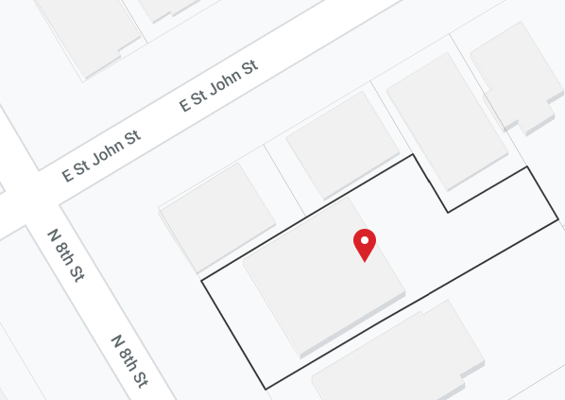
1.2 Outside Dimension
https://www.google.com/maps/place/90+N+8th+St,+San+Jose,+CA+95112/data=!4m2!3m1!1s0x808fcc95f7d47979:0x690c13fe2b3d2333?sa=X&ved=2ahUKEwicq7CZoYHwAhUHsJ4KHUE_D_cQ8gEwAHoECAMQAQ
Outside Dimension:
6’2” (Walk way) + 3’5” (city plant) + 8” (curb)
= 10’3”
9’10”
87’6”
33’8”
23’7”
12’5”
26’2”
4’4”
Rear Neighbor Drive way: (9’10”/2) x (33’8” + 26.2”) = 5’4”x 69.10”
= 350 sq ft.
Backyard: 33’ x 23’7”
= 792 sq ft.
Net Near Neigbor = 792 - 350.81
= 442 sq ft
Back yard Parking = 23’7” x 33’
Basement height: 7’8” (above ground 4’8”, below ground 3’).
33’
29’8”
147’
42’4”
43’
12’8”
53’
5’8”-6’3”
53’
114’
16’3” - 18’

Slide 9
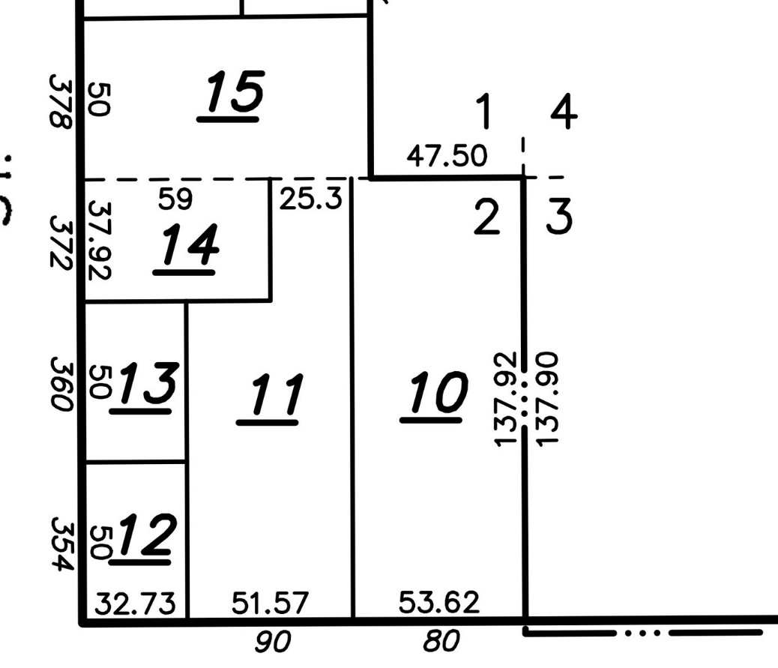
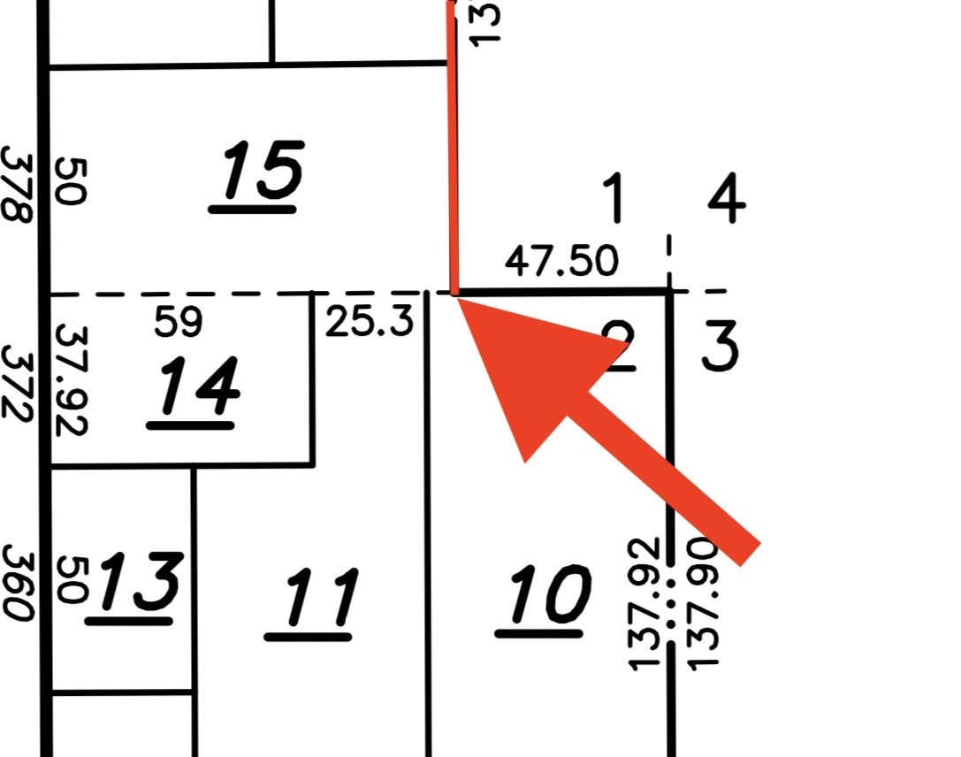
1.2 Outside Dimension
https://www.google.com/maps/place/90+N+8th+St,+San+Jose,+CA+95112/data=!4m2!3m1!1s0x808fcc95f7d47979:0x690c13fe2b3d2333?sa=X&ved=2ahUKEwicq7CZoYHwAhUHsJ4KHUE_D_cQ8gEwAHoECAMQAQ
Outside Dimension:
≈ 47.5”
≈ 47.5”
3
2
3
2
1
1

Slide 10
1.3 Attic Dimension

Slide 11
1.3 Attic Dimension
https://www.google.com/maps/place/90+N+8th+St,+San+Jose,+CA+95112/data=!4m2!3m1!1s0x808fcc95f7d47979:0x690c13fe2b3d2333?sa=X&ved=2ahUKEwicq7CZoYHwAhUHsJ4KHUE_D_cQ8gEwAHoECAMQAQ
Attic Dimension:
Highest point = 15’
35’
36’

Slide 12
1.4 Basement Dimension

Slide 13
1.4 Basement Dimension
https://www.google.com/maps/place/90+N+8th+St,+San+Jose,+CA+95112/data=!4m2!3m1!1s0x808fcc95f7d47979:0x690c13fe2b3d2333?sa=X&ved=2ahUKEwicq7CZoYHwAhUHsJ4KHUE_D_cQ8gEwAHoECAMQAQ
Basement Dimension:
Highest point = 6’ to 7’9”’

Slide 14
1.5 Backyard

Slide 15
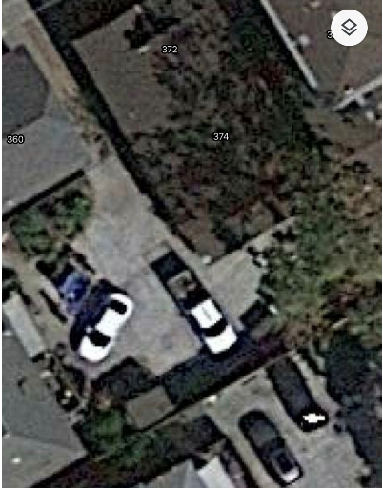
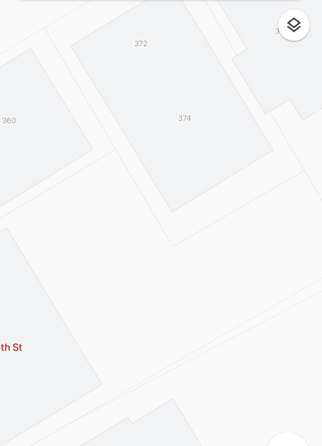
1.5 Backyard
https://www.google.com/maps/place/90+N+8th+St,+San+Jose,+CA+95112/data=!4m2!3m1!1s0x808fcc95f7d47979:0x690c13fe2b3d2333?sa=X&ved=2ahUKEwicq7CZoYHwAhUHsJ4KHUE_D_cQ8gEwAHoECAMQAQ
Backyard Parking
Remove storage.
Move Neighbor’s and our garbage container here.
??

Slide 16
End

