Slide 1
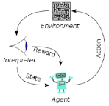
001 90 N 8th Street
Peter H. Chen

Slide 2
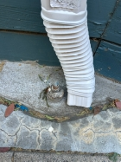
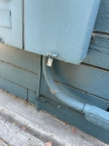
90 N 8th Street
Main Panel (above ground)
90 N 8th Street
Existing wires (Fourplex A, B, C,D) with public E
E
C
B
B
A
D
A
14 feet
Ground spot
Safety spot
23 feet
Building/Basement Wall
Sub-panel Panel (7 feet below ground)
Breakers: 40 A, 20 A, 15 A
E
E
D
C
C
B
B
B
A
A
D
A
Fire Line
Neutral Line

Slide 3
90 N 8th Street
Main Panel (above ground)
90 N 8th Street
Add new Ground Line (Fourplex A, B, C,D) with public E
E
C
B
B
A
D
A
14 feet
Ground spot
Safety spot
23 feet
Building/Basement Wall
Sub-panel Panel (7 feet below ground)
Breakers: 40 A, 20 A, 15 A
E
E
D
C
C
B
B
B
A
A
D
A
Fire Line
Neutral Line
Ground Wire (5 separate #8 AWG wire with PVC covered)
5 Ground Bars

Slide 4
90 N 8th Street
Q. When we install the ground bar do we need to connect to the physical ground or safety spot?
Ans:
When you install an equipment ground bar in an electrical panel, you actually need to connect it to both, as they are parts of the same continuous safety path. Specifically, the ground bar must be physically bonded (screwed directly) to the metal panel enclosure (the "safety spot"), and that entire panel system must ultimately connect back to the earth/grounding rods (the "physical ground").
Here is exactly how these two concepts work together to keep you safe:
1. Connecting to the "Safety Spot" (The Enclosure)
The ground bar must be mounted tightly against the bare metal of the panel box.
  The Mechanism: You must use the specific thread-cutting machine screws (usually 10-32) that come with the ground bar. Do not use regular drywall or sheet metal screws.
  The Purpose: This creates a direct electrical "bond" between the bar and the metal box. If a loose hot wire ever touches the metal box, the electricity safely flows into the ground bar and immediately trips the circuit breaker rather than shocking you when you touch the panel door.
2. Connecting to the "Physical Ground" (The Earth)
An isolated ground bar sitting in a metal box does nothing without a path out. The ground bar must hook into the larger grounding system:
  Main Panel: If this is your main service panel, the ground bar connects directly to the thick, bare copper wire that goes outside to your physical ground rods or metal water pipes buried in the earth. In the main panel only, it is also bonded to the incoming neutral wire.
  Subpanel: If you are adding this bar to a subpanel (like in a garage or basement), the new ground bar must connect to a dedicated equipment grounding conductor (green or bare wire) that runs all the way back to the main panel's grounding system.
A Crucial Warning on Neutrals
  Never mix up your grounds and your neutrals in a subpanel. While the ground bar must touch the metal panel box, the neutral bar must remain completely isolated on its plastic spacers. Merging them anywhere past your main panel can send dangerous currents over your safety grounding system.

Slide 5
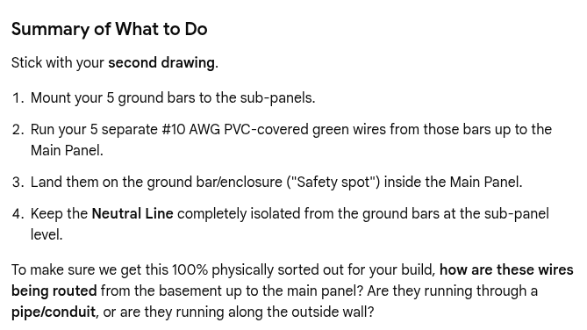
90 N 8th Street
Gemini AI

Slide 6
End

