Slide 1
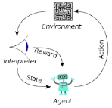
001 90 N 8th Street
Peter H. Chen

Slide 2
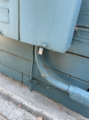
90 N 8th Street
D
E
C
Main Panel
(above ground)
90 N 8th Street
I don’t have Ground Line (Fourplex A, B, C,D) with public E.
B
A
Neutral and Ground Wire together.
23 feet
Safety spot
Building/Basement Wall
E
D
C
Sub-panel Panel (7 feet below ground)
B
Breakers: 40 A, 20 A, 15 A
A
Fire Line
Neutral Line
Neutral Barf

Slide 3
90 N 8th Street
D
E
C
Main Panel
(above ground)
90 N 8th Street
Add new Ground Line (Fourplex A, B, C,D) with public E.
Neutral and Ground Wire together and maintain 0V if normal condition. If not 0V (Abnormal), then main breaker will be tripped.
Owner can have authority to open main panel.
B
A
Neutral and Ground Wire together.
23 feet
Safety spot
Building/Basement Wall
E
D
C
Sub-panel Panel (7 feet below ground)
B
Breakers: 40 A, 20 A, 15 A
A
Fire Line
Neutral Line
Neutral Barf
Ground Wire (#8 AWG wire with PVC covered)
Ground bar:
Connect the Green or Bare Copper Wire

Slide 4
End

