Slide 1
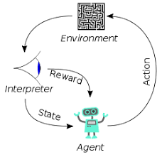
001 Palo Alto 2581 - 2587
Peter H. Chen

Slide 2
001 Palo Alto 2585
https://www.hsinchu.gov.tw/cp.aspx?n=982&s=263
Palo Alto 2585
3’
8’’
2585 Car
Carport
2583 Car
2581 Car
Main Building (2581 Alma)
6’
Car
Car
8’
216’’
6’
2585 Car
2581’
6’
216’’
3’
> 16’
Main Building (2585)
26’’

Slide 3
End

