Slide 1
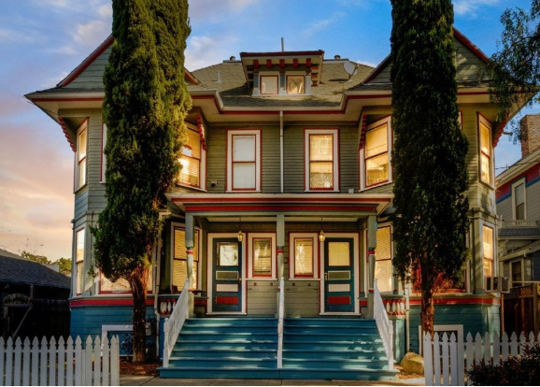
1 County Record

Slide 2
1 County Record
https://www.sccassessor.org/online-services/property-search/search-by-map
County Record
https://www.sccassessor.org/online-services/property-search/search-by-map
This is the APN 46718011
https://www.sccassessor.org/index.php/apn-redirect?ApnValue=46718011

Slide 3
End

