Slide 1

001 90 N 8th Street
Peter H. Chen

Slide 2
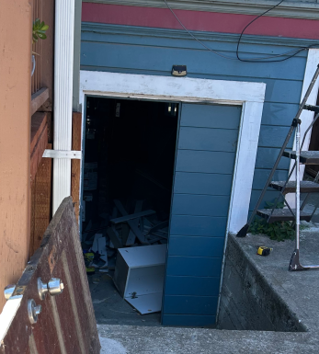
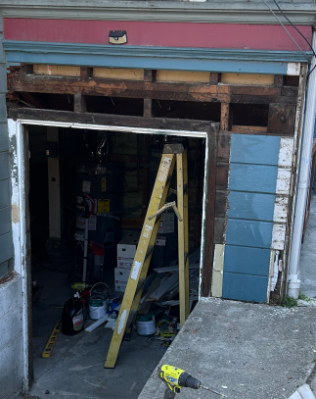
001 90 N 8th Street
https://www.hsinchu.gov.tw/cp.aspx?n=982&s=263
90 N 8th Street
Basement Door:
1. Standard door height is 80 inch. Beam height is 70 inch. To prevent the cut the door height. Change from 70 inch (limited by beam height) in-swing into 80 inch out-swing door
2. For more out-swing space: Move the door from building into just before the beam.
36”
70”
14”
80”
46”
36”
82”
70”

Slide 3
End

