Slide 1

5 Implement
Peter H. Chen

Slide 2
5 Implement
pip install git+https://github.com/philferriere/cocoapi.git#subdirectory=PythonAPI
https://colab.research.google.com/drive/16jcaJoc6bCFAQ96jDe2HwtXj7BMD_-m5#scrollTo=QHnVupBBn9eR
Facebook does not support Detectron2 installation on Windows.
https://github.com/facebookresearch/detectron2/issues/9
There is complicated solution:
https://github.com/facebookresearch/maskrcnn-benchmark/pull/741
Below that I tried on window and cannot resolve the problem during the compilation.
It is easier to compile detectron 2 under the Ubuntu.

Slide 3
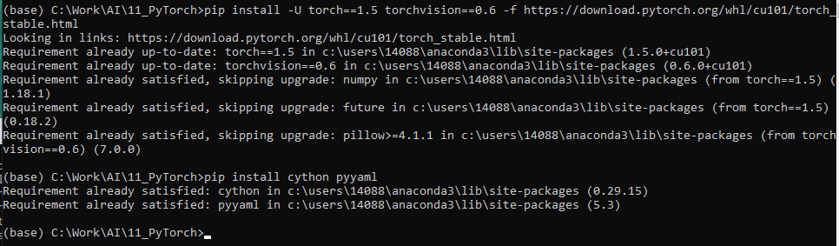
5 Implement
pip install git+https://github.com/philferriere/cocoapi.git#subdirectory=PythonAPI
https://colab.research.google.com/drive/16jcaJoc6bCFAQ96jDe2HwtXj7BMD_-m5#scrollTo=QHnVupBBn9eR
https://colab.research.google.com/drive/16jcaJoc6bCFAQ96jDe2HwtXj7BMD_-m5#scrollTo=QHnVupBBn9eR
Open anaconda command prompt:
> pip install -U torch==1.5 torchvision==0.6 -f https://download.pytorch.org/whl/cu101/torch_stable.html
> pip install cython pyyaml

Slide 4
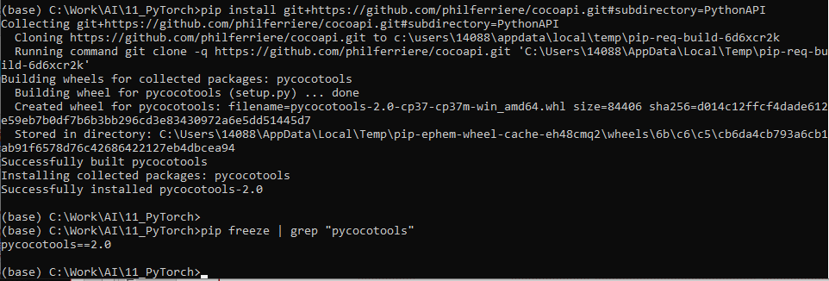
5 Implement
pip install git+https://github.com/philferriere/cocoapi.git#subdirectory=PythonAPI
https://colab.research.google.com/drive/16jcaJoc6bCFAQ96jDe2HwtXj7BMD_-m5#scrollTo=QHnVupBBn9eR
https://colab.research.google.com/drive/16jcaJoc6bCFAQ96jDe2HwtXj7BMD_-m5#scrollTo=QHnVupBBn9eR
> pip install -U 'git+https://github.com/cocodataset/cocoapi.git#subdirectory=PythonAPI’ # NG
> pip install git+https://github.com/philferriere/cocoapi.git#subdirectory=PythonAPI # OK
> pip freeze | grep "pycocotools"

Slide 5
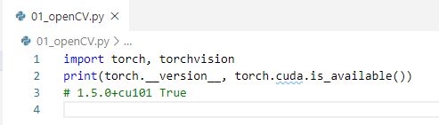

5 Implement
https://colab.research.google.com/drive/16jcaJoc6bCFAQ96jDe2HwtXj7BMD_-m5#scrollTo=QHnVupBBn9eR
https://colab.research.google.com/drive/16jcaJoc6bCFAQ96jDe2HwtXj7BMD_-m5#scrollTo=QHnVupBBn9eR
Print torch version (1.5.0)

Slide 6
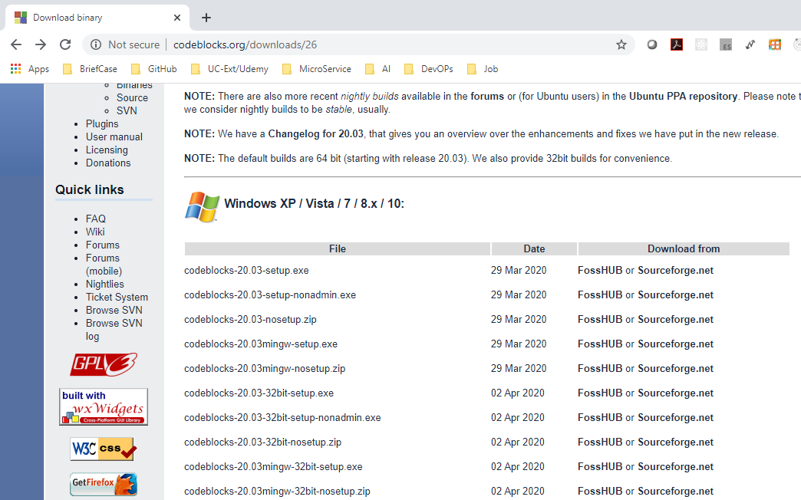
5 Implement
https://colab.research.google.com/drive/16jcaJoc6bCFAQ96jDe2HwtXj7BMD_-m5#scrollTo=QHnVupBBn9eR
https://github.com/facebookresearch/detectron2/blob/master/INSTALL.md
gcc & g++ ≥ 5 are required.
To load gcc > 5, we need download gcc from Code::Blocks
http://www.codeblocks.org/downloads/26

Slide 7
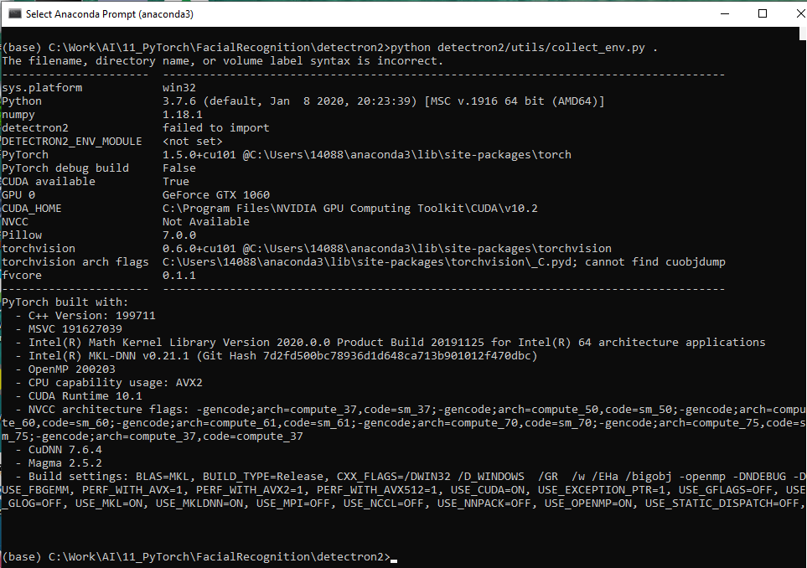
5 Implement
https://colab.research.google.com/drive/16jcaJoc6bCFAQ96jDe2HwtXj7BMD_-m5#scrollTo=QHnVupBBn9eR
https://github.com/facebookresearch/detectron2/issues/160
Check the compiled environment:
> python detectron2/utils/collect_env.py.

Slide 8
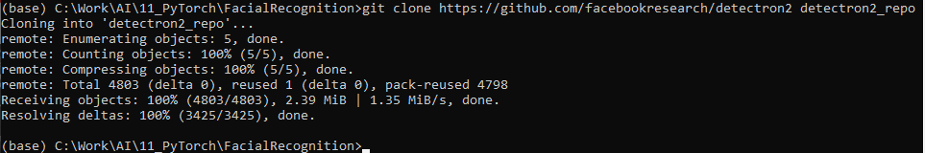
5 Implement
https://colab.research.google.com/drive/16jcaJoc6bCFAQ96jDe2HwtXj7BMD_-m5#scrollTo=QHnVupBBn9eR
https://github.com/facebookresearch/detectron2/blob/master/INSTALL.md
gcc & g++ ≥ 5 are required.
To load gcc > 5, we need download gcc from Code::Blocks
http://www.codeblocks.org/downloads/26
> git clone https://github.com/facebookresearch/detectron2 detectron2_repo
Note: detectron2 cannot install under window 10

Slide 9
5 Implement
https://colab.research.google.com/drive/16jcaJoc6bCFAQ96jDe2HwtXj7BMD_-m5#scrollTo=QHnVupBBn9eR
Restart the computer

Slide 10
5 Implement
https://colab.research.google.com/drive/16jcaJoc6bCFAQ96jDe2HwtXj7BMD_-m5#scrollTo=QHnVupBBn9eR
https://github.com/facebookresearch/detectron2/blob/master/INSTALL.md
9:56/1:07:20
> git clone https://github.com/facebookresearch/detectron2.git
> python -m pip install -e detectron2

Slide 11
End of Chapter

