Slide 1

1 Facial Recognition
Peter H. Chen

Slide 2
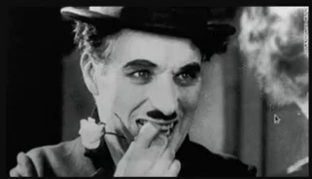
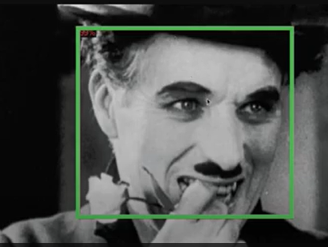
1 Facial Recognition
https://www.youtube.com/watch?v=8eLHZ0R5nHQ&t=11s
What is Facial Recognition?
If you take a image, e.g., Charlie Chaplin, the software will find the human face in this image if there is a face inside the image.
Good result will be on the right below.
We are going to train a model or use a pre-trained model, fine-tune it to small dataset, and draw the bounding boxes around the human faces.
Why this is useful?
When you do face recognition, if you want to tell who this person actually is, e.g., for security reason or you want to detect the emotion of human face for marketing reason. To find the face is the first step in understanding or solving the problem.

Slide 3

1 Facial Recognition
https://www.youtube.com/watch?v=8eLHZ0R5nHQ&t=11s
We discuss more about the detector of framework.
We can use Jupyter notebook or Google Quad notebook.
Facebook Detectro2 is a curtting-edge alpha technology.
Facebook Detectron2 repository location: https://github.com/facebookresearch/detectron2

Slide 4

1 Facial Recognition
https://www.youtube.com/watch?v=8eLHZ0R5nHQ&t=11s
The development of Facebook detectron2 is really active.
They almost commit to check in every few days. The tool is relatively stable and extremely easy to use for a new developer.

Slide 5
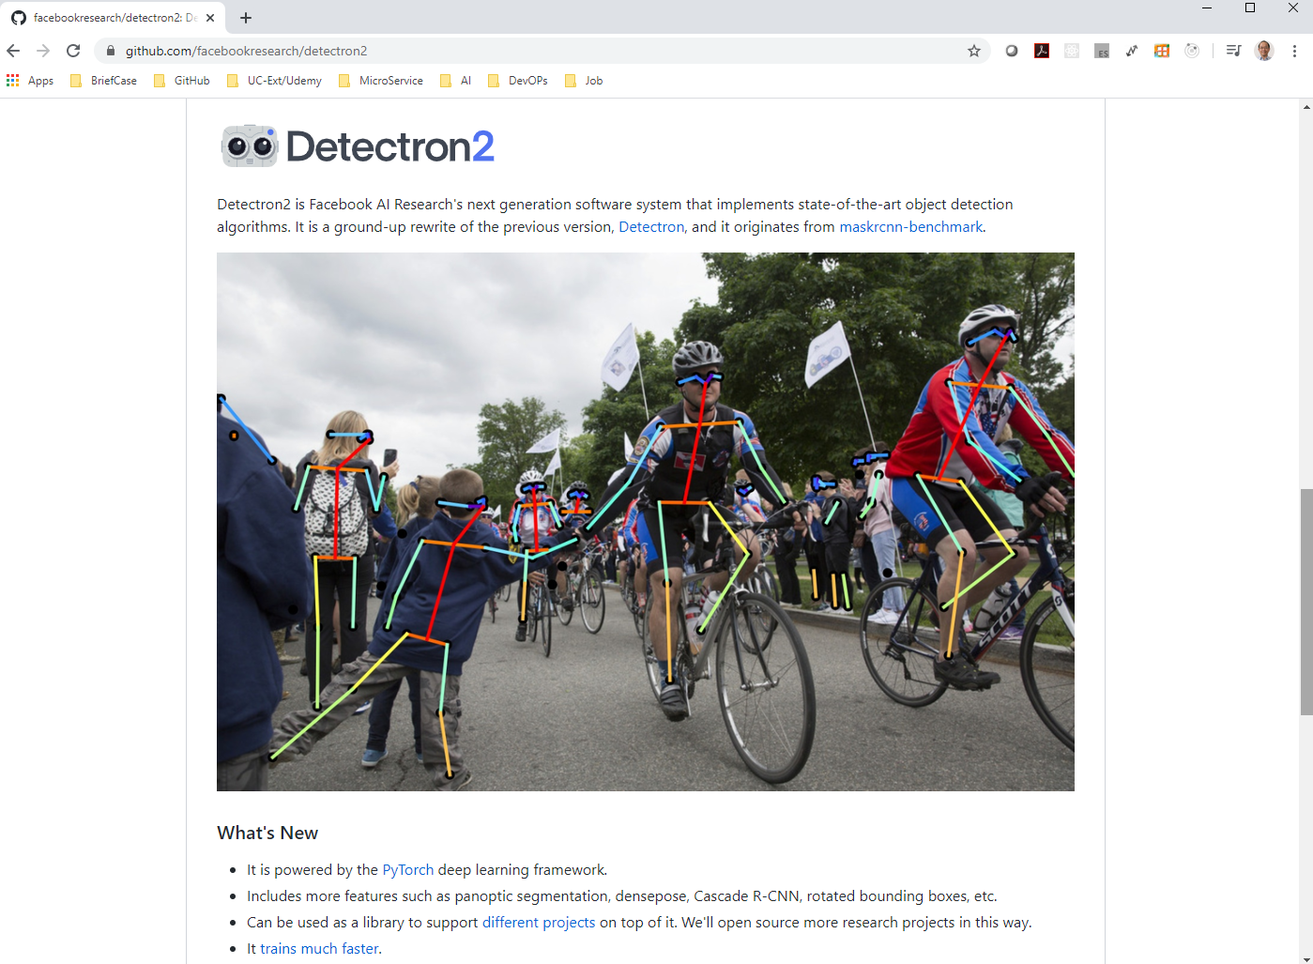
1 Facial Recognition
https://www.youtube.com/watch?v=8eLHZ0R5nHQ&t=11s
The etectron2 is a very powerful tool.
It detects the object in the image and segmentation.

Slide 6
End of Chapter

